Slide 1
Human Papillomavirus (HPV) Vaccination Programme for Men who have sex with men (MSM)
Last updated March 2022
Notes:
Rationale for resource
This resource is designed to support healthcare professionals involved in the delivery of the HPV MSM vaccination programme.
This resource does not cover the actual administration techniques involved in vaccination against HPV. If staff are required to deliver vaccinations they should refer to their line manager for additional training.

Slide 2
Key Messages
men who have sex with gay, bisexual and other men who have sex with men (MSM) are at increased risk of HPV related disease and adverse outcomes compared to heterosexual men
a targeted HPV-MSM vaccination programme was introduced in England from April 2018
aim of the programme is to provide direct protection against HPV infection, HPV associated cancers and genital warts to the MSM population up to and including 45 years of age
the vaccine can be offered opportunistically through existing appointments at specialist Sexual Health Services and/or HIV clinics
Notes:
Background: In June 2012, the Joint Committee on Immunisation and Vaccination (JCVI) asked the Health Protection Agency (now UK Health Security Agency, previously Public Health England), to undertake modelling studies to assess the impact and cost effectiveness of HPV vaccination for men who have sex with men (MSM), acknowledging this group were expected to benefit far less from indirect herd protection from the HPV vaccination programme at the time in which the vaccine was offered to adolescent females.
Since 2012, the JCVI has regularly reviewed all the available evidence on the disease epidemiology, vaccine efficacy and cost effectiveness of an HPV MSM immunisation programme in the UK.
In November 2015, the JCVI published its advice on the extension of HPV vaccination to MSM¹. It advised that a programme should be undertaken to vaccinate all MSM up to and including 45 years of age who attend sexual health services and HIV treatment services, subject to procurement of the vaccine and delivery of the programme at a cost-effective price
In June 2016, a PHE-led pilot commenced in which the HPV vaccine was offered opportunistically to men who have sex with men (MSM) up to and including the age of 45, attending selected local sexual health services. The purpose of the pilot was to evaluate the feasibility, acceptability, uptake, impact and equity of a potential national HPV vaccination programme for MSM. The pilot demonstrated that such a programme could be delivered opportunistically in an acceptable and equitable manner through specialist Sexual Health Services and HIV clinics and consequently, the decision was made to roll out a national programme to all clinics across the country from April 2018.
1. Joint Committee on Vaccination and Immunisation. Statement on HPV vaccination of men who have sex with men. November 2015. Available at: www.gov.uk/government/publications/jcvi-statement-on-hpv-vaccination-of-men-who-have-sex-with-men

Slide 3
Aims of training resource
to support healthcare professionals involved in discussing HPV vaccination with men who have sex with men (MSM) by providing evidence based information
to raise awareness of the current epidemiology of HPV and the important role of vaccination in the MSM population
to provide guidance on the administration of the vaccine including recommended dosage and schedule, contraindications, precautions and potential adverse reactions

Slide 4
Learning Outcomes
After completing this resource, immunisers will be able to:
describe the epidemiology of HPV and the possible consequences of infections with HPV
understand the rationale and evidence base for a targeted HPV-MSM vaccination programme to those aged up to and including 45 years and their role in delivering it
discuss the benefits of vaccination against HPV with their eligible MSM clinic attending population
identify sources of additional information
Notes:
Contents
What is HPV?
Why vaccinate MSM?
The HPV-MSM Vaccination programme
Vaccination against HPV
The role of the immuniser
Resources

Slide 5
Human Papillomavirus (HPV)
DNA virus
infects skin and mucosal sites (squamous epithelium) through skin-to-skin contact
HPVs are a large group of related viruses. Each virus in the group is given a number, which is called an HPV type
HPV infections are often asymptomatic
infection can resolve spontaneously:
- 70% new high-risk infections will clear within a year
- 90% new infections clear within 2 years
persistent infection can cause cell changes leading to lesions, warts or ano-genital cancers
Notes:
HPV is the abbreviation for the human papillomavirus. This is a double stranded DNA virus that infects the deepest layer of the skin or mucosae of the upper respiratory and anogenital tracts.
The majority of HPV infections do not cause any symptoms and infection is usually cleared by the body’s own immune system without the need for other treatment. Around 70% of new infections will clear within one year and approximately 90% will clear within two years.
Persistent infection with high risk HPV types such as types 16 and 18 can lead to cancer – most notably cancer of the anus, oropharyngeal and penis, as well as cervical cancer in women. Other types of HPV such as 6 and 11 cause genital warts
Immunisation against infectious disease (the Green book), Chapter 18a (HPV), Available at www.gov.uk/government/publications/human-papillomavirus-hpv-the-green-book-chapter-18a

Slide 6
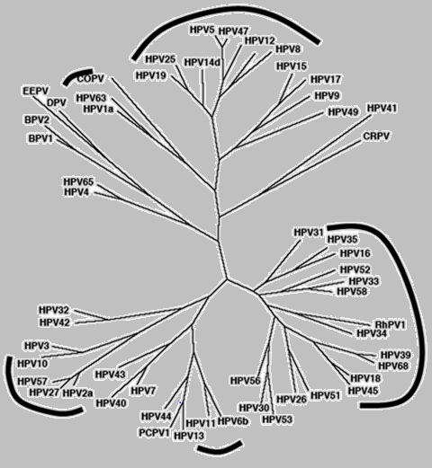
HPV Genotypes
Plantar Warts
Cutaneous (mostly asymptomatic)
Genital mucosa (cancer–associated)
Common and flat warts
External genital warts
De Villiers and others. Classification of papillomaviruses. Virology, 2004
Notes:
There are over 100 types of HPV virus

Slide 7
Human Papillomavirus (HPV)
Of the 100+ different types of HPVs:
  over 40 types affect genital area
  high risk types (include HPV 16,18,31,33,45,52,58) cause cancer
  low risk types (HPV 6,11) cause genital warts
  HPV16:
  HPV18:
  HPV6:
  HPV11:
together account for around 70% of all cervical cancers
also associated with most cases of cancer of the anus, penis, oropharyngeal, vagina & vulva
90% of cases of genital warts are due to HPV 6 and 11
Notes:
There are over 100 different types of HPV of which around 40 infect the genital area.
Genital HPVs are categorised as either High risk types - known to be associated with cancer or Low risk types- known to lead to the development of genital warts.
HPV16 and HPV18 responsible for between 70%-80% of all cervical cancers.
Types 16 and 18 are also associated with the majority of HPV related cancers of the anus, penis, oropharyngeal, vagina and vulva.
HPV infection is associated with 80-90% of all anal squamous cell cancers and HPV types 16 and 18 are found in the majority of HPV-related anal cancers.
Around 90% of cases of genital warts are thought to be due to HPV type 6 and 11. Although they do not cause cancer, genital warts can be difficult to treat. Some individuals may also experience frequent recurrent episodes which may cause significant distress to the individual and substantial costs to healthcare.

Slide 8
Transmission
HPV is one of the most common sexually transmitted infections in the UK
nearly all sexually active people get infected with HPV at some point in their lives
the risk of acquiring infection increases with the:
number of previous sexual partners
introduction of a new sexual partner
sexual history of partners
you can still have HPV even if it has been years since you were sexually active
Notes:
The transmission of genital HPV’s are primarily by sexual contact with an infected partner, particularly through sexual intercourse but also by non-penetrative genital contact, including oral sex.

Slide 9
Introduction of HPV vaccination in England
The National HPV Immunisation Programme began in September 2008 (throughout the UK)
Delivered in schools:
targeted school Year 8 females (aged 12 to 13 years)
catch up for all girls aged under 18 years
Following a successful pilot in 2018, the programme was extended to offer vaccine to MSM up to 45 years of age attending local specialist Sexual Health Services and/or HIV clinics
In 2019 the universal programme was extended to include boys as well as girls
Eligible girls and boys (eligible boys born after 01/09/2006) can continue to be caught up until their 25th birthday
In 2022 Gardasil 9 vaccine will become available as the HPV vaccine for the routine programme (HPV types 6,11,16,18,31,33,45,52,58)
From 1 April 2022 eligible individuals 15 years of age and over and MSM will move from a 3-dose to a 2-dose vaccine schedule (2-doses given at least 6 months apart)
Notes:
Based on advice from the Joint Committee on Vaccination and Immunisation (JCVI)
From 1 April 2022 the HPV vaccine schedule will change from a 3 dose to 2 dose (0, 6-24 months) schedule for eligible individuals of all ages including individuals who start the course late at over 15 years of age and those receiving HPV vaccine through the MSM vaccination programme. Individuals known to be HIV+, including those on antiviral therapy, or known to be immunocompromised should continue to be offered the 3-dose schedule.

Slide 10
HPV vaccine introduction
Cervarix vaccine used 2008 to 2012
  HPV types 16, 18
Gardasil vaccine used from September 2012
  HPV types 6, 11, 16, 18
Gardasil 9 vaccine to be introduced in 2022
  HPV types 6, 11, 16, 18, 31, 33, 45, 52, 58
Notes:
The bi-valent Cervarix vaccine was offered for the first four years of the national programme. This vaccine protects against the two HPV types which cause the majority of cervical cancer.
Since September 2012, the quadrivalent vaccine, Gardasil, has been used for the national programme. Gardasil provides protection against HPV types 6 and 11, the HPV types that cause genital warts, in addition to the cancer causing types 16 and 18.
In 2022 Gardasil 9 will be introduced and this vaccine offers protection against 5 additional types of HPV (31, 33, 45, 52, 58) which although less common than types 16 and 18, are also considered high-risk HPV types.
Gardasil 9 is expected to prevent the majority of cervical, vaginal and vulvar cancers and premalignant lesions, as well as genital warts associated with HPV.

Slide 11
Prevalence of HPV16 and/or 18 among 16-18 year old females
Notes:
The graph shows post-vaccination changes in prevalence of HPV type 16/18 and the impact the girls vaccination programme has had to date. This prevalence estimate is derived from UKHSA’s ongoing surveillance among young women attending for chlamydia screening.
Among 16-18 year old females where vaccine coverage was highest, HPV 16/18 prevalence decreased from 15% in 2008 prior to the introduction of the vaccination programme, to 8.2% in 2010/11 and subsequently to 1.6% in 2016. In the most recent year, 2018, 10 years after vaccination was introduced, no HPV16/18 infections were detected in 16-18 year olds. These results indicate the programme has succeeded in delivering both direct and indirect protection.

Slide 12
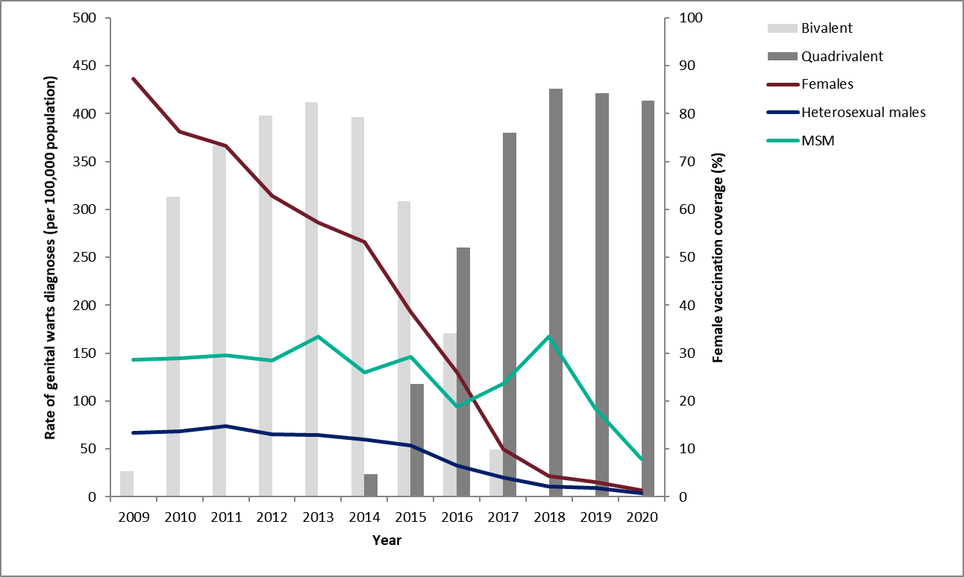
Declines in genital warts diagnoses in England: 2009 to 2020
Notes:
Latest data on declines in GW diagnoses in England. As reported in latest STI report https://assets.publishing.service.gov.uk/government/uploads/system/uploads/attachment_data/file/914184/STI_NCSP_report_2019.pdf):
In 2019, the rate of genital warts diagnoses among girls aged 15 to 17 years attending SHSs, most of whom would have been offered the quadrivalent HPV vaccine (protecting against HPV types 16,18, 6 and 11) when aged 12 to 13 years old, was 91% lower compared to 2015 (16.9 vs 193.5 per 100,000 population). A decline of 81% (10.0 vs 53.3 per 100,000 population) was seen in same aged heterosexual boys over the same period, suggesting substantial herd protection.

Slide 13
Why vaccinate MSM against HPV?
In all men:
80 to 85% of anal cancers
50% of penile cancer
36% of oropharyngeal cancer
are associated with HPV infection
MSM who attend sexual health and HIV treatment services experience higher rates of HPV infection and related cancers
HPV-associated anal cancers are far more common in MSM compared to heterosexual men
the incidence of anal cancer is also highest in HIV positive MSM
some MSM have high risk sexual behaviour
MSM would benefit from direct effect of vaccine
Notes:
JCVI considered modelling studies to assess the cost-effectiveness of a targeted HPV vaccination of MSM in SSHS and HIV clinics, looking at the impact of vaccination against penile, anal and oropharyngeal (head and neck) cancers, and genital warts.
In all men 80-85% of anal cancers, 36% of oro-pharyngeal cancer and 50% of penile cancers are associated with HPV infection.^{(9,10)} Evidence suggests men who have sex with men (MSM) attending sexual health and HIV treatment services bear a significantly increased burden of HPV related disease and adverse outcomes compared to heterosexual men. HPV type 16-associated anal cancers in particular are far more common in MSM compared to heterosexual men, this is even more marked in those with HIV infection.^{(11,12)}
This group is expected to receive very little indirect benefit from the HPV vaccination programme, which is currently offered to adolescent females.

Slide 14
Why deliver the service through sexual health and HIV clinics?
MSM accessing sexual health and/or HIV services are known to be at higher risk of HPV infection and disease
more known about MSM using these services, which allowed the evidence for benefit from HPV vaccination to be assessed for this group
sexual healthcare services are also the services where MSM are most likely to self-declare their sexual orientation
efficiencies in delivery, cost and clinic capacity are likely to be added advantages of this approach
may have an additional benefit of increased adherence and acceptability
Notes:
The cost-effectiveness analysis considered by JCVI is only possible because of the sexual health data available from SSHS and HIV clinics.
There is more known about MSM using these services, which allowed the evidence for benefit from HPV vaccination to be assessed for this group of MSM.
JCVI also agreed with the HPV sub-committee that SSHS and HIV clinics are by far the most accessed sexual healthcare service by self-declaring MSM, who might not otherwise self-declare to a GP, and that MSM accessing SSHS services are known to be a high-risk group within the MSM population in terms of risk behaviour and STI transmission.

Slide 15
Aims of the HPV-MSM immunisation programme
to provide the HPV vaccine to MSM up to the age of 45 (inclusive) attending participating specialist Sexual Health Services (SHSs) and/or HIV clinics
to reduce the number of preventable HPV infections and their onward transmission
to reduce morbidity and mortality from HPV-related disease including anal, penile and oropharyngeal cancers and genital warts

Slide 16
Programme eligibility
all MSM up to and including 45 years of age attending participating specialist Sexual Health Services and/or HIV clinics, regardless of risk, sexual behaviour or disease status
MSM older than 45 years are not eligible for HPV vaccination under this NHS England procured service
any eligible vaccinee that started but did not complete the schedule before reaching the age of 46 years should complete the vaccination course
transgender individuals should be assessed on a case-by-case basis. The clinical decision to vaccinate should be based on a risk assessment that includes their sexual behaviour and the sexual behaviour of their partners
Notes:
The HPV vaccine is recommended for all MSM up to and including 45 years of age, attending participating SHSs or HIV clinics, regardless of risk, sexual behaviour or disease status.
MSM older than 45 years are not eligible for HPV vaccination under this NHS England procured service.
JCVI considers that there may be considerable benefit in offering the HPV vaccine to other individuals who have a similar risk profile to that seen in the SHSS-attending MSM population, including some MSM over 45, sex workers, HIV+ve men and women, transgender individuals. Clinicians may exercise their clinical judgement to offer vaccinations outside of the national programme and so HPV vaccination can therefore be considered for such individuals on a case-by-case basis. Vaccine centrally procured for the HPV MSM programme should not be used for this purpose. In these instances, vaccine should be purchased directly from the manufacturer or pharmaceutical wholesaler and providers will not be paid for administering the vaccine.

Slide 17
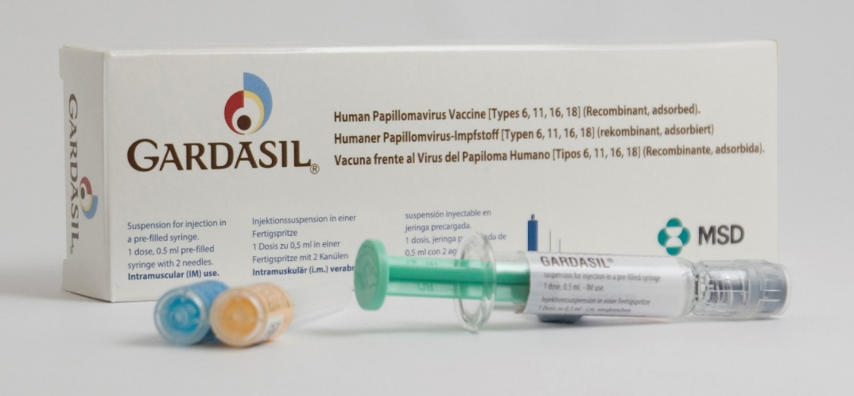
Gardasil
Brand name: Gardasil
Generic Name: Human Papillomavirus Vaccine
[Types 6, 11, 16, 18]
Type of vaccine: Recombinant, adsorbed
Marketed by: MSD
Licensed from: 9 years of age
Notes:
Gardasil provides protection against four HPV strains: HPV-16 and HPV-18, the two high risk HPV types that can lead to cancer; and HPV-6 and HPV-11, the two HPV types that cause approximately 90 per cent of all anogenital warts in males and females.
SPC for Gardasil: www.medicines.org.uk/emc/product/261/smpc

Slide 18
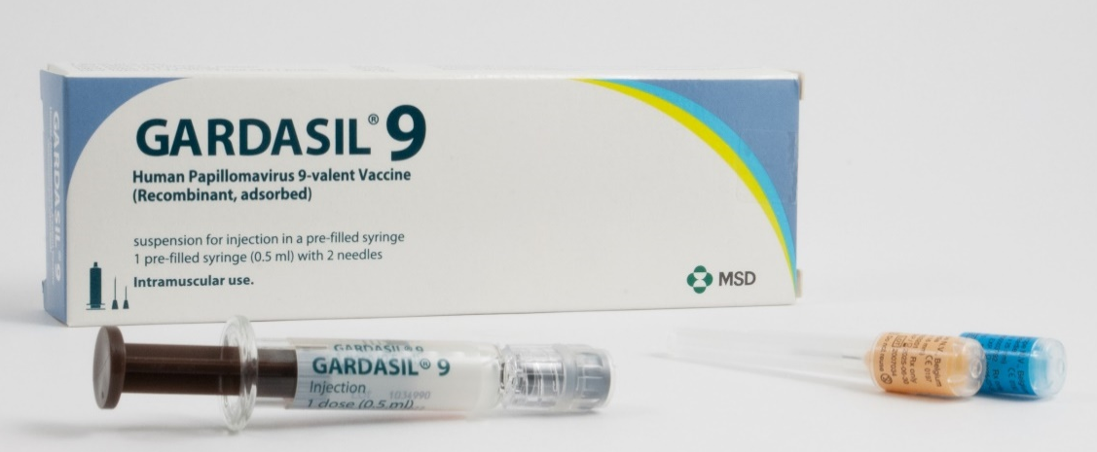
Gardasil 9
Brand name: Gardasil 9
Generic Name: Human Papillomavirus Vaccine
[Types 6, 11, 16, 18, 31, 33, 45, 52, 58]
Type of vaccine: Recombinant, adsorbed
Marketed by: MSD
Licensed from: 9 years of age
Notes:
Gardasil 9 provides protection against Types 6, 11, 16, 18, 31, 33, 45, 52, 58.
The additional Types 31, 33, 45, 52, 58 although less common than types 16 and 18, are also considered high-risk HPV types.
Gardasil 9 is expected to prevent the majority of cervical, vaginal and vulvar cancers and premalignant lesions, as well as genital warts associated with HPV
SPC for Gardasil 9: www.medicines.org.uk/emc/product/7330/smpc

Slide 19
HPV Vaccine interchangeability
in 2022 Gardasil 9 Vaccine will be introduced into the programme and supplied for those eligible for the HPV vaccine
as the programme transitions from Gardasil to Gardasil 9 individuals might receive a mixed schedule
both Gardasil and Gardasil 9 vaccines should be considered as interchangeable
vaccination should not be delayed due to preference for either vaccine

Slide 20
HPV Vaccines
made from the proteins of the outer coat of the virus types
inactivated vaccine so cannot cause the diseases against which it protects
highly immunogenic
clinical trials show very high efficacy and well tolerated
  over 99% effective at preventing pre-cancerous lesions associated with HPV types 16 and 18. Gardasil 9 offers protection against 5 additional types of HPV (31, 33, 45, 52, 58) which although less common than types 16 and 18, are also considered high-risk
  99% effective at preventing genital warts associated with vaccine types in young women
a clinical trial of Gardasil in men indicated that it can prevent anal cell changes caused by persistent infection and genital warts
may boost immunity and prevent re-infection or reduce reoccurrences in people with previously treated high-grade anal intraepithelial neoplasia established diseases
Notes:
Gardasil vaccine is made from the proteins that make up the outer coat of the virus types. These proteins assemble into small spheres that are called virus-like particles (VLPs). VLPs are not infectious and cannot cause HPV-associated cancers or genital warts as they do not contain the virus’s DNA. VLPs are however very immunogenic, which means that they induce high levels of antibody production by the body.
As with many other immunisations, when a person is vaccinated, their immune system mounts a response against these VLPs. When a person is then exposed to the live virus, the body’s immune system reacts quickly to stop the infection.
In clinical trials in young women with no previous history of HPV infection, vaccine was 99% effective at preventing pre-cancerous lesions associated with HPV types 16 and 18.
A clinical trial of Gardasil in men indicated that it can prevent anal cell changes caused by persistent infection, and genital warts.
HPV vaccines have not been shown to have an impact on an existing infection or any of the outcomes of an existing HPV infection, such as anogenital warts but may boost immunity and prevent re-infection or reduce reoccurrences in people with previously treated high-grade anal intraepithelial neoplasia.
Swedish KA, Factor SH, Goldstone SE. Prevention of recurrent high-grade analneoplasia with quadrivalent human papillomavirus vaccination of men who have sexwith men: a nonconcurrent cohort study. Clin Infect Dis. 2012;54:891-8.Available at www.ncbi.nlm.nih.gov/pubmed/22291111

Slide 21
Safety of HPV vaccine
the safety of HPV vaccine has been established through rigorous testing in clinical trials, followed by use of many millions of doses across the world
some people may experience a mild side effect, but these are generally of short duration and are far outweighed by the expected benefits of the vaccine
the US health authorities have posted clear advice on their website supporting the safety of HPV vaccine
Notes:
www.who.int/news/item/31-10-2019-major-milestone-reached-as-100-countries-have-introduced-hpv-vaccine-into-national-schedule
www.gavi.org/types-support/vaccine-support/human-papillomavirus
Safety Information for HPV Vaccine | Vaccine Safety | CDC

Slide 22
Postural Orthostatic Tachycardia Syndrome (POTS)
in recent years in the UK and other European countries, parents and pressure groups have raised safety concerns linking the HPV vaccine to a condition called Postural Orthostatic Tachycardia Syndrome (POTS)
in June 2015, the JCVI concluded that it had no concerns about the safety of the HPV vaccine
the European Medicines Agency (EMA) independent review concluded evidence does not support a causal link between the vaccine and the condition
Notes:
Postural tachycardia syndrome (PoTS) is an abnormal increase in heart rate after sitting or standing up. It typically causes dizziness, fainting, sweating and other symptoms.
In June 2015, the JCVI concluded that it had no concerns about the safety of the HPV vaccine. The European Medicines Agency has also conducted an independent review and, in line with findings from the UK’s Medicine and Healthcare Regulatory Agency (MHRA), concluded that available evidence does not support a causal link between the vaccine and the condition. (www.ema.europa.eu/ema/index.jsp?curl=pages/news_and_events/news/2015/11/news_detail_002429.jsp&mid=WC0b01ac058004d5c1)

Slide 23
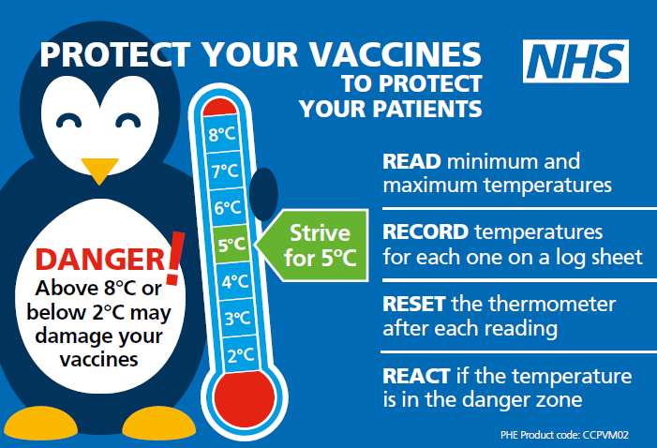
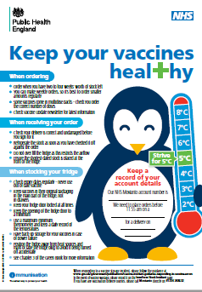
Storage of HPV vaccine
store between +2 and +8ºC
store in original packaging
protect from light
use as soon as possible after removing from fridge
Effectiveness cannot be guaranteed for vaccines unless the cold chain has been maintained and vaccine has been monitored as per national recommendations
Notes:
Gardasil and Gardasil 9 must be stored in accordance with the manufacturer’s instructions and stored between +2°C and +8°C.
The vaccine should be stored in the original packaging. This makes it easy to identify in the vaccine fridge, provides some protection against fluctuation of temperature and will protect from light.
Vaccines are expensive and it is important to minimise wastage through inappropriate storage.
Further information on the storage and handling of vaccines is included in chapter 3 of the green book.
www.gov.uk/government/publications/storage-distribution-and-disposal-of-vaccines-the-green-book-chapter-3
The vaccine incident guidance document provides further information on actions to take in the event of a vaccine storage event
www.gov.uk/government/publications/vaccine-incident-guidance-responding-to-vaccine-errors

Slide 24
Vaccine stock management
All providers should:
review available fridge space to ensure adequate storage capacity before ordering new vaccine
ensure that there is enough stock for 2 to 4 weeks of use and not over order
have local protocols in place to reduce vaccine wastage to a minimum and protect vaccines in the event of a cold chain incident
report any cold chain failures or vaccine wastage through the ImmForm website on the stock incident page
Small percentage reductions in vaccine wastage have a major impact on the financing of vaccine supplies
Notes:
Effective management of vaccines throughout the supply chain is essential to reduce vaccine wastage and it is recommended that healthcare professionals order only what they need for a 2-4 week period rather than over-ordering or stockpiling vaccines.
Providers should review available fridge space to ensure adequate storage capacity before ordering and the delivery of vaccine.
All providers should have emergency vaccine storage and handling plans which clearly outline the actions to take in the event of out of range temperature excursions or refrigerator break down.
Cold chain failures must be documented and reported through the ImmForm website on the stock incident page.

Slide 25
Administration of Gardasil and Gardasil 9
the vaccine comes as pre-filled suspension that must be shaken before use to form a cloudy white suspension
2 separate needles are available with the pre-filled syringe, choose the appropriate needle to ensure an intramuscular (IM) administration depending on the patient’s size and weight
administer by intramuscular injection, preferably into the deltoid muscle of the arm
individuals with bleeding disorders – see specific guidance in individual vaccine PGD
can be given at the same time as Hepatitis B or other national schedule vaccines
Notes:
A small air bubble may be visible in the prefilled syringe. This is not harmful and should not be removed prior to administration. This small bolus of air injected following administration of medication clears the needle and prevents a localised reaction from the vaccination. To try to expel it risks accidently expelling some of the vaccine and therefore not giving the patient the full dose.
HPV vaccine can be given at same time as other vaccines such as Hepatitis B. The vaccines should be given at a separate site, preferably in a different limb. The sites at which each vaccine was given should be noted in the individual’s health records.
Healthcare professionals are encouraged to read the Summary of Product Characteristics (SPC) to ensure accurate reconstitution and delivery of the product.
Individuals with bleeding disorders may be vaccinated intramuscularly if a doctor familiar with the individual's bleeding risk advises vaccines or similar small volume intramuscular injections can be administered with reasonable safety by this route. If the individual receives medication/treatment to reduce bleeding, for example treatment for haemophilia, intramuscular vaccination can be scheduled shortly after such medication/treatment is administered.
Individuals on stable anticoagulation therapy, including individuals on warfarin who are up to date with their scheduled INR testing and whose latest INR was below the upper threshold of their therapeutic range, can receive intramuscular vaccination. A fine needle (equal to 23 gauge or finer calibre such as 25 gauge) should be used for the vaccination, followed by firm pressure applied to the site (without rubbing) for at least 2 minutes.
If in any doubt, consult with the clinician responsible for prescribing or monitoring the individual’s anticoagulant therapy. See details specific vaccine PGD.

Slide 26
Gardasil and Gardasil 9 dosage and schedule
From 1 April 2022, all individuals receiving HPV vaccine through the routine adolescent and MSM programme should follow a 2 dose schedule:
2 doses of 0.5ml at 0 and 6 to 24 months
second dose should be administered at least 6 months after the first dose
Immunocompromised individuals and those known to be HIV positive, including those on antiretroviral therapy should continue to follow a 3 dose course:
3 doses of 0.5 ml at 0, 1 and 4 to 6 months
second dose should be administered at least 1 month after the first dose
third dose should be administered at least 3 months after the second dose
all 3 doses should ideally be given within a 12 month period
Notes:
For the routine schedule, any interval between doses of between 6 and 24 months is clinically acceptable.
Current studies suggest that protection is maintained for at least ten years. Based on the immune responses, it is expected that protection will be extended further; long-term follow-up studies are in place to evaluate this and will determine the need for any subsequent boosters.
Based on advice from the Joint Committee on Vaccination and Immunisation (JCVI)
From 1 April 2022 there is a move from 3 doses to 2 doses of HPV vaccine (2 doses at least 6 months apart) for eligible individuals starting the course over 15 years of age and those receiving HPV vaccine through the MSM vaccination programme. Individuals known to be HIV positive, including those on antiviral therapy, or known to be immunocompromised should continue to be offered the 3-dose schedule.

Slide 27
HPV vaccine booster doses
for optimum protection, it is important the full course of vaccination is received
current studies suggest that protection is maintained for at least ten years
based on the immune responses seen in studies, it is expected that protection will last longer than this
long-term follow-up studies are in place to evaluate length of protection and will determine the need for any subsequent boosters
booster doses are not currently indicated

Slide 28
Administration of HPV vaccine
Gardasil and Gardasil 9 are prescription only medicines and should only be administered using one of the following:
prescription written manually or electronically by a registered medical practitioner or other authorised prescriber
Patient Specific Direction (PSD)
Patient Group Direction (PGD)
UKHSA have developed a national PGD template which should be reviewed and authorised locally before use.
Providers may choose to use this to source their own PGDs locally or prescribe the vaccination on an individual patient basis using a Patient Specific Direction (PSD).
Notes:
UKHSA Immunisation PGD template:
www.gov.uk/government/publications/human-papillomavirus-hpv-vaccine-pgd-template

Slide 29
Contraindications and Precautions
Contraindications
Gardasil and Gardasil 9 should not be administered to those who have had:
  a confirmed anaphylaxis to a previous dose of the vaccine
  a confirmed anaphylaxis to any constituent or excipient of the vaccine
Yeast allergy is not a contraindication to the HPV vaccine
Even though Gardasil is grown in yeast cells, the final vaccine product does not contain any yeast
If an individual is acutely unwell, immunisation may be postponed until they have fully recovered to avoid confusing the differential diagnosis of any acute illness by wrongly attributing any signs or symptoms to any possible adverse effects of the vaccine
Notes:
There are very few individuals who cannot receive HPV vaccines. Where there is doubt, instead of withholding immunisation, appropriate advice should be sought from a consultant with immunisation expertise, a member of the screening and immunisation team or from the local health protection team.
A mild fever or upper respiratory infection (for example cold) itself is not a reason to delay vaccination.
If acutely unwell, the immunisation may be deferred until the individual has recovered – this is to avoid confusing the differential diagnosis of acute illness by wrongly attributing signs or symptoms as adverse effects of the vaccine.
For the composition and full list of excipients of the vaccine, please refer to the manufacturer’s Summary of Product Characteristics (SPC).

Slide 30
Immunosuppression and HIV infection
individuals in the eligible cohort who are known to be human immunodeficiency virus (HIV) positive can be given HPV vaccine regardless of CD4 count, antiretroviral therapy use or viral load
individuals who are HIV positive are at increased risk of acquiring HPV and persistent infection, as well as frequent carriage of multiple HPV types and increased risk of HPV-related rapidly progressive malignancies
HPV vaccines are known to be safe and immunogenic when given to individuals who are HIV positive
the immune response to this vaccination and its effectiveness may be less than that observed among those who are HIV negative
individuals known to be HIV positive or immunocompromised at the time of vaccination should be offered a 3-dose course of vaccine
Notes:
Evidence suggests individuals who are HIV positive are at increased risk of acquiring HPV and persistent infection, as well as frequent carriage of multiple HPV types and increased risk of HPV related rapidly progressive malignancies.
HPV vaccines are known to be safe and immunogenic when given to individuals who are HIV positive. There is however no data to support giving fewer than 3 doses among HIV positive individuals, therefore only a 3-dose schedule should be offered to MSM in the eligible cohort who are known to be HIV positive.

Slide 31
Possible adverse reactions
Gardasil and Gardasil 9
Most common:
pain, redness and swelling at the injection site
headache, fever, nausea, dizziness
These adverse reactions are usually mild or moderate in intensity and short lasting.
Full details available from the manufacturer’s SPC:
Gardasil
Gardasil 9
Notes:
The full list of adverse reactions associated with HPV vaccine is available in the marketing authorisation holder’s ‘Summary of Product Characteristics’
In clinical vaccine trials, the most common adverse reaction observed were injection-site reactions (Gardasil: 77.1% of vaccinees and Gardasil 9: 84.8% of vaccinees within 5 days following any vaccination visit). These include mild to moderate short-lasting pain at the injection site, immediate localised stinging sensation and redness at the injection site. Other reactions commonly reported are headache, myalgia, fatigue, and low grade fever. These adverse reactions are usually mild or moderate in intensity.

Slide 32
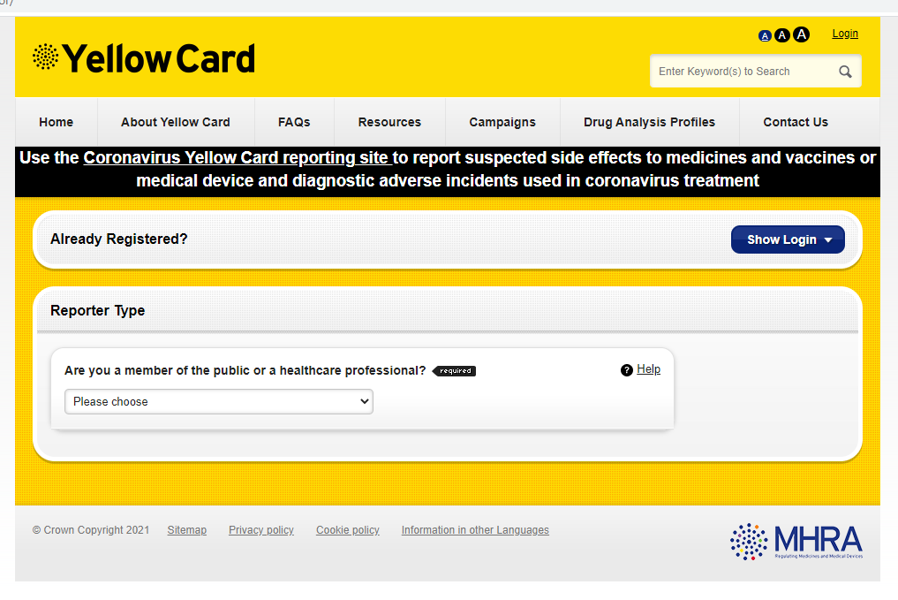
Reporting suspected adverse reactions
any suspected side effects following vaccine administration should be reported to the MHRA Yellow Card Scheme
report even if uncertain about whether vaccine caused condition
Yellow Card Scheme site
see Green Book Chapter 9 for detailed guidance on reporting vaccine reactions
Notes:
Healthcare professionals and patients are encouraged to report suspected adverse reactions to the Medicines and Healthcare Products Regulatory Agency (MHRA) using the yellow card reporting scheme.

Slide 33
The role of healthcare professionals
to provide clear and concise information regarding vaccination against HPV
to emphasise the importance of completing the full course of vaccine to ensure full protection and encourage timely uptake of doses
to safely administer the vaccine to MSM in the eligible cohort
Notes:
The success of the HPV MSM programme relies heavily on healthcare professionals having a clear understanding around the rationale for offering the vaccine to this group and the key role that sexual health clinics have to play in delivering the vaccine.
Every effort should be made by healthcare professionals to maximise the success of the HPV-MSM programme and promote the opportunistic uptake of the HPV vaccine.

Slide 34
Hepatitis B vaccination
Good opportunity to check and correctly code HBV vaccination status:
the UK’s risk-based vaccination policy for Hepatitis B Virus (HBV) includes MSM
HBV vaccination uptake amongst MSM attending specialist Sexual Health Services is below national targets
recording of both HBV immunity and HBV vaccine delivery by clinician coding is also suboptimal
maintaining high vaccine coverage in MSM is important to avoid outbreaks of infection
Hepatitis B vaccine can be given at the same time as HPV vaccine
the vaccines should be given at a separate site, preferably in a different limb, and site where each was given should be recorded
Notes:
Healthcare professionals should also take this opportunity to check patients’ Hepatitis B Virus (HBV) vaccination status.
Hepatitis B vaccine can be given at the same time as HPV vaccine. The vaccines should be given at a separate site, preferably in a different limb. The sites at which each vaccine was given should be noted in the individual’s health records, recorded and coded correctly.
Useful link:
UKHSA Immunisation against infectious diseases: Hepatitis B Chapter 18
www.gov.uk/government/publications/hepatitis-b-the-green-book-chapter-18
United Kingdom National Guideline on the Management of the Viral 1 Hepatitides A, B & C 2015 www.bashh.org/documents/New%20Viral%20Hepatitides%20FINAL%20DRAFT%20MAY15.pdf

Slide 35
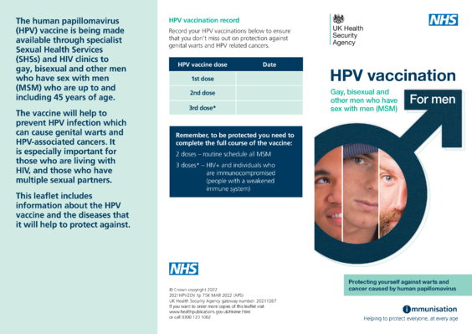
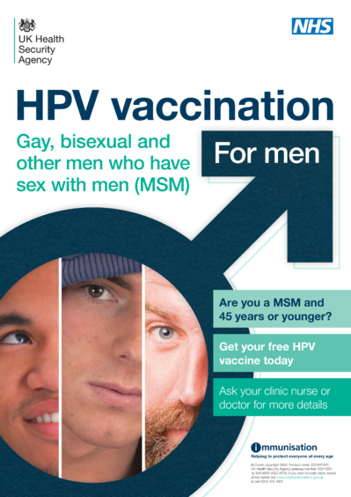
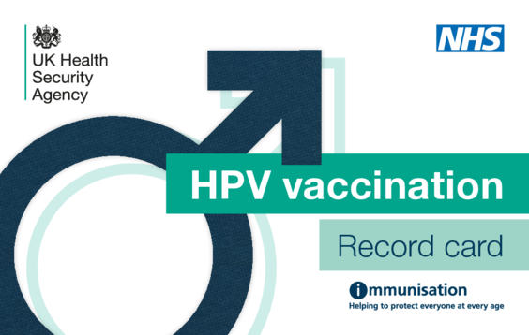
Resources – posters and leaflets
HPV-MSM vaccination programme information leaflet
HPV-MSM programme poster
HPV vaccination record card
Notes:
Leaflets and posters available from Health Publications:
www.healthpublications.gov.uk/Home.html
www.gov.uk/government/publications/hpv-vaccination-for-msm-posters-and-leaflets

Slide 36
Resources
1) UKHSA Immunisation against infectious diseases The Green Book: Human papillomavirus (HPV) Chapter18a
2) HPV guidance for healthcare practitioners
3) Summary of Product Characteristics for Gardasil
4) Summary of Product Characteristics for Gardasil 9
5) UKHSA HPV vaccination programme for men who have sex with men (MSM)
6) JCVI statement on HPV vaccination of men who have sex with men November 2015
7) HPV universal immunisation programme: introduction of Gardasil 9 letter
8) HPV immunisation programme: changes to a 2 dose schedule for eligible groups April 2022 letter
Notes:
1. Ho GY, Bierman R, Beardsley L and others. ‘Natural history of cervicovaginal papillomavirus infection in young women’ New England Journal of Medicine 1998: volume 338 issue 7, pages 423-8
2. Franco EL, Villa LL, Sobrinho JP and others. ‘Epidemiology of acquisition and clearance of cervical human papillomavirus infection in women from a high-risk area for cervical cancer’ Journal of Infectious Diseases 1999: volume 180 issue 5, pages 1,415-23.
3. McCance DJ. ‘Papillomaviruses’ In: Zuckerman AJ, Banatvala JE, Pattison JR, Griffiths P and Schoub B (eds) Principles and practice of clinical virology 2004: fifth edition, Wiley and Sons Ltd.
4. Li N, Franceschi S, Howell-Jones R and others. ‘Human papillomavirus type distribution in 30,848 invasive cervical cancers worldwide: variation by geographical region, histological type and year of publication’ International Journal of Cancer 2011: volume 28, pages 27-35
5. Mesher D, Cuschieri K, Hibbitts S and others. ‘Type-specific HPV prevalence in invasive cervical cancer in the UK prior to national HPV immunisation programme: baseline for monitoring the effects of immunisation’ Journal of Clinical Pathology 2015: volume 68, pages 135-40
6. Munoz N, Castellsague X, de Gonzalez AB and others. ‘Chapter 1: HPV in the etiology of human cancer’ Vaccine 2006: volume 24, S3/1-10
7. Lacey CJ, Lowndes CM, Shah KV. ‘Chapter 4: Burden and management of non-cancerous HPV-related conditions: HPV-6/11 disease’ Vaccine 2006: volume 24 (Supplement 3), S3/35-41
8. Chow EP and others. ‘Ongoing decline in genital warts among young heterosexuals seven years after the Australian human papillomavirus (HPV) vaccination programme’ Sexually Transmitted Infections 2015: volume 91 issue 3, pages 214-219
9. Giuliano AR, Nyitray AG, Kreimer AR, Pierce Campbell CM and others. ‘EUROGIN 2014 roadmap: Differences in human papillomavirus infection natural history, transmission and human papillomavirus-related cancer incidence by gender and anatomic site of infection’ International Journal of Cancer 2014: Jul 17. doi:10.1002/ijc.29082
10. Kreimer AR, Clifford GM, Boyle P, Franceschi S. ‘Human Papillomavirus Types in Head and Neck Squamous Cell Carcinomas Worldwide: A Systematic Review’ Cancer Epidemiology, Biomarkers and Prevention 2005: volume 14, pages 467-75
11. Chin-Hong PV, Vittinghoff E, Cranston RD, Buchbinder S and others. ‘Age-Specific prevalence of anal human papillomavirus infection in HIV-negative sexually active men who have sex with men: the EXPLORE study’ Journal of Infectious Diseases 2004: volume 190, pages 2,070-6
12. Daling JR, Weiss NS, Hislop TG, Maden C and others. ‘Sexual practices, sexually transmitted diseases, and the incidence of anal cancer’ New England Journal of Medicine 1987: volume 317, pages 973-7
13. Ault KA and FUTURE II Study Group. ‘Effect of prophylactic human papillomavirus L1 virus-like-particle vaccine on risk of cervical intraepithelial neoplasia grade 2, grade 3, and adenocarcinoma in situ: a combined analysis of four randomised clinical trials’ Lancet 2007: volume 369 issue 9576, pages 1,861-8
14. Lu B and others. ‘Efficacy and safety of prophylactic vaccines against cervical HPV infection and diseases among women: a systematic review and meta-analysis’ BioMed Central Infectious Diseases 2011: volume 11, page 13
15. Harper DM and others. ‘Sustained efficacy up to 4.5 years of a bivalent L1 virus-like particle vaccine against human papillomavirus types 16 and 18: follow-up from a randomised control trial’ Lancet 2006: volume 367 issue 9518, pages 1,247-55
16. Barr E and Tamms G. ‘Quadrivalent human papillomavirus vaccine’ Clinical Infectious Diseases 2007: volume 45 issue 5, pages 609-17
17. Giuliano AR and others. ‘Efficacy of quadrivalent HPV vaccine against HPV Infection and disease in males’ New England Journal of Medicine 2011: volume 364 issue 5, pages 401-411
18. Swedish KA and others. ‘Prevention of recurrent high-grade anal neoplasia with quadrivalent human papillomavirus vaccination of men who have sex with men: a nonconcurrent cohort study’ Clinical Infectious Diseases 2012: volume 54, pages 891-8
19. Miltz A, Price H, Shahmanesh M, Copas A, Gilson R. ‘Systematic review and meta-analysis of L1-VLP-based human papillomavirus vaccine efficacy against anogenital pre-cancer in women with evidence of prior HPV exposure’ PLOS One 2014: volume 9, e90348
20. British HIV Association guidelines on the use of vaccines in HIV-positive adults (2015) chapter 9 Human papilloma virus. https://www.bhiva.org/file/NriBJHDVKGwzZ/2015-Vaccination-Guidelines.pdf

