Slide 1
The Rotavirus vaccination programme
Information for Healthcare Practitioners
Updated September 2021

Slide 2
Key messages
in July 2013 the UK introduced rotavirus vaccine into the routine childhood immunisation schedule to protect infants aged from 8 weeks against rotavirus infection
the programme was introduced in all part of the UK to reduce the incidence of rotavirus gastroenteritis in young infants
rotavirus is a highly infectious virus and is the most common cause of gastroenteritis among young children
infections are recurrent with most children having at least one episode of infection by the age of 5 years
in young infants, gastroenteritis can be serious and may cause dehydration resulting in hospital admission
during 2017, the presentation of Rotarix vaccine changed from a syringe-like applicator to a tube applicator
Notes:
Joint letter from DH, PHE and NHS England April 2013:
“Important changes to the national immunisation programme in 2013/14: introduction of rotavirus vaccination for babies at 2 and 3 months”
www.gov.uk/government/organisations/public-health-england/series/immunisation

Slide 3
Aims of training resource
to support staff involved in discussing immunisation against rotavirus with parents/carers by providing evidence based information
to raise awareness of rotavirus epidemiology and the benefits of rotavirus immunisation for young infants
to provide guidance on the administration of the oral vaccine, including contraindications, precautions and potential adverse reactions
to highlight the impact of the rotavirus immunisation programme since its introduction into the UK schedule
to update immunisers on the change in presentation of Rotarix vaccine from an oral syringe applicator to an oral tube applicator
Notes:
The key roles of healthcare professionals in relation to immunisation against rotavirus:
To strongly recommend the vaccine to parents/carers of children and outline the importance of their child being protected against the disease.
Explain what rotavirus infection is, its potential complications and that immunisation will provide protection to young infants against the main strains of rotavirus
Explain which vaccine will be used, the contraindications and possible side effects to immunisation and the evidence for the immunisation programme.
To safely administer the oral vaccine to young infants
To ensure immunisation is administered according to the schedule
To ensure any adverse events are managed and reported appropriately
To ensure immunisation is recorded appropriately, along with other infant immunisations

Slide 4
Learning outcomes
After completing this training resource, healthcare professionals will be able to:
describe the aetiology and epidemiology of rotavirus
have an understanding of how rotavirus is transmitted and the potential complications of infection in infants
discuss the importance of immunisation against rotavirus
have a knowledge of the contraindications for rotavirus immunisation
safely administer the vaccine
have an understanding of potential adverse reactions and how to report these
be aware of sources of additional information

Slide 5
Contents
rotavirus
rotavirus vaccination
the use of Rotarix vaccine
the impact of the infant rotavirus immunisation programme since its introduction into the schedule
the role of healthcare professionals
resources

Slide 6
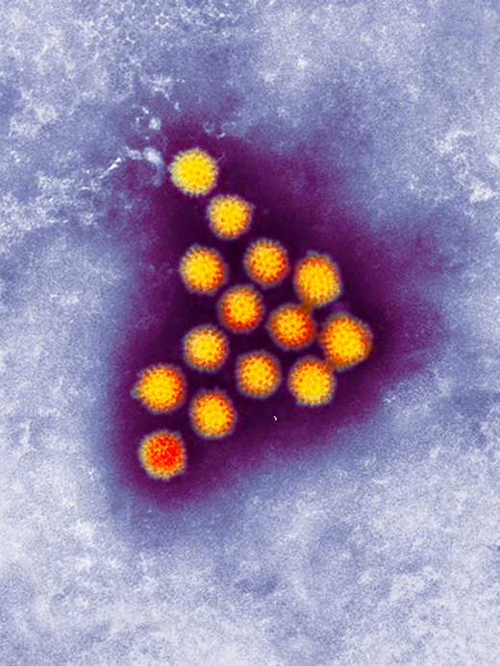
Rotavirus
rotavirus is a virus that causes gastroenteritis in infants and young children
it is estimated that all children will become infected with rotavirus at least once by the time they are 5 years old
it is estimated that rotavirus causes around half of all gastroenteritis in children aged under 5 years
virtually all children living in industrialised or developing countries will become infected
Image courtesy of PHE/SPL
Notes:
Rotavirus is a leading cause of gastroenteritis in infants and children throughout the world.
Gastroenteritis can have a number of possible causes, including norovirus infection or food poisoning. However, rotavirus is the leading cause in children.
It is a ubiquitous virus, virtually all children, rich or poor, living in the industrialised or developing world will become infected with rotavirus at least once by the time they are five years old. Individuals can have repeat infections, but the repeat infections tend to be less severe than the original infection.
Bernstein DI, Ward RL, Rotavirus. In Feigin RD, Cherry JD, eds. Textbook of Pediatric Infectious Diseases. 5th ed Vol 2. Philadelphia, Pa: Saunders; 2004; 4; 2110-2133
Rotavirus is so named because of its wheel like appearance under the electron microscope – the name rotavirus being derived from the Latin rota, meaning wheel.
There are a number of different strains of rotavirus. The vaccine protects against the most common circulating strains.
https://assets.publishing.service.gov.uk/government/uploads/system/uploads/attachment_data/file/457263/Green_Book_Chapter_27b_v3_0.pdf

Slide 7
Incubation period and infectious period
Incubation period
The incubation period is approximately 2 days.
Infectious period
Shedding of the virus in faeces may begin before the onset of major symptoms and may continue for several days after symptoms have resolved.
Notes:
Rotavirus is very infectious as the shedding of the virus in faeces may begin before the onset of major symptoms and may continue for several days after symptoms have resolved.
Bishop RF (1996) Natural history of human rotavirus infection. Archives of Virology 12 (Suppl) 119-128
Raebel MA, Ou BS (1999) Rotavirus disease and its prevention in infants and children. Pharmacotherapy 19: 1279-1295

Slide 8
Clinical presentation of rotavirus
Rotavirus gastroenteritis usually begins with the symptoms of
diarrhoea
vomiting
The child may also have
a fever (high temperature) of 38ºC or above
abdominal pain
The symptoms of vomiting usually pass within 1 to 2 days. In most children, vomiting will not last longer than 3 days.
The symptoms of diarrhoea usually pass within 5 to 7 days. Most children’s diarrhoea symptoms will not last longer than 2 weeks.
Notes:
More information on the clinical presentation is available at https://www.nhs.uk/conditions/vaccinations/rotavirus-vaccine/#what-is-rotavirus

Slide 9
Complications of rotavirus
Rotavirus gastroenteritis can cause dehydration because the virus affects the absorption of water from digested food into the body
this can be more serious than the rotavirus infection itself and can require hospitalisation for intravenous rehydration
before the introduction of the vaccine:
approximately 12,700 children were estimated to be admitted to hospital each year with rotavirus in England and Wales
almost all babies were expected to get rotavirus within the first 5 years of life. Of these, about 1 in every 5 would need medical attention and about 1 in 10 would be admitted to hospital
although deaths from rotavirus in the UK are rare and are difficult to quantify accurately, there are likely to be approximately 3 to 4 a year in the UK
Notes:
Rotaviruses affect one of the main functions of the intestines – the absorption of water from digested food into the body. This is why one of the common symptoms is diarrhoea.
The combination of the symptoms of vomiting, diarrhoea and fever can lead to dehydration, requiring admission to hospital for intravenous rehydration.
Before the introduction of the vaccine, almost all babies were expected to get rotavirus within the first five years of life. Of those, about one in every five would need medical attention and about one in ten would be admitted to hospital with illnesses caused by the infection.
Approximately 12,700 children were estimated to be admitted to hospital each year with rotavirus in England and Wales before the introduction of the vaccine
Although deaths from rotavirus in the UK are rare and are difficult to quantify accurately, there are likely to be approximately three to four a year in the UK
Jit M, Pebody R, Chen M et al (2007) Estimating the number of deaths with rotavirus as a cause in England and Wales. Human Vaccines and Immunotherapeutics 3 (1) 23-6
https://assets.publishing.service.gov.uk/government/uploads/system/uploads/attachment_data/file/457263/Green_Book_Chapter_27b_v3_0.pdf

Slide 10
Transmission of rotavirus
Rotavirus is highly infectious
as few as 10 to 100 virus particles may cause disease
transmission mainly via the faecal-oral route
if a child leaves tiny samples of infected faeces on surfaces or utensils e.g. not washing their hands properly after going to the toilet, they can be picked up by another child
small droplets of infected faeces can also be carried in the air, which children can breathe in
Notes:
Rotavirus is a very infectious pathogen and infants with rotavirus gastroenteritis can shed 100 billion infectious particles per gram of faeces but the infectious dose for humans may be as low as 10 infectious particles.
Studies have also shown that in addition to being stable in most environmental conditions, rotavirus is also relatively resistant to most commonly used soaps and disinfectants. This allows the virus to persist in the environment and retain the potential to cause infection for significant periods of time.
Ansari SA, Springthorpe VS, Satter SA. (1991) Survival and vehicular spread of human rotaviruses: Possible relation to seasonality of outbreaks. Research and Reviews of Infectious Diseases 13: 448-461
Bishop RF (1996) Natural history of human rotavirus infection. Archives of Virology 12 (Suppl) 119-128

Slide 11
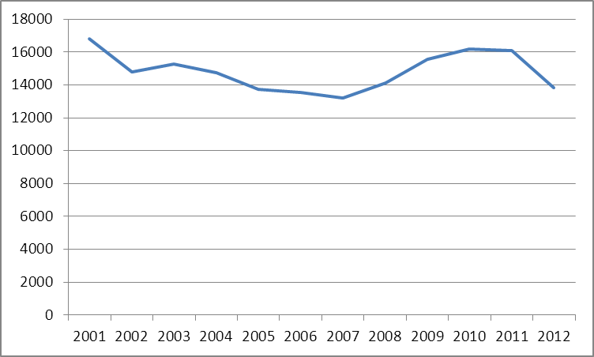
Epidemiology of rotavirus in England and Wales prior to vaccination
One study estimated that for every case of rotavirus that is laboratory confirmed, another 43 occur in the community.
Laboratory confirmed cases of rotavirus reported in England and Wales 2001 to 2012
Notes:
This graph shows that between 2001 and 2012, in England and Wales, between 13000 and 17000 people were laboratory confirmed with rotavirus each year.
Most cases of rotavirus do not require a stool sample to be submitted for testing so these laboratory confirmed cases are just the tip of the iceberg. In 2012, 13833 laboratory confirmed cases of rotavirus were reported in England and Wales.
A study of infectious intestinal disease has estimated that for every case of rotavirus that is laboratory confirmed another 43 (confidence interval range 30-62) occur in the community.
The infectious intestinal disease 2 study: http://www.foodbase.org.uk//admintools/reportdocuments/711-1-1393_IID2_FINAL_REPORT.pdf

Slide 12
Epidemiology of rotavirus in England and Wales prior to vaccination – risk by age in years
Most cases occurred in children under 5 years of age.
About two thirds of these were in children less than 2 years old.
Numbers of laboratory confirmed cases of rotavirus infection in England and Wales July 2000 to June 2012
Notes:
This graph shows the age of the laboratory confirmed cases of rotavirus in England and Wales between 2000 and 2012. Most of these occurred in children under 5 years of age and about two thirds of these were in children less than 2 years old.

Slide 13
Epidemiology of rotavirus in England and Wales prior to vaccination – risk by age in months
Highest incidence of infection was in children under one year, with most infections occurring in children between one month and four years of age
Confirmed rotavirus infections in children under 5 years of age by age in months, England and Wales 2000 to 2011
Notes:
This graph shows confirmed rotavirus infections in children under 5 years of age by age in months, showing clearly that the highest incidence of infection is in children under one year, with most infections occurring in children between one month and four years of age. The case numbers shown in this graph are just the tip of the iceberg as most cases won’t be laboratory confirmed.
Children under one year and, in particular, those younger than six months are at increased risk of dehydration.
Infection in newborns is common but tends to be either mild or asymptomatic because of protection from circulating maternal antibodies.
Grillner L, Broberger U, Chrystie I et al (1985) Rotavirus infections in newborns: an epidemiological and clinical study. Scandinavian Journal of Infectious Diseases 17 (4) 349-355
Bishop RF (1994) Natural history of human rotavirus infection. In: Kapikian AZ (ed) Viral infections of the gastroenteritis tract. New York: Marcel Dekker, p 131-67

Slide 14
Rotavirus laboratory reports in England by week during 2019/2020 and 2020/2021 seasons, compared to 5-season average (2014/2015 to 2018/2019 and 2015/2016 to 2019/2020)*
Rotavirus infection in the UK is seasonal, occurring mostly in winter and early spring (January to March).
Notes:
Rotavirus infection in the UK is seasonal, occurring mostly in winter and early spring (January to March), although there are also a small number of cases during the summer months.
https://assets.publishing.service.gov.uk/government/uploads/system/uploads/attachment_data/file/994241/Norovirus_bulletin_2020-21_week-24.pdf

Slide 15
Recommendation from JCVI for rotavirus vaccination
the Joint Committee on Vaccination and Immunisation (JCVI) is the UK’s independent panel of immunisation experts
in 2009, the JCVI considered all the available evidence on the burden of rotavirus infection and advised that the licensed rotavirus vaccine would have a significant impact on reducing the incidence of rotavirus gastroenteritis in young children
in November 2012, the vaccine was procured at a cost effective price and was introduced into the routine childhood immunisation schedule in July 2013
infants are recommended to receive two doses of vaccine at 8 and 12 weeks of age with the other primary immunisations due at these ages
Notes:
JCVI statement on Rotavirus 2009
http://www.dh.gov.uk/prod_consum_dh/groups/dh_digitalassets/@dh/@ab/documents/digitalasset/dh_095177.pdf

Slide 16
Effectiveness of rotavirus vaccine
very effective at protecting against the most common strains of rotavirus
very effective in protecting against severe rotavirus infection requiring hospitalisation
 | 1st year of life Rotarix N=2572 Placebo N=1302 | 2nd year of life Rotarix N=2554 Placebo N=1294
Vaccine efficacy (%) against rotavirus gastro-enteritis requiring medical attention [95% CI]
Circulating rotavirus strains | 91.8 [84;96.3] | 76.2 [63.0;85.0]
Vaccine efficacy (%) against hospitalisation due to rotavirus gastro-enteritis [95% CI]
Circulating rotavirus strains | 100 [81.8;100] | 92.2 [65.6;99.1]
Notes:
Rotavirus vaccine has been shown to be very effective in protecting against the most common strains of rotavirus and severe rotavirus infection (infection resulting in hospitalisation). Rotavirus vaccine will not prevent diarrhoea or vomiting caused by other pathogens.

Slide 17
Effectiveness of rotavirus vaccine
rotavirus vaccine is over 85% effective at protecting against severe rotavirus gastroenteritis in the first 2 years of life.
rotavirus vaccines are also used to routinely vaccinate children in the USA and many other countries
in the USA, studies have shown that rotavirus-related hospital admissions for young children have been cut by more than two thirds since rotavirus immunisation was introduced.
in England and Wales, it is estimated that 10,884 laboratory-confirmed infections and 50,427 all-cause acute gastroenteritis (AGE) associated hospital admissions were averted in 2013 to 2014
in infants, there was a 77% decline in laboratory-confirmed rotavirus infections and a 26% decline in all-cause AGE-associated hospitalizations in 2013 to 2014, compared with the pre-vaccination era, with large reductions also being observed in older children, adults, and older adults
Notes:
The vaccine is over 85% effective at protecting against severe rotavirus gastroenteritis in the first two years of life.
Rotavirus vaccines, including the Rotarix vaccine which is used in the UK, are also used to routinely vaccinate children in the USA and many other countries. In the USA, studies have shown that rotavirus-related hospital admissions for young children have been cut by more than two thirds since rotavirus immunisation was introduced.
In England and Wales, it is estimated that 10 884 laboratory-confirmed infections and 50 427 all-cause acute gastroenteritis (AGE) associated hospital admissions were averted in 2013-2014. In infants, there was a 77% decline in laboratory-confirmed rotavirus infections and a 26% decline in all-cause AGE-associated hospitalizations in 2013-2014, compared with the prevaccination era, with large reductions also being observed in older children, adults, and older adults.
Tate JE, Cortese MM, Payne DC, Curns AT, Yen C, Esposito DH, Cortes JE, Lopman BA, Gentsch JR, Parachar UD (2011) Uptake, impact, and effectiveness of rotavirus vaccination in the United States: review of the first 3 years of postlicencsure data. The Pediatric Infectious Disease Journal 30 (1 Suppl) S56-60
Jit M, Edmunds WJ (2007) Evaluating rotavirus vaccination in England and Wales. Part II. The potential cost-effectiveness of vaccination. Vaccine 25: 3971-9
Anderson EJ, Shippee DB, Weinrobe MH et al (2013) Indirect protection of adults from rotavirus by pediatric rotavirus vaccination. Clinical Infectious Diseases 56 (6) 755-760
https://www.ncbi.nlm.nih.gov/pubmed/26232438

Slide 18
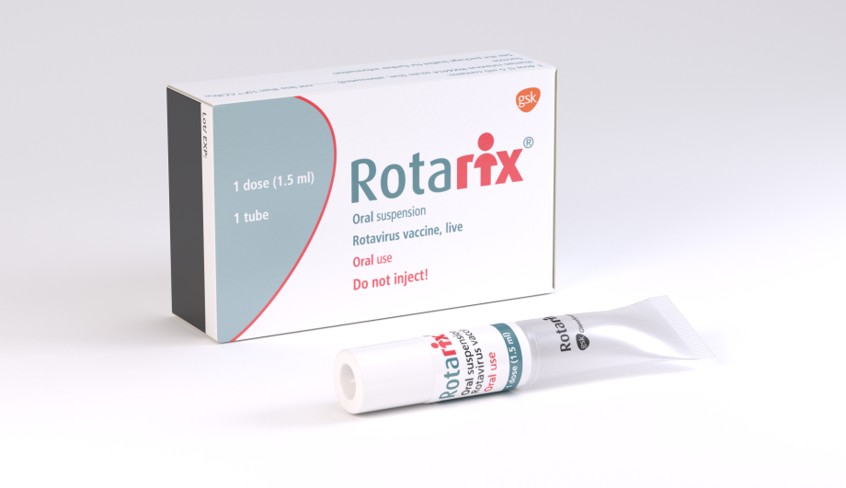
Immunisation against rotavirus: use of Rotarix vaccine
generic name: Rotavirus vaccine, live attenuated
marketed by GlaxoSmithKline
licensed from 6 weeks to 24 weeks
oral suspension in a prefilled tube
container dimensions 87mm x 53mm x 25mm
Image courtesy of GSK
Notes:
Rotarix is a live attenuated vaccine (a weakened form of virus which cannot cause disease but which protects against rotavirus)
This is an oral vaccine and must not be injected
The packaging is similar in size to many currently used childhood vaccines at 87mm x 53mm x 25mm

Slide 19
Rotarix composition
Active ingredient
-Human rotavirus RIX4414 strain
-live attenuated
-not less than 10^{6.0} CCID50
Excipients
-sucrose (to improve the taste for infants)
-Di-sodium Adipate (an acidity regulator)
-Dulbecco’s Modified Eagle Medium (cell culture medium)
-sterile water
Rotarix does not contain any antibiotic traces, formaldehyde or preservatives.
Rotarix is a live attenuated vaccine (contains a weakened form of virus which cannot cause disease but which protects against rotavirus).
Notes:
The live attenuated virus in Rotarix is Human rotavirus RIX4414 strain which is produced on vero cells (monkey cell line). The virus was initially isolated from the stool of a 15 month old child and then attenuated by serial cell culture passage.
Each dose contains not less than 10⁶ Cell Culture Infectious Dose50 (the amount of virus required to produce an effect in 50% of inoculated tissue culture cells).
There are relatively few excipients. Disodium Adipate is an acidity regulator and Dulbecco’s Modified Eagle Medium is a cell culture medium.
Rotarix does not contain any antibiotic traces, formaldehyde or preservatives such as thiomersal.
https://www.medicines.org.uk/emc/product/2739/smpc

Slide 20
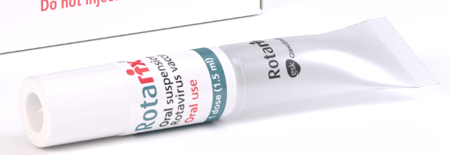
Rotarix presentation
prefilled, ready to use tube
oral suspension
each dose contains 1.5ml of clear colourless liquid
During 2017, the presentation of Rotarix vaccine changed to a tube applicator
Between 2013 and 2017 the vaccine was presented as a syringe-like oral applicator
Notes:
Rotarix is presented as a prefilled tube containing 1.5ml of oral suspension.
The tube is ready to use and does not require reconstitution or dilution.
The oral suspension should be a clear colourless liquid, free of visible particles. Before administration the vaccine should be visually inspected for particulate matter and/or abnormal physical appearance. In the event of either being observed the vaccine should be discarded.

Slide 21
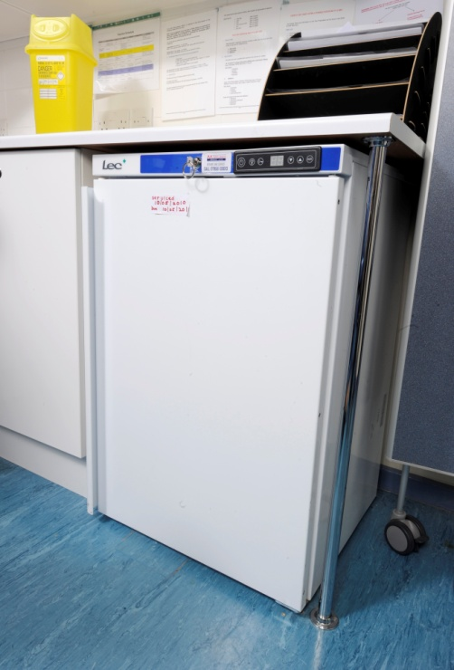
Storage of Rotarix
Rotarix must be stored in accordance with manufacturer’s instructions.
Cold chain must be maintained
store between +2⁰C and +8⁰C
store in original packaging
protect from light
If the vaccine is stored outside of this recommended temperature range, advice should be taken from the manufacturer to inform any risk assessment.
Notes:
Rotarix must be stored in accordance with the manufacturer’s instructions. As with other vaccines, Rotarix should be stored between +2°C and +8°C.
The vaccine should be stored in the original packaging. This makes it easy to identify in the vaccine fridge, provides some protection against fluctuation of temperature and will protect from light. The vaccine expiry date is displayed on the outer carton.
Vaccines are expensive and it is important to minimise wastage through inappropriate storage.

Slide 22
Rotarix dosage and schedule
2 dose schedule
first dose of 1.5ml at 8 weeks of age
• second dose of 1.5ml at least 4 weeks after the first (12 week appointment)
it is preferable that the full course of 2 doses is completed before 16 weeks of age. Rotarix must be given by 23 weeks and 6 days)
the first dose must be given 14 weeks and 6 days. Immunisation should not be initiated after 15 weeks of age.
if the course is interrupted it should be resumed but not repeated, provided that the second dose can be given before 24 weeks
if infant spits out/regurgitates most of dose, a replacement dose may be given at same visit
Notes:
Objective is to provide 2 doses of rotavirus vaccine to infants before 24 weeks (that is by age 23 weeks and 6 days) of age to protect against rotavirus infection
A full course is two doses with an interval of at least 4 weeks between doses (Rotavirus. Green Book Chapter)
https://www.gov.uk/government/organisations/public-health-england/series/immunisation-against-infectious-disease-the-green-book)
The routine programme offers a first dose at the 8 week visit when an infant receives their other first primary immunisations. The second dose should be given at least four weeks after the first dose, ideally at the second visit for the primary immunisations due when they are 12 weeks old.
Both doses of Rotarix must be given by 24 weeks of age but ideally before 16 weeks of age.
Immunisation should not be initiated after 15 weeks of age (that is 14 weeks and 6 days).
As they get older, some infants (about 120 per 100,000) develop intussusception. The background risk of intussusception increases to peak at around 5 months of age. Research from some countries suggests that Rotarix may be associated with a very small increased risk of intussusception within seven days of immunisation, possibly up to six cases per 100,000 first doses given. The benefits of immunisation in preventing the consequences of rotavirus infection outweigh this small potential risk in young children. Because of the potential risk, and to reduce the likelihood of a temporal association with rotavirus vaccine, the first dose of vaccine should not be given after 15 weeks of age (that is it can be given up to and including 14 weeks and 6 days).

Slide 23
Administration of Rotarix
Rotarix is different from the other infant vaccines, as it is a live oral vaccine and must not be injected
Rotarix can be administered at the same time as other childhood vaccines
Rotarix can also be given at any time before or after BCG vaccine
it is suggested that Rotarix be given to the infant at the beginning of their immunisation visit, before administration of intramuscular vaccines which may unsettle the infant
Notes:
Rotarix can be given at the same time as the other vaccines administered as part of the routine childhood immunisation programme, and so should ideally be given at the scheduled eight week and twelve week immunisation visits.
Rotavirus. Green Book Chapter
https://www.gov.uk/government/organisations/public-health-england/series/immunisation-against-infectious-disease-the-green-book

Slide 24
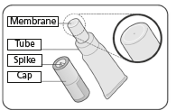
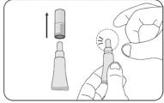
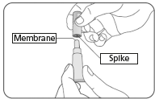
Preparing Rotarix ORAL vaccine
 | Check the expiry date Check the tube has not been damaged or is already open Check the liquid is clear and colourless without particles in it If you notice anything abnormal, do not use the vaccine This vaccine is given orally, straight from the tube It is ready to use, you do not need to do anything with it
 | Pull off and keep the cap to pierce the membrane later Hold the tube upright Repeatedly flick to tube until it is clear of any liquid. You can clear any liquid from the thinnest part of the tube by flicking just below the membrane
 | Position the cap to open the tube Hold the tube upright Hold the side of the tube Identify the small spike in the inside of the cap and then turn the cap upside down
Notes:
Check the expiry date on the vaccine and that the tube is not damaged in any way. Check that the appearance of the vaccine is clear and colourless with no visible particles. If the appearance of the vaccines does not match the manufacturers description, discard the vaccine.
Pull off the cap and put the cap in a safe place, you will need it later to pierce the tube. Hold the tube upright and clear the top of the tube by flicking it until it is clear of liquid.

Slide 25
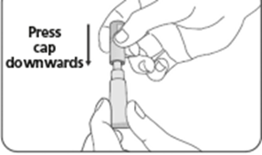
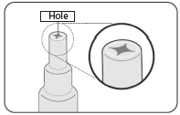
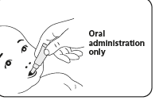
Preparing Rotarix ORAL vaccine
 | To open the tube, press the cap down, piercing the membrane with the spike inside the cap Then lift off the cap
 | Check that the membrane has been pierced, there should be a hole at the top of the tube If the membrane has not been pierced, repeat the previous steps
 | Once the tube is open, check the liquid is clear, without particles in it. If you notice anything abnormal, do not use the vaccine Give the vaccine straight away The child should be seated, leaning slightly backwards Squeeze the liquid gently into the side of the child’s mouth, towards the inside of their cheek You may need to squeeze the tube a few times to get all of the vaccine out – it is ok if a drop remains in the tip of the tube
Notes:
In one hand, hold the tube upright, in your other hand, turn the cap upside down and place it over the tube, insert the small spike positioned inside the top of the cap in the centre of the tube to piece the membrane then lift off the cap.
Check that there is a hole at the tope of the membrane, if it has not been pierced repeat the previous steps
Ensure that the child is in a seated position and leaning slightly backwards before administering
Once the tube is open, check the liquid is clear and has no particles in it, if you notice anything abnormal with the appearance of the vaccine, discard it and prepare a new one.
Administer the vaccine orally by squeezing the liquid gently into the side of the child’s mouth – towards the inside of their cheek. Ensure that all of the vaccine is given, you may need to squeeze the tube a few times to get it all out. If a drop remains in the tip of the tube, this is ok.
Discard the empty tube and cap in accordance with local requirements
If the infants spits out or regurgitates most of the vaccine, a single replacement dose may be given at the same immunisation visit.
If the child has left the premises and vomits, the dose does not need to be repeated as the vaccine is very quickly absorbed.
There are no restrictions on infant’s feeding before or after immunisation.
Based on evidence generated in clinical trials, breast-feeding does not reduce the protection against rotavirus gastroenteritis afforded by Rotarix. Therefore, breast-feeding may be continued during the immunisation schedule (Rotarix SPC, available on ema website
http://www.medicines.org.uk/emc/medicine/17840/SPC/Rotarix)

Slide 26
Contraindications
infants presenting for their first dose of Rotarix 15 weeks of age or older
infants aged 24 weeks of age or over (beyond 23 weeks and 6 days)
babies born to mothers that used medical biologicals during their pregnancy
infants with Severe Combined Immunodeficiency (SCID) disorder
infants with a confirmed anaphylactic reaction to a previous dose of the vaccine
infants with a confirmed anaphylactic reaction to any components of the vaccine
infants with a previous history of intussusception
infants with a malformation of GI tract that could predispose to intussusception
rare hereditary problems of fructose intolerance, glucose-galactose malabsorption or sucrose-iso-maltose insufficiency
there are very few infants who cannot receive rotavirus vaccine; where there is doubt seek advice
Notes:
Although the vaccine is a live attenuated virus, the benefit from immunisation may exceed any risk from forms of immunosuppression not included in this list. The vaccine is contraindicated for infants with severe combined immune-deficiency (SCID), and it is recommended that infants born to mothers using biological medicines during pregnancy, such as Infliximab should not receive live vaccines during the first six months of life. This means that these infants will not receive immunisation to protect against rotavirus but they should benefit from herd immunity. Therefore, there are very few infants who cannot receive rotavirus vaccine. Where there is doubt, appropriate advice should be sought from your local screening and immunisation team or Consultant in Public Health Medicine rather than withholding immunisation.

Slide 27
Severe Combined Immune Deficiency (SCID) and Rotavirus vaccine
although it is important that infants receive rotavirus vaccine in early life to protect against gastrointestinal illness, Rotavirus vaccine is a live vaccine and SCID is the major contraindication to rotavirus vaccination
Bakari and others previously described reports of severe gastroenteritis and prolonged viral shedding in immunocompromised infants involving the vaccine strain
Ladhani and others conducted a prospective national surveillance study. This study described infants with acute gastroenteritis symptoms in primary and secondary care who also had Rotarix vaccine derived rotavirus strain in their stools. Those infants with the vaccine derived rotavirus strain that were identified more than 7 weeks after being given rotavirus vaccine were often found to have underlying SCID

Slide 28
SCID screening evaluation
from September 1 2021, all babies born in regions served by certain screening laboratories, who attend for their immunisations from 27 October 2021, should have their records checked for SCID screening results before rotavirus vaccine is administered
the regions included in the evaluation are those served by screening laboratories in Newcastle, Manchester, Sheffield, Birmingham, Great Ormond Street hospital and Guys and St Thomas hospital. This will form part of the newborn screening test at 5 days
if the infant was born in an area participating in the SCID screening evaluation, the outcome of the screening test should be available by the 8 week routine vaccination appointment. Parents should be asked to bring the outcome letter with them to the appointment. If the infant is SCID suspected, rotavirus vaccine is contraindicated. If the infant is SCID not suspected or if no result can be found, rotavirus vaccine can be administered
immunisers should be aware that newly registered infants may have moved in from a SCID screening evaluation area and every effort should be made to confirm whether any SCID screening outcome is available before administering rotavirus vaccine

Slide 29
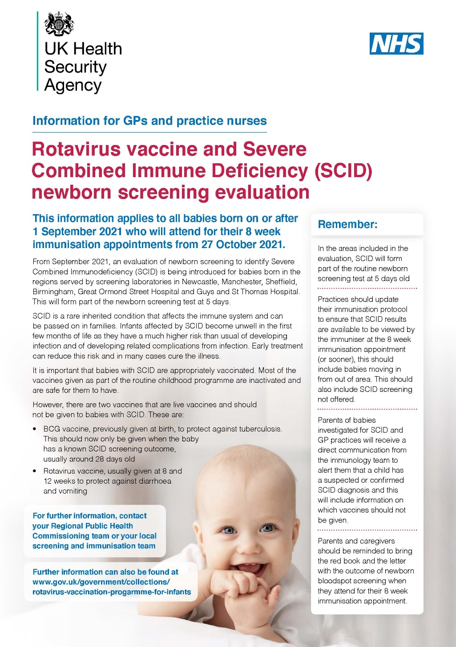
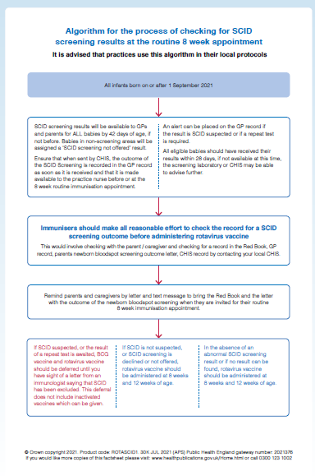
Notes:
An algorithm for the process of checking for SCID screening results at the routine 8 week appointment is available at https://www.gov.uk/government/collections/rotavirus-vaccination-progarmme-for-infants
Immunisers should make all reasonable effort to check the record for a SCID screening outcome before administering rotavirus vaccine. SCID is a contraindication for rotavirus vaccine.
Following receipt of a letter from the immunologist advising that ‘it was highly unlikely that your baby has SCID’ the PGD can be used by a registered healthcare practitioner to assess the infant for rotavirus immunisation and administer the vaccine under the PGD so long as the PGD has local authorisation, the individual practitioner is authorised by name under the current version of the PGD before working to it and none of the other exclusion criteria apply (see https://www.gov.uk/government/publications/rotavirus-vaccine-rotarix-patient-group-direction-pgd-template ).

Slide 30
Immunosuppression and HIV
Rotarix should not be administered to infants known to have severe combined immunodeficiency disorder (SCID) or to infants whose mothers have used biological medicines, such as Infliximab, during pregnancy
for infants with other immuno-suppressive disorders, rotavirus immunisation should be actively considered, if necessary in collaboration with the clinician dealing with the child’s underlying condition
Rotarix immunisation is advised in HIV infected infants. Additionally infants of unknown HIV status, but born to HIV positive mothers should be offered immunisation
Notes:
Rotavirus immunisation should not be administered to infants known to have Severe Combined Immunodeficiency Disorder (SCID) or to infants whose mothers used biological medicines, such as Infliximab, during pregnancy.
There is a lack of safety and efficacy data on the administration of rotavirus to infants with other immuno-suppressive disorders. Given the high risk of exposure to natural rotavirus, however, the benefits of administration is likely to outweigh any theoretical risks and therefore should be actively considered, if necessary in collaboration with the clinician dealing with the child’s underlying condition.
In a clinical study, 100 infants with HIV were administered Rotarix lyophilised formulation or placebo. The safety profile was similar between Rotarix and placebo recipients. Therefore immunisation is supported in HIV infected infants. Additionally infants with unknown HIV status, but born to HIV positive mothers should be offered immunisation.
Rotavirus. Green Book Chapter
https://www.gov.uk/government/organisations/public-health-england/series/immunisation-against-infectious-disease-the-green-book
Steele AD, Madhi SA, Louw CE, et al (2011) Safety, Reactogenicity, and Immunogenicity of human rotavirus vaccine RIX4414 in Human Immunodeficiency Virus positive infants in South Africa. The Pediatric Infectious Disease Journal 30 (2) 125-30

Slide 31
Immunosuppression and maternal biological medicines
Rotavirus vaccine should not be given to infants of mothers that used immunosuppressive biological therapy during their pregnancy
it is recommended that immunisation with live vaccines should be delayed for 6 months in children born to mothers who were on immunosuppressive biological therapy (TNFα antagonists and other biological medicines such as Infliximab) during pregnancy
this is because of the potential that these will have a postnatal influence on the infants’ immune status
as Rotarix vaccine is contraindicated in infants presenting for the first dose after 15 weeks of age (beyond 14 weeks and 6 days), infants whose mothers received such treatment during pregnancy will therefore not be eligible to receive Rotarix vaccine but they should benefit from herd (indirect) protection
Notes:
https://www.gov.uk/drug-safety-update/live-attenuated-vaccines-avoid-use-in-those-who-are-clinically-immunosuppressed
https://assets.publishing.service.gov.uk/government/uploads/system/uploads/attachment_data/file/655225/Greenbook_chapter_6.pdf

Slide 32
Precautions
vaccination should be deferred in infants with acute severe febrile illness and/or acute diarrhoea or vomiting until the infant has recovered
minor illnesses without fever or systemic upset are not valid reasons to postpone immunisation
Notes:
Minor illnesses without fever or systemic upset are not valid reasons to postpone immunisation. If infant is acutely unwell the immunisation may be deferred until they have recovered – this is to avoid confusing the differential diagnosis of acute illness by wrongly attributing signs or symptoms as adverse effects of the vaccine.
In infants with acute diarrhoea or vomiting the vaccine may be postponed until they have recovered – this is to make sure the vaccine is not regurgitated or passed through GI tract too quickly which could reduce the effectiveness of the vaccine

Slide 33
Vaccine virus transmission
potential transmission of live attenuated vaccine virus from infants to severely immunocompromised contacts through faecal matter for 14 days post immunisation
cases of transmission of the excreted vaccine virus to seronegative contacts of vaccinees have been observed without causing clinical symptoms
immunisation of the infant will offer protection to household contacts from wild-type rotavirus disease and outweigh any risk from transmission of vaccine virus to any immunocompromised close contacts
those in close contact with recently vaccinated infants should observe good personal hygiene and hand washing techniques
Notes:
There is a potential for transmission of the live attenuated virus in Rotarix from the infant to severely immunocompromised contacts through faecal material for at least 14 days. However, immunisation of the infant will offer protection to household contacts from wild-type rotavirus disease and outweigh any risk from transmission of vaccine virus to any immunocompromised close contacts.
Those in close contact with recently immunised infants should observe good personal hygiene e.g. washing their hands after changing a child’s nappy
Rotavirus. Green Book Chapter
https://www.gov.uk/government/organisations/public-health-england/series/immunisation-against-infectious-disease-the-green-book
Anderson EJ. (2008) Rotavirus vaccines: viral shedding and risk of transmission. Lancet Infectious Diseases 8 (10) 642-9

Slide 34
Adverse reactions
a full list of the adverse reactions associated with Rotarix vaccine are described in the summary of product characteristic.
the most common adverse reactions observed after Rotarix are diarrhoea and irritability
Other reactions commonly reported are
-vomiting -fever
-abdominal pain -loss of appetite
-flatulence -regurgitation of food
-skin inflammation
Notes:
The full list of adverse reactions associated with Rotarix is available in the marketing authorisation holder’s Summary of Product Characteristics’ .
Anaphylaxis is a very rare side effect of most vaccines and facilities for its recognition and management must be available.
Rotarix SPC, available on ema website
http://www.medicines.org.uk/emc/medicine/17840/SPC/Rotarix

Slide 35
Intussusception
intussusception is a naturally occurring condition of the intestines with a background annual incidence of around 120 cases per 100,000 children under 1 years
intussusception occurs when a section of the bowel folds in on itself, like a telescope closing, typically at the junction of the ileum and the colon
symptoms are episodes of pain, pallor and vomiting which may lead to disruption of blood supply
some research suggests that Rotarix may be associated with a very small increased risk (between 1 and 6 cases per 100,000) of intussusception within 7 days of immunisation
even with this small potential risk, the benefits of immunisation in preventing the consequences of rotavirus infection outweigh any possible side effects
to reduce the likelihood of a temporal association with rotavirus vaccine, the first dose of Rotarix should not be administered after 15 weeks of age (that is by age 14 weeks and 6 days)
Notes:
Research from some countries suggests that Rotarix may be associated with a very small increased risk of intussusception within seven days of immunisation, possibly up to 6 cases per 100,000 first doses given. The benefits of immunisation in preventing the consequences of rotavirus infection outweigh this small potential risk in young children. Because of the potential risk, and to reduce the likelihood of a temporal association with rotavirus vaccine, the first dose of vaccine should not be given after 16 weeks of age.
Parents should be advised that if the infant develops severe vomiting, abdominal pain and passes what looks like redcurrent jelly in their stools they should contact their doctor immediately.
Rotavirus. Green Book Chapter
https://www.gov.uk/government/organisations/public-health-england/series/immunisation-against-infectious-disease-the-green-book

Slide 36
Reporting suspected adverse reactions
Medicines and Healthcare products Regulatory Agency (MHRA) Yellow Card scheme
voluntary reporting system for suspected adverse reaction to medicines/vaccines
success depends on early, complete and accurate reporting
report even if uncertain about whether vaccine caused condition
see chapter 9 of the Green Book for details
Notes:
As with all vaccine and other medicines registered healthcare professionals and patients are encouraged to report suspected adverse reactions to the Medicines and Healthcare products Regulatory Agency (MHRA) using the yellow card reporting scheme.
Medicines and Healthcare products Regulatory Agency (MHRA)
http://www.mhra.gov.uk

Slide 37
Data management - call and recall
infants are called for their rotavirus immunisation at the same time as their routine primary immunisations at 8 and 12 weeks via the local CHIS or GP surgery
administered rotavirus vaccines should be recorded in the same way as other infant immunisations
infants aged 15 weeks or older attending late for their primary immunisations should not be offered Rotarix vaccine but should still continue to receive other routine primary immunisations
Notes:
Infants are called for their rotavirus vaccine at the same time as their other infant immunisations offered at 8 and 12 weeks of age, via the local Child Health Computer System or their GP surgery (whichever is the usual method of call/recall used in the area). immunisation will be recorded in the same way as the other infant immunisations.
Note:
If an infant attends late for their vaccines due at 8 and 12 weeks, it is important to remember that both doses of Rotarix vaccine should be given by 24 weeks (i.e. up to age 23 weeks and 6 days) of age but preferably before 16 weeks of age. Infants who have not received a first dose by 15 weeks of age (ie up to age 14 weeks and 6 days) should not be offered Rotarix. This does not apply to the other routine infant immunisations which can be given if the infant presents late.

Slide 38
The impact of the infant rotavirus immunisation programme

Slide 39
Vaccine coverage
High vaccine coverage was rapidly achieved following the introduction of the rotavirus immunisation programme in England in July 2013.
In 2019 to 2020, 90.1% of children in England were reported to have received 2 doses of the rotavirus vaccine as measured at 12 months which represents an increase from 89.7% in 2018 to 2019.
Coverage in 6 regions was above 90% but no region achieved 95% coverage.
Notes:
https://files.digital.nhs.uk/31/DDCEC7/child-vacc-stat-eng-2019-20-report.pdf

Slide 40
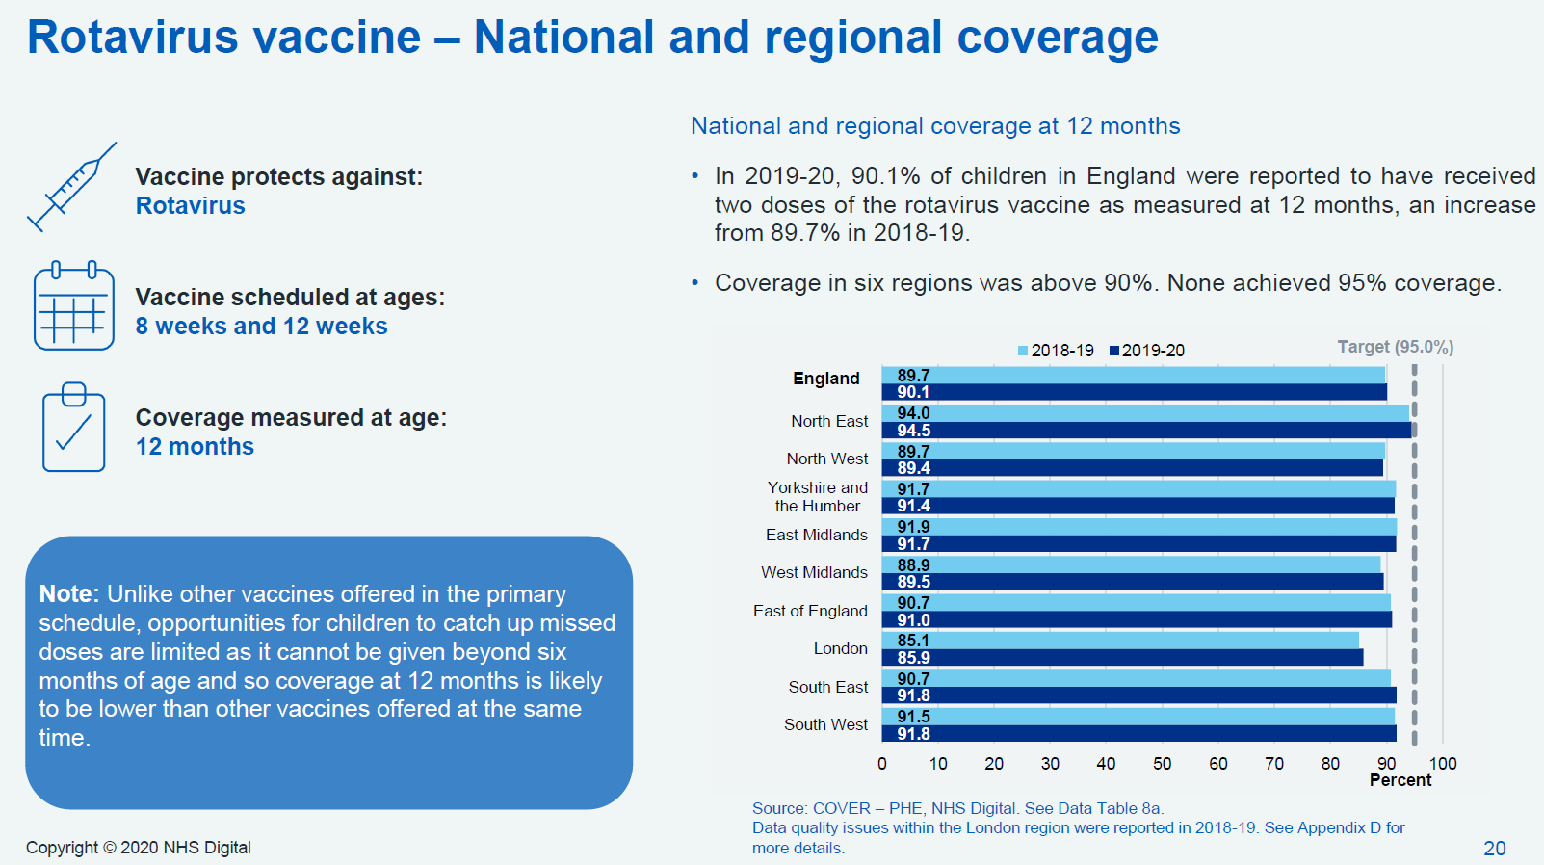
National and regional coverage for 2 doses as measured at 12 months (2018 to 2019 and 2019 to 2020)
Notes:
This chart shows % vaccine coverage for 2 doses of Rotarix vaccine at 12 months of age by region
https://files.digital.nhs.uk/31/DDCEC7/child-vacc-stat-eng-2019-20-report.pdf

Slide 41
The impact of the infant rotavirus immunisation programme
the programme has been highly successful in reducing cases of rotavirus, indicated by the substantial decline in the number of laboratory reports of cases
to July 2016 there has been a 84% decrease in lab reports compared with the ten season average for the same period (seasons 2003, 2004 to 2012 and 2013)
Notes:
The impact of the rotavirus immunisation programme can be seen on the next slide

Slide 42
Seasonal comparison of laboratory reports of rotavirus in England and Wales (2011 to 2012 to 2019 to 2020)
Notes:
Rotavirus infection in the UK is seasonal, occurring mostly in winter and early spring (January to March), although there are also a small number of cases during the summer months.
https://www.gov.uk/government/uploads/system/uploads/attachment_data/file/681385/Norovirus_update_2018_week_05.pdf
Rotavirus particularly contributes to reported diarrhoea and vomiting illness in children aged under five. In the first season following the introduction of the rotavirus vaccine in July 2013, a 77 per cent decline in laboratory-confirmed rotavirus infections in infants was observed (Atchison et al, 2016) and between 2003/04 and 2012/13, there was an 84% decrease in lab reports. The number of laboratory reports of rotavirus in England and Wales as reported to Public Health England, in the week 27, 2017 to week 05, 2018 season was 739. This is 47 per cent lower than the four season average (post-vaccine) for the same period in the seasons 2013/14 to 2016/17 (1395). The total number of laboratory-confirmed rotavirus infections each season has since remained low compared to the pre-vaccine period.
https://assets.publishing.service.gov.uk/government/uploads/system/uploads/attachment_data/file/878578/Norovirus_update_2020_weeks_12_to_13.pdf

Slide 43
Laboratory reports of Rotavirus by week and age group 2009 to 2020 (England and Wales)
Notes:
The number of laboratory confirmed reports of Rotavirus infections in infants has remained low each season compared to the pre-vaccine period.
The rotavirus season runs from week 27 in year 1 to week 26 in year 2, i.e. week 27 2017 to week 26 2018, July to June. This is in order to capture the winter peak of rotavirus activity in one season, for reporting purposes
https://assets.publishing.service.gov.uk/government/uploads/system/uploads/attachment_data/file/878578/Norovirus_update_2020_weeks_12_to_13.pdf

Slide 44
The healthcare professionals’ key role
to provide clear and concise information to parents/guardians regarding immunisation against rotavirus
to check for any contraindications before giving the vaccine
to safely administer the oral vaccine to young infants according to the schedule

Slide 45
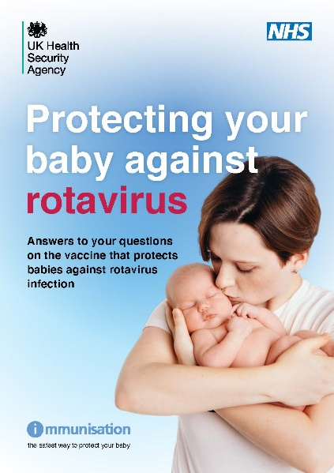
Resources
joint letter from DH, PHE and NHS England April 2013:
“Important changes to the national immunisation programme in 2013/14: introduction of rotavirus immunisation for babies at 2 and 3 months”
Green Book Rotavirus chapter
rotavirus vaccination programme: ‘Information for healthcare professionals’ document
NHS UK Rotavirus webpage
rotavirus information leaflet and flyer
Notes:
Rotavirus references
¹ Joint letter from DH, PHE and NHS England April 2013:
“Important changes to the national immunisation programme in 2013/14: introduction of rotavirus immunisation for babies at 2 and 3 months”
www.gov.uk/government/organisations/public-health-england/series/immunisation
² Bernstein DI, Ward RL, Rotavirus. In Feigin RD, Cherry JD, eds. Textbook of Pediatric Infectious Diseases. 5th ed Vol 2. Philadelphia, Pa: Saunders; 2004; 4; 2110-2133
³ Bishop RF (1996) Natural history of human rotavirus infection. Archives of Virology 12 (Suppl) 119-128
⁴ Raebel MA, Ou BS (1999) Rotavirus disease and its prevention in infants and children. Pharmacotherapy 19: 1279-1295
⁵ NHS Choices Rotavirus
http://www.nhs.uk/conditions/Rotavirus-gastroenteritis/Pages/Introduction.aspx
⁶ Jit M, Pebody R, Chen M et al (2007) Estimating the number of deaths with rotavirus as a cause in England and Wales. Human Vaccines and Immunotherapeutics 3 (1) 23-6
⁷ Ansari SA, Springthorpe VS, Satter SA. (1991) Survival and vehicular spread of human rotaviruses: Possible relation to seasonality of outbreaks. Research and Reviews of Infectious Diseases 13: 448-461
⁸ Offit PA, Clark HF. Rotavirus. In Mandell GL, Bennett JE, Dolin R, eds. Mandelll, Douglas, and Bennett’s: Principles and Practice of Infectious Diseases. 5th ed. New York: Churchill Livingstone; 2000: 1696-1703
⁹ The infectious intestinal disease 2 study
http://www.foodbase.org.uk//admintools/reportdocuments/711-1-1393_IID2_FINAL_REPORT.pdf
¹⁰ Grillner L, Broberger U, Chrystie I et al (1985) Rotavirus infections in newborns: an epidemiological and clinical study. Scandinavian Journal of Infectious Diseases 17 (4) 349-355
¹¹ Bishop RF (1994) Natural history of human rotavirus infection. In: Kapikian AZ (ed) Viral infections of the gastroenteritis tract. New York: Marcel Dekker, p 131-67
¹² JCVI statement on Rotavirus 2009
http://www.dh.gov.uk/prod_consum_dh/groups/dh_digitalassets/@dh/@ab/documents/digitalasset/dh_095177.pdf
¹³ Rotarix SPC, available on ema website
http://www.medicines.org.uk/emc/medicine/17840/SPC/Rotarix
¹⁴ Tate JE, Cortese MM, Payne DC, Curns AT, Yen C, Esposito DH, Cortes JE, Lopman BA, Gentsch JR, Parachar UD (2011) Uptake, impact, and effectiveness of rotavirus immunisation in the United States: review of the first 3 years of postlicencsure data. Pediatric Infectious Disease Journal 30 (1 Suppl) S56-60
¹⁵ Jit M, Edmunds WJ (2007) Evaluating rotavirus immunisation in England and Wales. Part II. The potential cost-effectiveness of immunisation. Vaccine 25: 3971-9
¹⁶ Anderson EJ, Shippee DB, Weinrobe MH et al (2013) Indirect protection of adults from rotavirus by pediatric rotavirus immunisation. Clinical Infectious Diseases 56 (6) 755-760
¹⁷ De Vos B, Vesikari T, Linhares AC et al (2004) A rotavirus vaccine for prophylaxis of infants against rotavirus gastroenteritis. Pediatric Infectious Disease Journal 23 (10 Suppl) S170-82
¹⁸ Rotavirus. Green Book Chapter
https://www.gov.uk/government/organisations/public-health-england/series/immunisation-against-infectious-disease-the-green-book
¹⁹ Steele AD, Madhi SA, Louw CE, et al (2011) Safety, Reactogenicity, and Immunogenicity of human rotavirus vaccine RIX4414 in Human Immunodeficiency Virus positive infants in South Africa. Pediatric Infectious Disease Journal 30 (2) 125-30
²⁰ Anderson EJ. (2008) Rotavirus vaccines: viral shedding and risk of transmission. Lancet Infectious Diseases 8 (10) 642-9
²¹ Medicines and Healthcare products Regulatory Agency (MHRA)
http://www.mhra.gov.uk

Slide 46
Key messages
rotavirus is the most common cause of gastroenteritis in young children
most children rich or poor, living in industrialised or developing countries will experience at least one infection with rotavirus by the time they are 5 years old
rotavirus gastroenteritis can cause dehydration which may lead to hospitalisation for intravenous rehydration
an oral vaccine against rotavirus was introduced in July 2013 into the infant immunisation programme at the 8 and 12 week appointments to reduce the incidence of disease
to date, rotavirus immunisation has been shown to significantly reduce the incidence of rotavirus gastroenteritis in young children
during 2017, the manufacturer changed the applicator or Rotarix vaccine and all immunisers should be familiar with the instructions for oral administration

Slide 47
Acknowledgement
This slide set was developed by NHS Education for Scotland as a national training template to support the introduction of rotavirus vaccine into the infant immunisation schedule.
Their permission to adapt it for use in England is gratefully acknowledged.

