Slide 1
The hexavalent DTaP/IPV/Hib/HepB vaccines Information for healthcare practitioners

Slide 2
Purpose of resource
To provide information to healthcare practitioners about the 2 hexavalent DTaP/IPV/Hib/HepB vaccines in order that they are:
knowledgeable and confident in administering and discussing these vaccines with parents or carers as part of the routine infant programme
aware of the selective HepB vaccination programme for high risk infants

Slide 3
Content
Rationale for introducing a hepatitis B containing vaccine into the routine infant immunisation schedule
Hepatitis B: transmission, symptoms and epidemiology
information about the 2 hexavalent vaccines (Infanrix hexa® and Vaxelis®) and its use
the neonatal selective immunisation programme for babies at risk of hepatitis B
sources of information

Slide 4
Key points
a hexavalent DTaP/IPV/Hib/HepB vaccine which includes protection against hepatitis B was introduced into the infant primary immunisation from 1 August 2017
in 2022, the UKHSA will start to supply the hexavalent vaccine Vaxelis®, in addition to Infanrix hexa®, for use in the primary immunisation schedule
neither of the hexavalent vaccines are new vaccines. Both vaccines have been widely used in other countries across the world for several years
studies have shown both hexavalent vaccines to be safe and highly immunogenic for all their component toxoids and antigens
any adverse events experienced following both hexavalent vaccines are mild to moderate
the infant immunisation schedule remains unchanged at 8,12 and16 weeks
Infanrix hexa® and Vaxelis ® vaccines are considered interchangeable, but where possible and if local stock allows, it is preferable that the same DTaP/IPV/Hib/HepB vaccine be used for all 3 doses of the primary course

Slide 5
Introduction of a hexavalent infant vaccine
Since autumn 2017, all babies born on or after 1 August 2017 have been eligible to receive a hexavalent (6 in 1) vaccine for their primary immunisations at 8, 12 and 16 weeks
This hexavalent vaccine protects against diphtheria, tetanus, pertussis, poliomyelitis, hepatitis B and disease caused by Haemophilus influenzae type b (Hib)
2017 - Infanrix hexa® replaced the pentavalent (5 in 1) infant primary vaccines Infanrix®-IPV+Hib and Pediacel® and offered protection against Hepatitis B to all infants for the first time
2022 - Vaxelis® was introduced into the programme, for use in the primary immunisation schedule in addition to Infanrix hexa®

Slide 6
Why is a hepatitis B containing vaccine being offered to all infants?
In 1992, the World Health Assembly recommended every country should have a universal hepatitis B immunisation programme
However, as the UK is a low prevalence and low incidence country for hepatitis B, introducing a universal hepatitis B programme using a monovalent hepatitis B vaccine would not have been cost-effective
In recent years, infant combination hepatitis B-containing vaccines (which also protect against diphtheria, tetanus, polio, pertussis and Hib) have become available in the UK
In 2014, the Joint Committee of Vaccination and Immunisation (JCVI) re-evaluated the benefits and cost-effectiveness of a universal hepatitis B infant immunisation programme in the UK
They subsequently recommended the use of the hexavalent DTaP/IPV/Hib/HepB combination vaccines for all infants

Slide 7
What is hepatitis B?
Hepatitis B is a viral infection that attacks the liver and can cause both acute and chronic disease
many new infections with hepatitis B virus (HBV) are sub-clinical or may only cause a flu-like illness
mostly asymptomatic in infants
acute HBV infection occasionally leads to sudden and severe liver damage which can be fatal
chronic HBV infection can result in progressive liver disease
this can lead to cirrhosis (development of scar tissue) and an increased risk of developing liver cancer

Slide 8
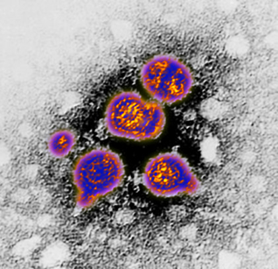
How is hepatitis B virus (HBV) transmitted?
HBV is highly transmissible through the exchange of infected blood and bodily fluids
it can survive outside the body for at least 7 days
transmission mostly occurs:
through vaginal or anal intercourse
as a result of blood-to-blood contact through percutaneous exposure (for example sharing of needles and other equipment by people who inject drugs or through ‘needlestick’ injuries)
through perinatal transmission from mother to child
transmission has also followed bites from infected persons although this is rare
transfusion-associated infection now also rare in UK as blood donors and donations are screened

Slide 9
Clinical presentation
many new infections are subclinical showing no signs of infection
if symptomatic, symptoms of acute infection start insidiously and may present as flu like illness with or without mild fever or symptoms may be non-specific
anorexia, nausea, vomiting and aching in the right upper abdomen may be present
followed by malaise, decreased appetite, joint pain and jaundice with progressive darkening of urine and lightening of the faeces
symptoms may last several weeks to months
in those with symptoms not suggestive of hepatitis, infection only detected through abnormal liver function tests and or presence of serological markers of infection for example hepatitis B surface antigen (HBsAg)

Slide 10
Stages of hepatitis B infection
Incubation period
average incubation period is 60 to 90 days but can vary between 40 and 160 days
Infectious period
those with detectable surface antigen (HBsAg) in serum are considered to be infectious
those who also have the e-antigen marker (HBeAg) are the most infectious
Acute stage
within the first 6 months of infection
those who clear the virus during this stage will be immune for life
Chronic stage
defined as persistence of HBsAg in the serum for 6 months or longer
they remain infectious
children less than 6 years of age who become infected with hepatitis B virus are the most likely to develop chronic infection

Slide 11
Treatment and prevention
no specific treatment is available for acute hepatitis B
supportive treatment may be indicated for severe clinical manifestations for example replacement of fluids lost from vomiting and diarrhoea
chronic hepatitis B infection can be treated with oral antivirals which can slow the progression of cirrhosis, reduce incidence of liver cancer and improve long term survival
Hepatitis B vaccination is the most effective prevention
a completed course of vaccine induces protective antibody levels in more than 95% of infants, children and young adults
protection lasts at least 20 to 30 years
the vaccine has an excellent record of safety and effectiveness
as of 2015, 185 countries had introduced nationwide hepatitis B vaccination for infants. However, some countries have adopted selective vaccination strategies that target only high-risk individuals

Slide 12
UK hepatitis B epidemiology
UK is a very low-prevalence country for HepB: 0.2 to 0.4% UK population infected
prevalence of Hep B infection varies across the country for example prevalence rates in antenatal women vary from 0.05 to 0.08% in some rural areas but rise to 1% or more in certain inner city areas
higher prevalence in those born in high-endemicity countries, many of whom will have acquired infection at birth or in early childhood
incidence of acute infection is low but is higher among those with certain behavioural or occupational risk factors

Slide 13
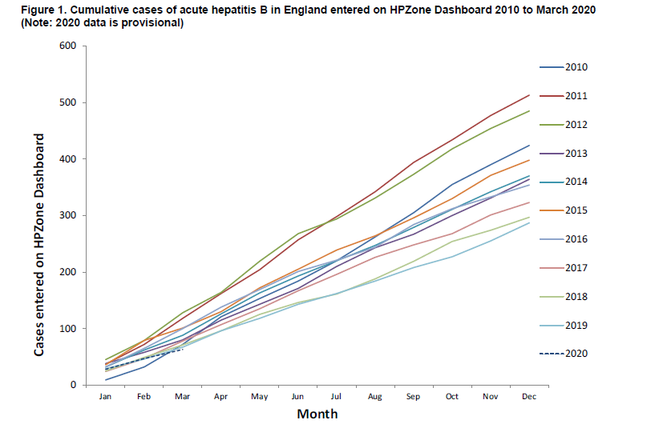
Laboratory reports of confirmed acute hepatitis B England 2010 to 2020
Acute hepatitis B: national enhanced surveillance report January to March 2020 Health Protection Report Volume 14 Number 24

Slide 14
Global prevalence of chronic hepatitis B (adults)
Source: CDC Health Information for International Travel 2016
Globally, hepatitis B is one of the most common infectious diseases - WHO estimates around 250 million people worldwide are chronically infected
Notes:
Hepatitis B is a disease of global public health importance. The World Health Organization (WHO) estimate that 257 million people are living with hepatitis B virus infection (defined as hepatitis B surface antigen positive).
In 2015, hepatitis B resulted in 887 000 deaths, mostly from complications (including cirrhosis and hepatocellular carcinoma).
The prevalence of disease varies by country. The WHO has categorised countries based upon the prevalence of HBsAg into high (more than 8%), intermediate (2 to 8%) and low (less than 2%) endemicity countries. In many high-prevalence countries, 10% or more of the population have chronic hepatitis B infection. High-prevalence regions include sub-Saharan Africa, most of Asia and the Pacific islands. Intermediate-prevalence regions include the Amazon, southern parts of Eastern and Central Europe, the Middle East and the Indian sub-continent. Low-prevalence regions include most of Western Europe and North America.

Slide 15
The hexavalent DTaP/IPV/Hib/HepB combination vaccine programme

Slide 16
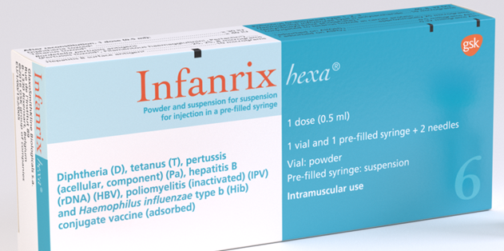
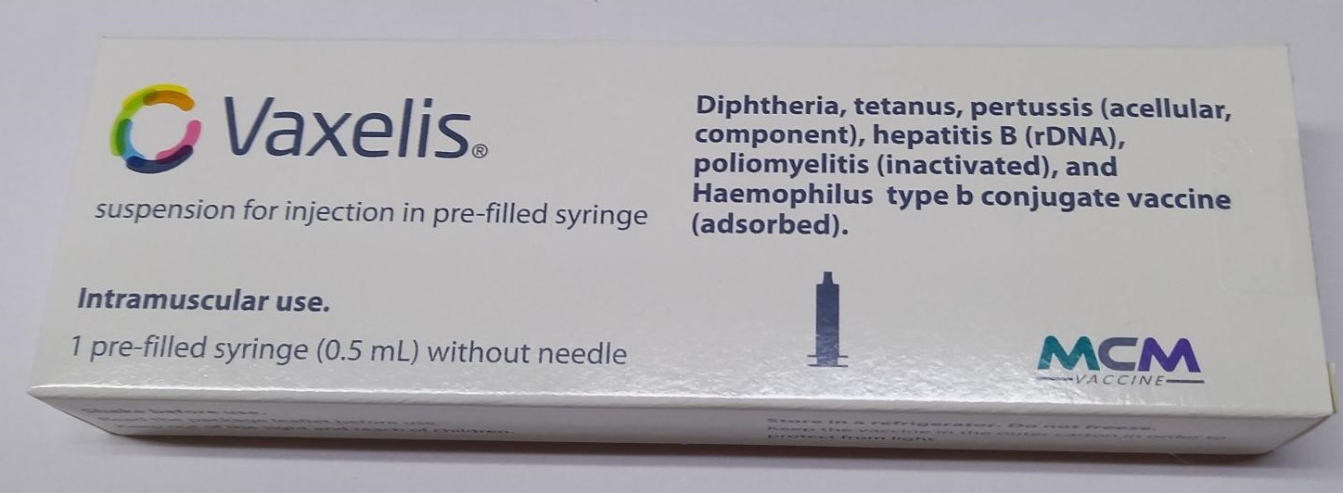
The hexavalent vaccines
Brand name : Infanrix hexa®
Brand name : Vaxelis ®
both vaccines are licensed for use from 6 weeks of age
routinely recommended for infants as part of the primary immunisation schedule at 8,12 and 16 weeks
Infanrix hexa® and Vaxelis® vaccines are considered interchangeable, but where possible and if local stock allows, it is preferable that the same DTaP/IPV/Hib/HepB vaccine be used for all 3 doses of the primary course
(however vaccination should never be delayed because the vaccine used for previous doses is not known or unavailable)

Slide 17
Who is eligible to receive the hexavalent vaccines?
all babies are eligible to receive hexavalent vaccine 8 weeks after their birth
Infanrix hexa® and Vaxelis ® can also be used for catch-up immunisation for children up to their 10th birthday where these children have missed out on doses of primary immunisations
both hexavalent vaccines are available to order online through the ImmForm website
both vaccines are distributed by Movianto UK for the use in the routine childhood immunisation schedule

Slide 18
Safety and efficacy of the hexavalent vaccines
The safety profile of both hexavalent vaccines is excellent and any adverse events experienced are generally mild to moderate in severity.
these may include: redness, swelling and tenderness at the injection site, fever, sleepiness, irritability, loss of appetite, diarrhoea and vomiting
Results from clinical trials show that nearly all infants given the 3 dose primary vaccination course of Infanrix hexa® at 2, 3 and 4 months of age develop protective levels of antibodies against diphtheria (100%), tetanus (100%), pertussis (100%), hepatitis B (99.5%), polio (99 to 100%) and Hib (96.4%)
Similar levels of protection are seen with Vaxelis ® where protective levels of antibodies against diphtheria (100%), tetanus (100%), pertussis (varies by component), hepatitis B (98%), polio (100%) and Hib (98%) were seen 1 month after completing the 3 dose primary vaccination schedule

Slide 19
Vaccine scheduling
the infant immunisation schedule remains unchanged at 8, 12 and 16 weeks of age
the first dose of the hexavalent vaccine can be given from 6 weeks if required in exceptional circumstances (for example travel to an endemic country) but not before
the minimum interval between doses of the hexavalent vaccine is 4 weeks
the hexavalent vaccines can be administered at the same time as, or at any time before or after, any other vaccine
if primary course is interrupted, resume but don’t repeat, allowing an interval of 4 weeks between the remaining doses
the hexavalent vaccines should be given to premature infants at the appropriate chronological age, according to the schedule
booster doses of hepatitis B will not usually be required for children vaccinated according to the routine childhood schedule

Slide 20
Contraindications
There are very few individuals who cannot receive the hexavalent vaccines.
Infanrix hexa® and Vaxelis ® should not be administered to those who have had :
a confirmed anaphylactic reaction to a previous dose of the vaccine OR
a confirmed anaphylactic reaction to any component of the vaccine (this includes formaldehyde, neomycin and polymyxin)
Where there is doubt, instead of withholding immunisation, appropriate advice should be sought from a member of the local Screening and Immunisation or Health Protection team

Slide 21
Precautions
if infant has a minor illness without fever or systemic upset, immunisations can still be given
if the infant is acutely unwell (for example fever above 38.5⁰C), immunisation may be postponed until they have fully recovered. This is to avoid wrongly attributing any new symptom or the progression of symptoms to the vaccine
the presence of a neurological condition is not a contraindication to immunisation but if evidence of current neurological deterioration, deferral of DTaP/IPV/Hib/HepB vaccination may be considered to avoid incorrect attribution of any change in the underlying condition
risk of deferral should be balanced against risk of infection and vaccination should be given promptly once diagnosis and/or expected course of the condition becomes clear

Slide 22
Premature infants
very premature infants (born ≤ 28 weeks of gestation) who are in hospital should have respiratory monitoring for 48 to 72 hrs when given their first immunisation, particularly those with a previous history of respiratory immaturity
if the premature infant has apnoea, bradycardia or desaturations after the first immunisation, the second immunisation should also be given in hospital, with respiratory monitoring for 48 to 72 hrs

Slide 23
Systemic and local reactions following a previous immunisation
Children who have had a systemic or local reaction following a previous immunisation with DTaP/IPV/Hib/HepB or DTaP/IPV/Hib including:
fever, irrespective of its severity
hypotonic-hyporesponsive episodes (HHE)
persistent crying or screaming for more than 3 hours, or
severe local reaction, irrespective of extent
can continue to receive subsequent doses of DTaP/IPV/Hib/HepB vaccine

Slide 24
Infanrix hexa® vaccine composition
After reconstitution, 1 dose (0.5 ml) contains:
Diphtheria toxoid
Tetanus toxoid
Bordetella pertussis antigens
Pertussis toxoid (PT)
Filamentous Haemagglutinin (FHA)
Pertactin (PRN)
Hepatitis B surface antigen (HBsAg)
Poliovirus (inactivated) (IPV)
type 1 (Mahoney strain)
type 2 (MEF-1 strain)
type 3 (Saukett strain)
Haemophilus influenzae type b polysaccharide (polyribosylribitol phosphate, PRP)
conjugated to tetanus toxoid as carrier protein
Adjuvants:
Aluminium hydroxide, hydrated (Al(OH)3)
Aluminium phosphate (AlPO4)
Excipients:
Lactose anhydrous
Sodium chloride (NaCl)
Medium 199 containing principally amino acids, mineral salts, vitamins
water for injections
The vaccine may contain traces of formaldehyde, neomycin and polymyxin which are used during the manufacturing process.

Slide 25
Vaxelis® vaccine composition
Pre-filled syringe, 1 dose (0.5 ml) contains:
Diphtheria toxoid
Tetanus toxoid
Bordetella pertussis antigens
Pertussis toxoid (PT)
Filamentous Haemagglutinin (FHA)
Pertactin (PRN)
Fimbriae Types 2 and 3 (FIM)
Hepatitis B surface antigen (HBs)
Poliovirus (inactivated) (IPV)
type 1 (Mahoney strain)
type 2 (MEF-1 strain)
type 3 (Saukett strain)
Haemophilus influenzae type b polysaccharide (polyribosylribitol phosphate, PRP)
conjugated to meningococcal protein
Adjuvants:
Amorphous aluminium hydroxyphosphate sulfate
Aluminium phosphate
The vaccine may contain traces of glutaraldehyde, formaldehyde, neomycin, streptomycin, polymyxin B, and bovine serum albumin which are used during the manufacturing process. Vaxelis® does not contain any thiomersal or porcine gelatine

Slide 26
How is Infanrix hexa® vaccine presented?
the DTaP/IPV/HepB component is presented as a cloudy white suspension in a pre-filled glass syringe. Upon storage, a clear liquid and a white deposit may be observed
the lyophilised (freeze dried) Hib vaccine is presented as a white powder in a glass vial
the vaccine is supplied in single dose packs containing the syringe, vial and 2 needles
the vaccine is reconstituted by adding the entire contents of the pre-filled syringe to the vial containing the powder.
the mixture should be well shaken until the powder is completely dissolved prior to administration
the reconstituted vaccine appears as a slightly cloudier suspension than the liquid component alone. This is a normal observation.
after reconstitution, it is recommended that the vaccine is used immediately
Full instructions for vaccine preparation are available in the SPC
Do not forget to reconstitute the Hib component

Slide 27
How is Vaxelis® vaccine presented?
the DTaP/IPV/HepB/Hib component is presented as a uniform, cloudy, white to off-white suspension in a pre-filled glass syringe
prior to administration, the pre-filled syringe should be shaken gently in order to obtain a homogeneous, whitish, cloudy suspension
the suspension should be visually inspected, prior to administration, for foreign particulate matter and or variation of physical appearance. If either is observed, discard the pre-filled syringe
Vaxelis does not require reconstitution – it is supplied ready to use
Full instructions for vaccine preparation are available in the SPC

Slide 28
Storage of the hexavalent vaccines
Infanrix hexa® and Vaxelis® should be stored between +2⁰C to +8⁰C
it must be stored in its original packaging to:
protect it from light
ensure the component parts are kept together
retain the batch number and expiry date for the entire product which is printed on the outer vaccine carton

Slide 29
Legal administration of the hexavalent vaccines
Infanrix hexa® and Vaxelis ® should only be supplied and administered:
against a prescription written manually or electronically by a registered medical practitioner or other authorised prescriber
against a Patient Specific Direction
against a Patient Group Direction
The patient group direction (PGD) template for the hexavalent vaccine is available on the UKHSA website.
Those using national immunisation PGDs developed by UKHSA must ensure that each PGD is organisationally authorised and signed in section 2 by an appropriate authorising person, in accordance with Human Medicines Regulations 2012 (HMR2012) . Without such authorisation, the PGD is not legal or valid.

Slide 30
Administration of the hexavalent vaccines
Infanrix hexa® and Vaxelis® should be administered intramuscularly
the preferred site of injection for infants under 1 year of age is the anterolateral aspect of the thigh
with the change to the infant PCV schedule meaning that only 2 injections need to be given at each primary vaccine appointment, 1 injection can be given into each thigh
should it be necessary to give more than 1 vaccine into the same limb, they should be given at least 2.5cm apart and the site at which each vaccine was given should be noted in the infant’s records

Slide 31
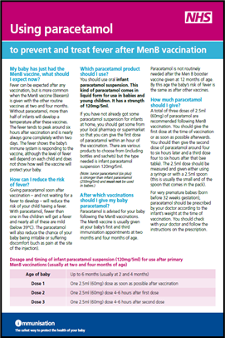
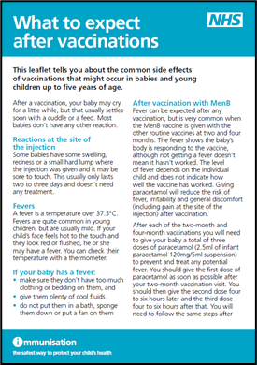
Post-immunisation care recommendations
when MenB is given alongside infant DTaP-containing combination vaccines, the rate of fever is higher than when either vaccine is administered alone
in the current UK schedule, infants receive MenB vaccine the same time as the DTaP/IPV/Hib/HepB vaccine at 8 and 16 weeks of age
it is recommended that prophylactic paracetamol is given soon after infants receive their vaccinations when MenB vaccine is given at the same appointment as the hexavalent vaccine
please see MenB vaccine and paracetamol information and What to expect after vaccinations leaflet on the GOV.UK Immunisation webpage for more information

Slide 32
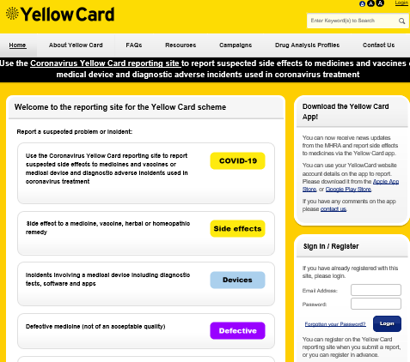
Possible adverse reactions
Most commonly reported (seen in more than 1 in 10 doses of the vaccine):
loss of appetite, fever (>38ºC), abnormal crying, irritability and restlessness
local swelling, pain and redness at the injection site
hypersensitivity reactions such as angioedema, urticaria and anaphylaxis can occur but are rare, as can convulsions (with or without fever) and hypotonic-hyporesponsive episodes (also rare)
suspected adverse reactions should be reported to the MHRA using the Yellow Card reporting scheme at: https://yellowcard.mhra.gov.uk/

Slide 33
Routine monitoring of vaccine coverage
Hexavalent vaccine coverage will be monitored routinely through the COVER programme alongside all other childhood immunisations COVER data is extracted from Child Health Information Systems (CHIS) at the local authority level and published quarterly as official statistics
Routine childhood programme COVER data:
percentage of eligible children in the local authority who have completed a primary course (3 doses), anytime up to the 1st, 2nd and 5th birthday
Selective ‘at-risk’ infants programme COVER data:
percentage of eligible children in the local authority who have received 5 doses of HepB-containing vaccine* anytime up to the 1st birthday
percentage of eligible children in the local authority who have received 6 doses of HepB-containing vaccine** anytime up to the 2nd birthday
*2 monovalent and 3 Infanrix hexa®/Vaxelis ®
**3 monovalent and 3 Infanrix hexa®/Vaxelis ®

Slide 34
Local monitoring of vaccine coverage data
Hexavalent and monovalent HepB vaccine coverage will also be monitored via ImmForm
aggregated GP-level data will be extracted to monitor dose specific coverage at an earlier age than the routine COVER programme
this data is for local performance management purposes only and will not be published
Routine childhood programme ImmForm GP data:
Hexavalent vaccine coverage for 1, 2 and 3 doses evaluated at 6 months of age
(percentage of eligible individuals registered with a GP who have received 0, 1, 2 and 3 doses of hexavalent vaccine)
Selective ‘at-risk’ infants programme ImmForm GP data:
HepB vaccine coverage for 1, 2 and 3 doses at 4 months of age
(percentage of eligible individuals registered with a GP who have received 0, 1, 2 and 3 doses of HepB-containing vaccine)
and
percentage who were tested for HBsAg at 18 months

Slide 35
Neonatal selective immunisation programme for babies at risk of hepatitis B

Slide 36
Implications for babies at high risk of hepatitis B infection
babies born to mothers chronically infected with HBV or who have had acute hepatitis B during pregnancy are at risk of becoming infected with HBV
objective of the selective neonatal hepatitis B immunisation programme is to provide post exposure immunisation to infants born to HBV infected mothers to prevent mother to child transmission at or around the time of birth
although hepatitis B vaccine is now included in the routine infant schedule, the maternal hepatitis B screening programme will continue:
as it remains essential to identify unborn babies at risk of infection
so that high risk infants receive a dose of HepB vaccine at birth followed by a dose at 4 weeks of age in addition to the doses given at 8,12 and 16 weeks as part of the routine infant schedule

Slide 37
Why is the selective neonatal immunisation programme continuing if all infants will receive hepatitis B vaccine?
HBV infection can be transmitted from infected mothers to their babies at or around the time of birth as infected blood from the mother passes through placenta to baby during delivery
babies acquiring infection at this time have a high risk of becoming chronically infected with the virus
over 90% of chronic infection in infants born to infected mothers after perinatal transmission can be prevented by appropriate post-exposure prophylactic vaccination starting at birth
timely vaccination at birth and at 4 weeks of age is critical to preventing infant infection
the dose that is given to all babies at 8 weeks of age (as part of the universal programme) would be too late to prevent infection in those high risk babies who are exposed at or around birth

Slide 38
Hepatitis B vaccine schedule for routine and at risk infant immunisation programmes
*Babies born to HepB negative mothers but going home to a household with another hepatitis B infected person may be at immediate risk of hepatitis B infection so should be given a monovalent dose of hepatitis B vaccine before discharge from hospital.

Slide 39
Blood tests for high risk infants
although hepatitis B vaccine is highly effective at preventing infection if given at birth, a very small number of infants may still acquire infection despite vaccination and immunoglobulin
testing high risk infants at 12 months of age is important to enable timely assessment of their infection status
finding out if infant is infected at this point can reduce risk of long term complications and disease in later life
the purpose of the 12 month blood test is to check for infection, not to check or measure response to the vaccine
numerous studies have already demonstrated that infants make a protective response to a course of hepatitis B given in the first year of life
more information on blood testing available at: www.gov.uk/guidance/hepatitis-b-dried-blood-spot-dbs-testing-for-infants

Slide 40
Booster doses for high risk infants
12 month hepatitis B booster:
a further dose of monovalent HepB vaccine should be given at 1 year of age, alongside a test for hepatitis B surface antigen (HBsAg)
testing at 1 year of age important to identify babies who have become chronically infected with hepatitis B despite vaccination
Pre-school hepatitis B booster:
increasing evidence that protection is long-lasting and benefits of booster doses therefore limited
a further dose of hepatitis B-containing vaccine at 3 years and 4 months is no longer recommended for those children who have completed their routine primary immunisations with hexavalent DTaP/IPV/Hib/HepB vaccine
pre-school booster vaccine appointment provides an opportunity to check high risk child has been appropriately managed that is is fully immunised against hepatitis B and tested for infection

Slide 41
Sources of information

Slide 42
Resources available
further information for healthcare practitioners about the hexavalent DTaP/IPV/Hib/HepB combination vaccine which includes the routine and selective infant immunisation schedule is available XXX
Hepatitis B Green Book chapter 18
Patient Group Direction (PGD) template for the hexavalent vaccines
Summary of Product Characteristics for Infanrix hexa®
Summary of Product Characteristics for Vaxelis ®
immunisation information for healthcare practitioners
guidance on the hepatitis B antenatal screening and selective neonatal immunisation pathway

