Slide 1
Excess Winter Deaths and the winter of 2017/18 Information for Local Authorities
PHE Extreme Events and Health Protection

Slide 2
Aims of this slide pack
This slide pack is intended for local authority (LA) staff, primarily those working in public health.
The aims of this slide pack are :
to raise awareness of the health impacts of cold weather
to be a resource which can be utilised to engage with stakeholders
to aid in planning and decision-making for the forthcoming winter.
The slides give an overview of the evidence base, epidemiology of excess winter deaths and recommendations for action, with particular reference to the winter of 2017/18. Links to additional information and resources are also provided.
We would encourage users to combine the information presented here with local data which can be accessed using the links in slides 22 and 23.

Slide 3
Contents
Background (slides 4-9)
Health impacts of cold weather
Who is affected
Data for the winter of 2017/18 (slides 10-18)
Overview of the winter of 2017/18
Excess winter deaths in the winter of 2017/18
When did the deaths occur
Who was affected
What were the causes of death
Which regions were affected
Implications (slides 19-23)
Preventing Excess Winter Deaths (EWD)
What does this means for the NHS?
Media messages and useful resources

Slide 4
Deaths over the year
More people die in the winter than in the summer
Deaths tends to peak in January, commonly the coldest month of the year in England and Wales

Slide 5
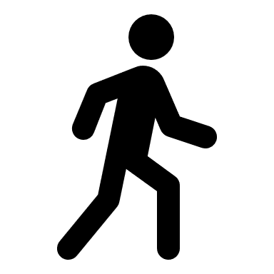
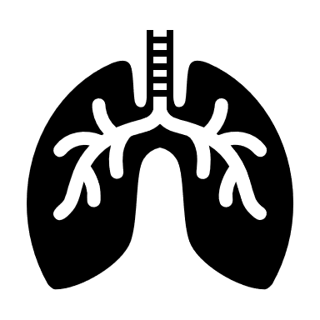
How does cold weather impact health – physiology?
The human body responds in several different ways to exposure to cold weather, even at temperatures which might be considered relatively mild (see Slide 7) .
Exposure to cold temperatures has a range of physiological effects including:
increased blood pressure
increased risk of clotting
suppression of the immune system
diminished capacity of the lungs to fight off infection
increased airway constriction and mucus production in the lungs²

Slide 6
How does cold weather impact health – morbidity and mortality?
Although exposure to extreme cold can kill directly through hypothermia, this is not the main cause of cold related illness and death².
The health impacts of cold weather can have direct and indirect effects
Direct health effects | Indirect health effects
heart attack | mental health effects from depression
stroke
respiratory disease | reduced educational and employment attainment
influenza
falls and injuries | risk of carbon monoxide poisoning
hypothermia

Slide 7
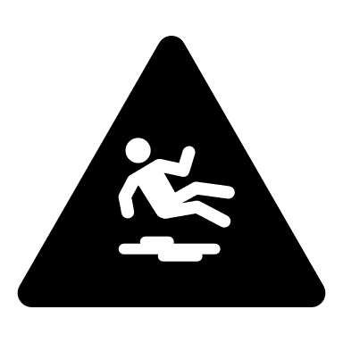
What happens during cold weather?
Deaths caused by cardiovascular conditions peak first followed by stroke and then respiratory.
Reference: 2009 Annual Report of the Chief Medical Officer. Original source: Donaldson GC, Keatinge WR. Early increases in ischaemic heart disease mortality dissociated from and later changes associated with respiratory mortality after cold weather in south east England. J Epidemiol Community Health. 1997 Dec;51(6):643-8.
Snow and ice also cause:
disruption to service provision
reduction in access to essential services
increase in the risk of falls and injuries

Slide 8
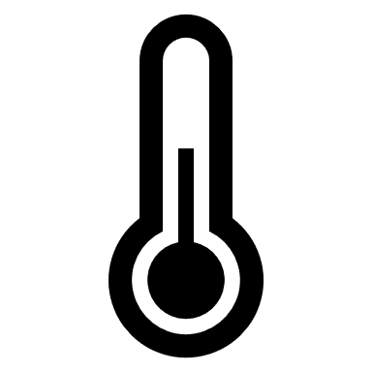
Which temperatures have an impact?
The health impacts of cold weather can be seen even at temperatures which might be considered relatively mild
Although the risk of death increases as temperatures fall, the higher frequency of days at moderate temperatures in an average winter means the greatest health burden in absolute numbers of deaths, occurs at more moderate temperatures²
Temperature | Health Impacts
18ºC | minimal risks to health for a sedentary person wearing suitable clothing
Under 18ºC | may increase blood pressure and risk of cardiovascular disease
Under 16ºC | may diminish resistance to respiratory diseases
4 – 8ºC | increased risk of death observed at population level
At or below 5ºC | high risk of hypothermia

Slide 9
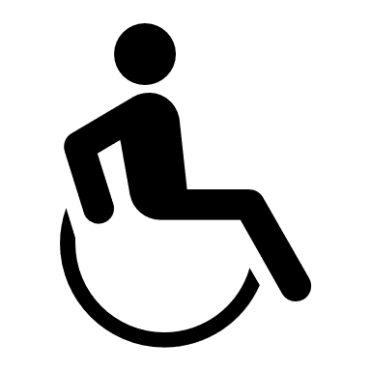
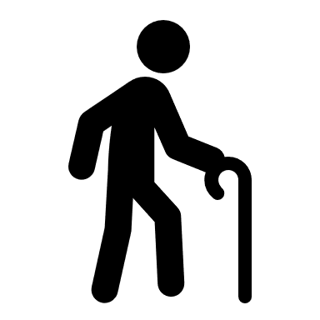
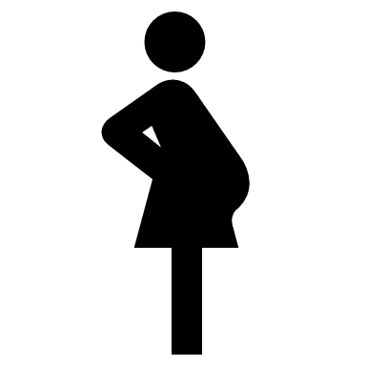
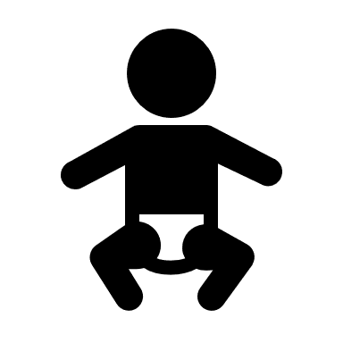
Who is affected?
EWDs are seen throughout England – all regions are affected
Whilst the burden of EWDs is primarily seen in older age groups, EWDs are seen in all age groups
EWDs represent an important health inequality – people who experience greater socioeconomic deprivation are more likely to be affected
There are a number of factors which contribute to EWDs:
Household income
Seasonal factors: weather, flu
Housing and economic factors
Attitudes to cold and associated behaviours
Individual vulnerability to health effects of cold
Cost of fuel
Energy efficiency of the home

Slide 10
Measuring winter deaths
Measure | Description | Main advantages and disadvantages
Counts | Simple counts of deaths by day, week, or month over the year | Good for looking at specific cold spells Doesn’t provide any measure of the impact of winter overall Doesn’t allow direct comparisons i.e. not standardised across different populations
Excess Winter Deaths (EWD) | Compares the number of deaths which occur during the ‘winter months’ in any given year with the ‘non-winter months’. Winter months are classified as November to March. EWD = winter deaths - average non-winter deaths | Provides an estimate of the overall impact of winter on number of deaths in a given year Doesn’t provide detail of when the deaths occurred during the winter (i.e. impact of specific cold spells like Beast from the East). Doesn’t allow for the impact of cold weather outside of the ‘winter months’ Doesn’t allow direct comparisons i.e. not standardised across different populations
Excess winter mortality (EWM) index | Similar to EWD but provides a measure of EWD relative to non-winter deaths in a particular population. EWM index = (EWD / average non-winter deaths) x 100 | Allows for crude comparison between groups with difference population sizes for example different sexes, age groups, and regions Not as easy to interpret as EWD
Further information on measures of winter deaths is provided in the ONS report – see references and useful documents section

Slide 11
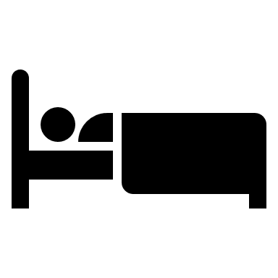
Why are we focusing on the winter of 2017/18?
It is the latest year for which we have comprehensive data and, the winter of 2017/18 had a significant impact on health due to both very cold temperatures and circulating flu.
The cold
The average winter temperature for 2017/18 was the coldest in 5 years
A particularly cold spell occurred in late February 2018 – ‘the Beast from the East’
The flu
Although uptake of the influenza vaccine was higher compared with 2016/17, overall the vaccine was less effective in those aged 65 years and over (10.1% effective) compared to younger age groups
Co-circulation of influenza A (H3N2) and influenza B was observed impacting predominantly older adults with increased care home outbreaks

Slide 12
How many EWDs were there during the 2017/18 winter?
In the 2017/18 winter period, there were an estimated 50,100 excess winter deaths (EWD) in England and Wales
This compares to an average of around 30,300 EWDs annually over the past 5 years
The number of EWDs in 2017/18 was the highest recorded since the winter of 1975/76

Slide 13
When did the deaths occur and how is this different from previous years?
The usual peak in number of deaths was seen in December and January, although this was higher in 2017/18 than the average for the previous 5 years
An additional peak in number of deaths was seen in late February/early March, coinciding with very cold weather caused by the Beast from the East
Grey shaded area corresponds to the ‘winter months’

Slide 14
Who was most affected by the 2017/18 winter?
The majority of EWDs occurred in the older age groups (80% were in those aged 75+) with females aged 85+ years being most affected
Note: due to differences in life-expectancy, there are more women aged 85+ than men. Therefore Excess Winter Mortality (EWM) index provides a better comparison of relative impact between male/female and age groups (right-hand figure)

Slide 15
How is this different from previous years?
EWM index was higher in 2017/18 than the five-year average EWM index for all age groups, for both men and women, indicating that the impact of winter in 2017/18 was greater than in recent years
EWM index in 2017/18 for males aged 0-64 years was more than double the five-year average

Slide 16
What were the causes of EWD in 2017/18?
The majority of EWDs were caused by either circulatory diseases, respiratory diseases, or dementia and Alzheimer’s disease
Over one third of deaths were caused by respiratory disease (accounting for 17,400 EWDs in 2017/18)

Slide 17
How is this different from previous years?
EWM index was higher for the winter of 2017/18 than the 5 year average for all the 3 major underlying causes of death
The biggest increase in EWM index was seen for deaths from respiratory diseases

Slide 18
Which regions were most affected?
Overall, the EWM index for all English regions has increased for 2 consecutive periods (between 2015 to 2016, and 2017 to 2018)
In England, the North East experienced the highest EWM index in 2017/18, with East of England, the North West, and West Midlands, also experienced a higher EWM index than the rest of the country
However, the EWM index is a crude indicator so direct comparison between years or across regions should be done with caution
EWM index for regions of England and in Wales, between 2015 to 2016 and 2017 to 2018
Reference: Office for National Statistics. Excess winter mortality in England and Wales: 2017 to 2018 (provisional) and 2016 to 17 (final). Available at: https://www.ons.gov.uk/peoplepopulationandcommunity/birthsdeathsandmarriages/deaths/bulletins/excesswintermortalityinenglandandwales/2017to2018provisionaland2016to2017final

Slide 19
Preventing EWDs
The NICE guidelines (NG6) for reducing the risk of death and ill health associated with living in a cold home aims to improve the health and wellbeing of people vulnerable to the cold, further detail is provided on the next slide.
The Cold Weather Plan for England recommends a series of steps to reduce the risks to health from cold weather for:
the NHS, Local Authorities, social care, and other public agencies
professionals working with people at risk
individuals, local communities and voluntary groups
Near real-time data is also produced throughout the year to support planning and prevention of EWDs. Links to these are provided in Appendix 1 (Slide 21).

Slide 20
What can LAs do?
The health consequences of living in a cold home should be included in the JSNA process
A summary of the recommendations from the NICE guidance is outlined here. For further information see NICE guidance NG6
Reducing EWDs
Identify people at risk
Make Every Contact Count
Discharge vulnerable people from care settings to a warm home
Raise awareness about how to keep warm at home
Train people to help individuals whose homes may be too cold
Provide a single-point-of-contact for help
Develop a strategy
Ensure buildings meet standards
Requires collaboration of primary health and home care practitioners, and relevant LA departments
Where professionals and public can go to get more information and support
Social care practitioners
Housing professionals
Faith and voluntary sector workers
Heating engineers, meter installers and those providing building insulation
Health and home care practitioners, and non-health and social care workers should assess the heating needs of people who use their services

Slide 21
Key public health messages for the public and media this winter
Below are some lines which can be used when dealing with media and other enquiries this winter:
Severe cold weather can be dangerous, especially for the very young or very old or those with chronic disease.
Advice on how to reduce the risk either for yourself or somebody you know can be obtained from the winter health pages at NHS.uk (www.nhs.uk) or from your local chemist.
If you are worried about your health or that of somebody you know, ring NHS 111.
Make sure that you stay warm. If going outside make sure you dress appropriately.
If indoors, make sure that you keep your heating to the right temperature; heating your home to at least 18ºC in winter poses minimal risk to your health when you are wearing suitable clothing.
If there is anyone you know who might be at special risk, for example, an older person living on their own, make sure they know what to do to stay warm and are well stocked with food and medications.

Slide 22
Appendix 1: Available data
PHE Real Time Syndromic Surveillance coordinates several national syndromic systems and provides information on weekly trends in diseases and healthcare usage, including:
NHS 111 enquiries
GP in-hours and out-of-hours consultations
emergency department attendances
ambulance call-outs
Available at: https://www.gov.uk/government/publications/syndromic-surveillance-weekly-summaries-for-2019
The Weekly National Flu Reports provide national-level data on consultations for influenza-like-illness, reported outbreaks, and laboratory reports of influenza (produced weekly during flu season)
Available at: https://www.gov.uk/government/collections/weekly-national-flu-reports#2018-to-2019-season
Weekly Infectious Intestinal Disease Activity bulletins provide regional-level data on consultation for gastroenteritis, reported outbreaks, and laboratory reports for viral and bacterial gastroenteritis. These are available by contacting your local PHE Health Protection Team.

Slide 23
Appendix 2: References and useful documents
Office for National Statistics report: Excess winter mortality in England and Wales: 2017 to 2018 (provisional) and 2016 to 2017 (final) https://www.ons.gov.uk/peoplepopulationandcommunity/birthsdeathsandmarriages/deaths/bulletins/excesswintermortalityinenglandandwales/2017to2018provisionaland2016to2017final
PHE Cold Weather Plan for England (https://www.gov.uk/government/collections/cold-weather-plan-for-england)
NICE Guidelines (NG6): Excess winter deaths and illness and the health risks associated with cold homes https://www.nice.org.uk/guidance/ng6
PHE Fingertips https://fingertips.phe.org.uk/
PHE Local Health http://www.localhealth.org.uk/#l=en;v=map15
PHE Homes for health https://www.gov.uk/government/collections/housing-for-health
Help from your energy supplier: the Affordable Warmth Obligation https://www.gov.uk/energy-company-obligation
Affordable warmth grants http://www.affordablewarmthgrants.co.uk/
NEA Action for Warm Homes https://www.nea.org.uk/

