Slide 1
TB in inclusion health groups in England, 2021: supplementary analysis
TB Unit
UK Health Security Agency, London UK.
UK Health Security Agency: TB in England, 2021, TB in Inclusion Health Groups slide set (Version 1.0, published January 2024)

Slide 2
Table of contents
Section | Title or description | Slide numbers
Glossary | Acronym definitions | 3
Notes | Notes on using data slides | 4 and 5
Section 1 | How common are social risk factors in people notified with TB? | 6 to 11
Section 2 | How do social risk factors overlap in people notified with TB? | 12 to 18
Section 3 | TB is associated with deprivation and social risk factors | 19 and 20
Section 4 | What socio-demographic characteristics are associated with SRFs in people notified with TB? | 21 to 30
Section 5 | How do social risk factors affect risk of infectious or drug resistant TB, co-morbidities and adverse TB treatment outcomes in people notified with TB? | 31 to 39
Section 6 | TB notification rates in those with Social risk factors | 40 and 41
Section 7 | Definitions of Social Risk Factors | 42 and 43
Further information | Contact details for further information | 44

Slide 3
Glossary
ICHs: Inclusion Health Groups
NTBS: National TB surveillance system
RR: Relative Risk. This is defined as the proportion of the outcome of interest (for example, pulmonary TB) in the exposed group (for example, those with a SRF) divided by the proportion of the outcome of interest in the non-exposed group (for example, those without an SRF). Please see the TB incidence and epidemiology in England, 2021 for more a more detailed explanation.
SRFs: Social Risk Factors. SRFs are recorded in NTBS and are characteristics and behaviours that have been frequently associated with an increased risk of developing active TB and of poorer TB treatment outcomes. These broadly overlap with many inclusion health groups and include alcohol and drug misuse, homelessness, history of imprisonment and asylum seekers. In addition, NTBS collects mental health as another
TB: Tuberculosis
USP: Under served populations

Slide 4
Notes on using data slides - 1
Purpose
These slides include graphs and figures of TB in people with social risk factors published in the ‘Tuberculosis prevention in England, 2021’ report (data up until the end of 2021) plus further data summaries and extended analyses. Social risk factors broadly overlap with inclusion health group definitions and specifically within those considered within the Tackling TB in Inclusion Health Groups: A toolkit for a multi-agency approach. These slides are intended to inform and supplement the above toolkit.
Data sources
TB notifications to the National TB Surveillance System (NTBS). Please see the methodology and definitions section of the ‘TB incidence and epidemiology in England, 2021’ report (data up to end of 2021) document for more detailed information.
Publicly available data sets on numbers of people in inclusion health groups in England – please see the detailed methodology and data sources document. Rates of TB in Inclusion Health Groups should be interpreted with caution due to the limitations of currently available suitable denominator population data and missing data in NTBS for some SRFS.
Social risk factors (SRFS) reported here are limited to people aged 15 years or more at notification and include:
Current alcohol misuse
history of drug misuse
history of homelessness
history of imprisonment
Currently seeking asylum status
Currently experiencing adverse mental health
SRFs reported as a history of are additionally asked for the time-frame as: current, within the past 5 years or more than 5 years ago

Slide 5
Notes on using data slides - 2
Ethnicity is self reported and recorded by TB case managers from a drop down list. For analytical purposes here these are further grouped into 4 categories of White, Black, South Asian and other/mixed. South Asian includes Indian Pakistani or Bangladeshi. Black includes Black African, Black Caribbean and any other Black background.
Data completeness
Prevalence of social risk factors (SRFs) are reported here for 2018 onwards when recording of SRFs beyond, drugs, alcohol, prison and homelessness began.
Systematic recording across regions and data collection systems improved since 2019 and since 2021 with the introduction of NTBS. Hence risk analyses are presented for the period of 2019 to 2021 combined. Where significant numbers of notifications have missing data, these are clearly indicated and raw data underlying risk ratio figures are available in the supplementary data sets.
Data are suppressed where there are less than 5 notifications in a group.
Analytical methods
Please see the detailed document.

Slide 6
Section 1: How common are social risk factors in people notified with TB? England, 2018 to 2022
TB Unit
UK Health Security Agency, London UK.

Slide 7
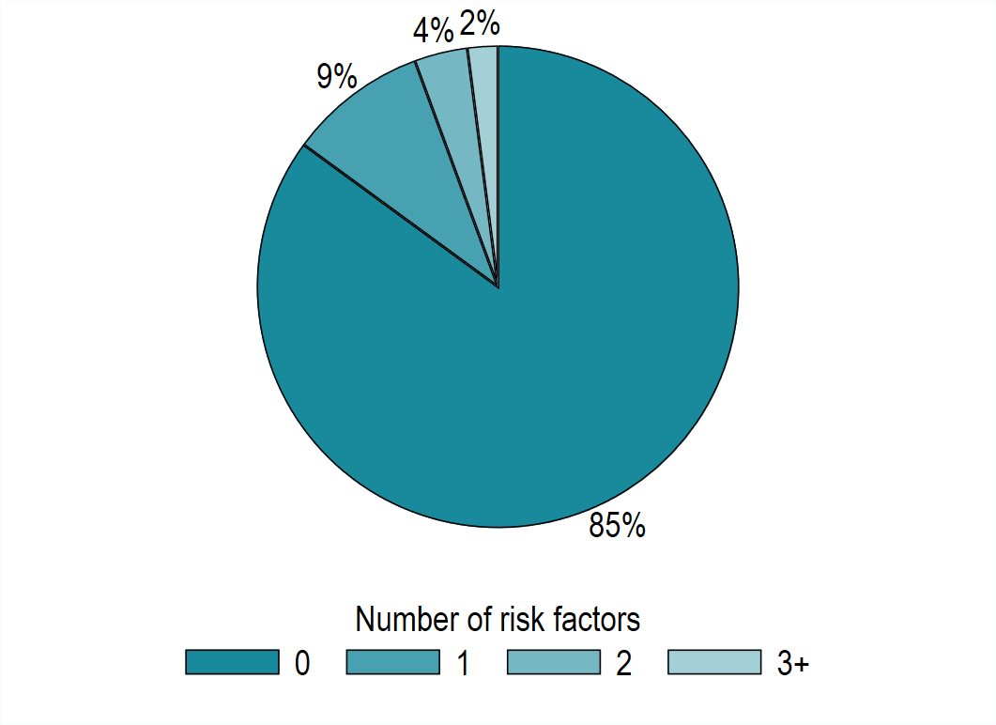
Prevalence of one or more social risk factors in people aged 15 years or more notified with TB in England, 2021
In 2021,14.5% from (622 of 4,296) people over 15 years old had at least one social risk factor
In 2021, 5.6% from (234 of 3,392) people over 15 years old had 2 or more social risk factors¹
Footnote 1: limited to notifications with values recorded for at least 2 SRFs
UK Health Security Agency: TB in England, 2021, TB in Inclusion Health Groups slide set (Version 1.0, published January 2024)

Slide 8
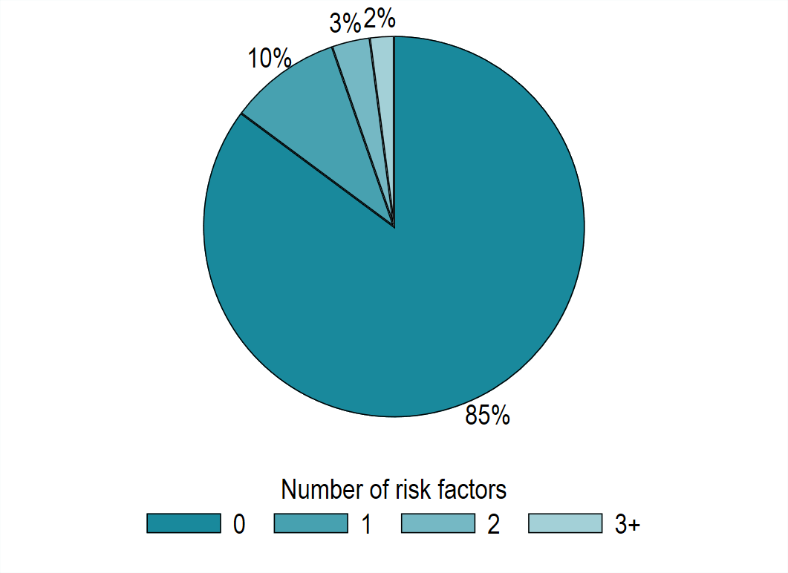
Prevalence of social risk factors in people aged 15 years or more notified with TB in England, 2018 to 2021
The prevalence of at least 1 and 2 or more social risk factors was unchanged between 2021 and 2018 to 2021.
In 2018 to 2021, 14.5% (2,498 of 17,269) had at least one social risk factor.
From 2018 to 2021, 5.3% (890 of 15,971) had 2 or more social risk factors^{1.}
Footnote 1: limited to notifications with values recorded for at least 2 SRFs.

Slide 9
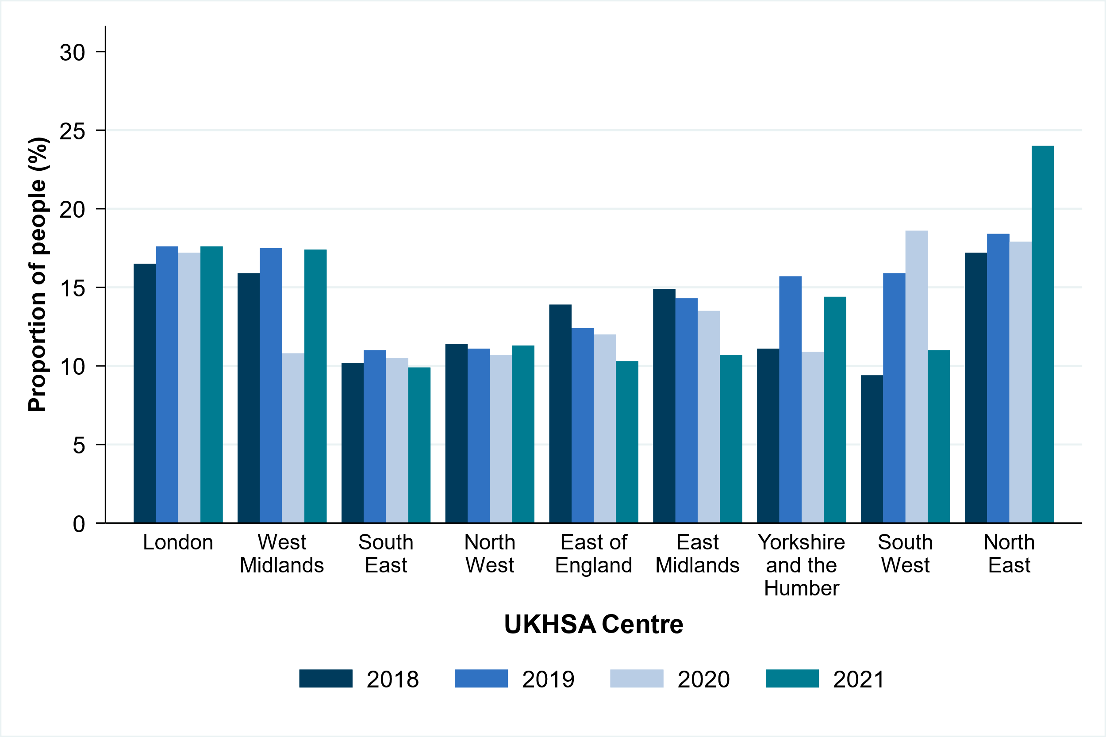
Proportion of people aged 15 years or more with at least one social risk factor by UKHSA Region, England, 2018 to 2021
Numbers are available in Supplementary Table 16 of TB Incidence and Epidemiology Supplementary Dataset 2022.

Slide 10
Number and proportion of people with TB with at least one social risk factor by local authority, England, 2018 to 2021 (box shows enlarged map of London area)

Slide 11
Proportion of people notified with TB with each social risk factor, England, 2019 to 2021
Social risk factor | Number and percentage (%) of total with data | Total with data reported | Number and proportion of missing data (%) all data
Drug misuse (current or previous) | 607 (5.1%) | 11,978 | 828 (6.5%)
Alcohol misuse (current) | 537 (4.5%) | 12,019 | 787 (6.2%)
Homelessness (current or previous) | 614 (5.1%) | 12,005 | 801 (6.3%)
Prison (current or previous) | 506 (4.3%) | 11,677 | 1,129 (8.8%)
Asylum seeker (current) | 251 (5.5%) | 4,556 | 8,250 (64.4%)
Mental health needs (current) | 347 (6.2%) | 5,605 | 7,201 (56.2%)
Two or more SRFs | 651 (5.2%) | 12,486 | 320 (2.5%)
Note that all data represents the total number of notifications between 2019 and 2021 is 12,806.

Slide 12
Section 2: How do social risk factors overlap in people notified with TB? England, 2018 to 2022
TB Unit
UK Health Security Agency, London UK.

Slide 13
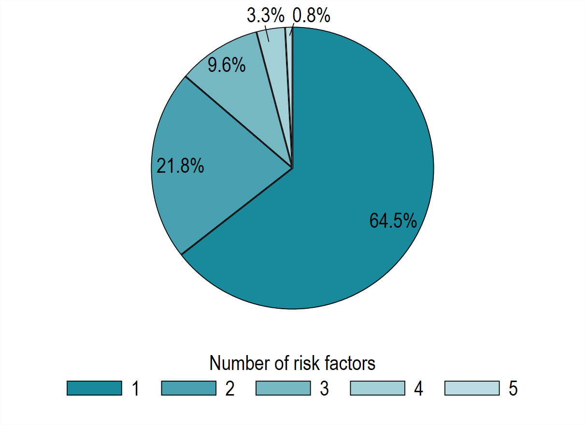
Number of social risk factors in people notified with TB, England, 2018 to 2021 (in those with at least one SRF)
The majority (65%) of 2,498 people with at least one SRF had only one SRF recorded.
22% of people with at least one SRF had 2 recorded.
Note: one person had 6 risk factors (0.04%) not shown on pie chart.

Slide 14
Proportions of SRFs in 1,612 people notified with TB with a single SRF, England, 2018 to 2021

Slide 15
Section 3: TB is associated with deprivation and social risk factors England, 2021
TB Unit
UK Health Security Agency, London UK.

Slide 16
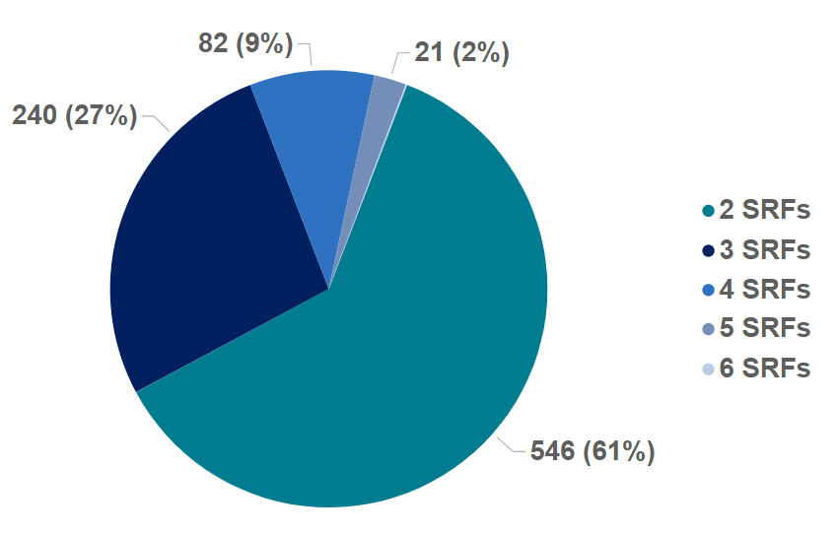
No of social risk factors in 890 people with at least 2 SRFs notified with TB, England, 2018 to 2021

Slide 17
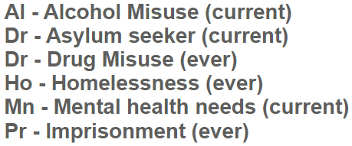
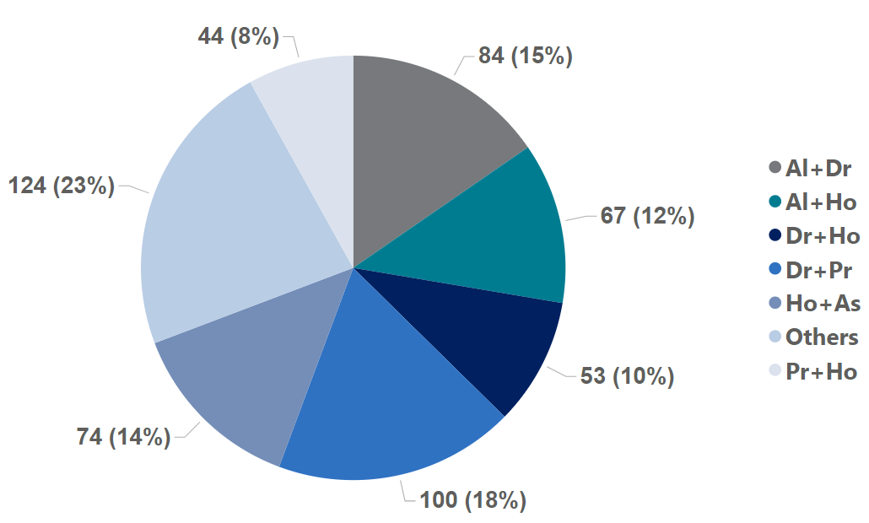
Combinations of SRFS in 546 people notified with TB with 2 SRFs, England, 2018 to 2021
The most common combination for those with 2 SRFs was history of drug misuse and imprisonment.

Slide 18
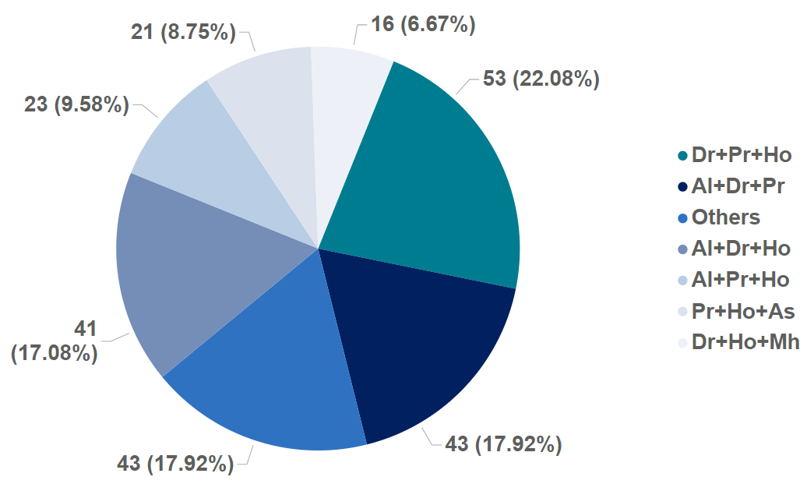
Combinations of SRFS in 240 people notified with TB with 3 SRFs, England, 2018 to 2021
The most common combination for those with 3 SRFs was history of drug misuse, imprisonment and homelessness.

Slide 19
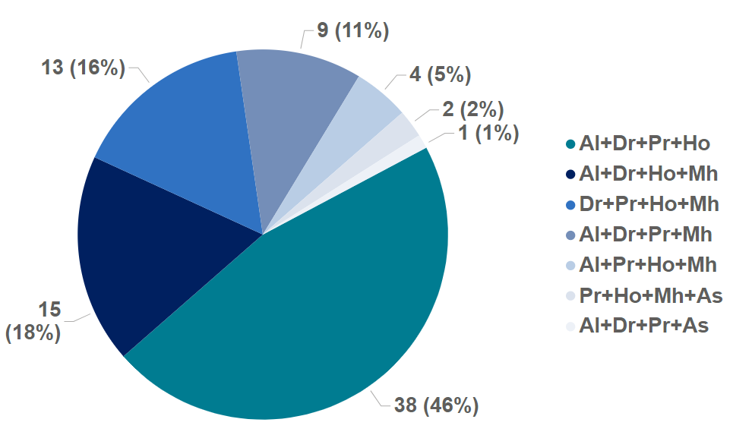
Combinations of SRFS in 82 people notified with TB with 4 SRFs, England, 2018 to 2021
The most common combination for those with 4 SRFs was history of drug misuse, imprisonment, homelessness and alcohol misuse.

Slide 20
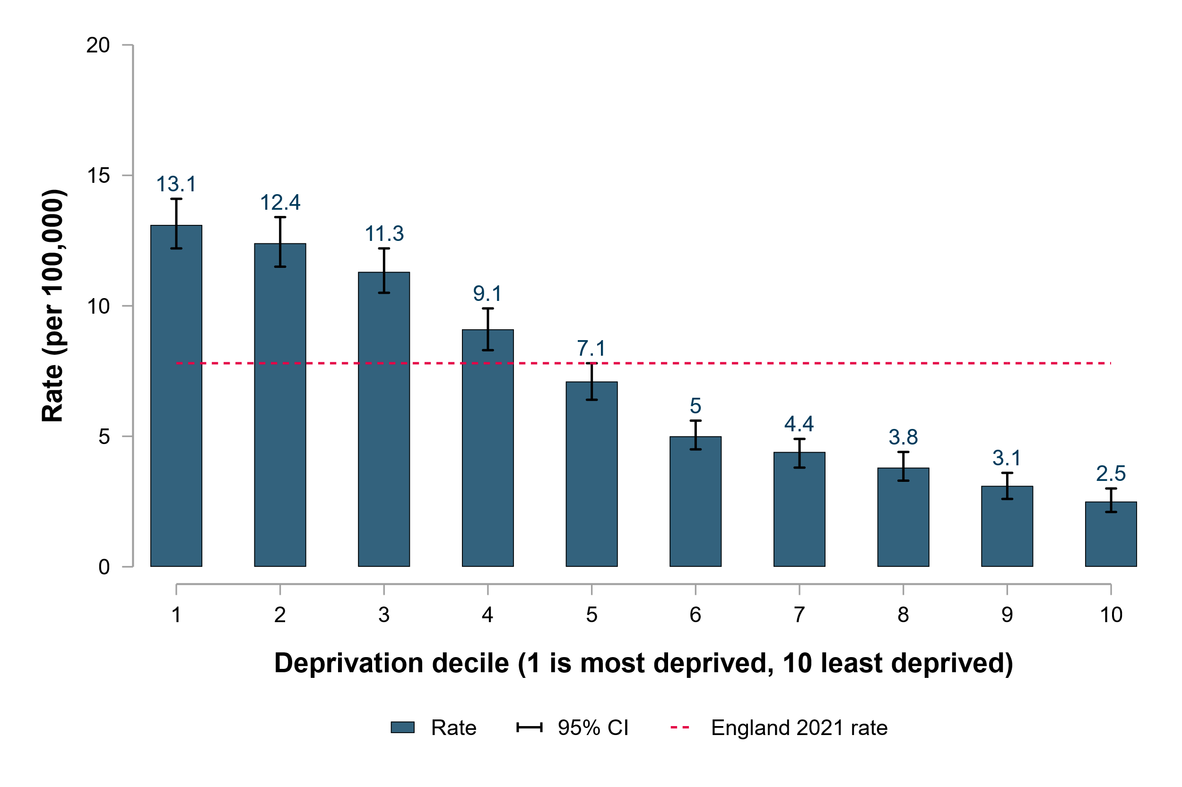
TB notification rate by deprivation decile, England, 2021
Proportion (%) with at least one social risk factor
Proportion of people with at least one SRF is 2 times higher in people in the most deprived compared with the least deprived.
17
19
17
14
10
12
10
5
10
8
UK Health Security Agency: TB in England, 2021, TB in Inclusion Health Groups slide set (Version 1.0, published January 2024)

Slide 21
Section 4: What socio-demographic characteristics are associated with SRFs in people notified with TB? England 2019 to 2021
TB Unit
UK Health Security Agency, London UK.

Slide 22
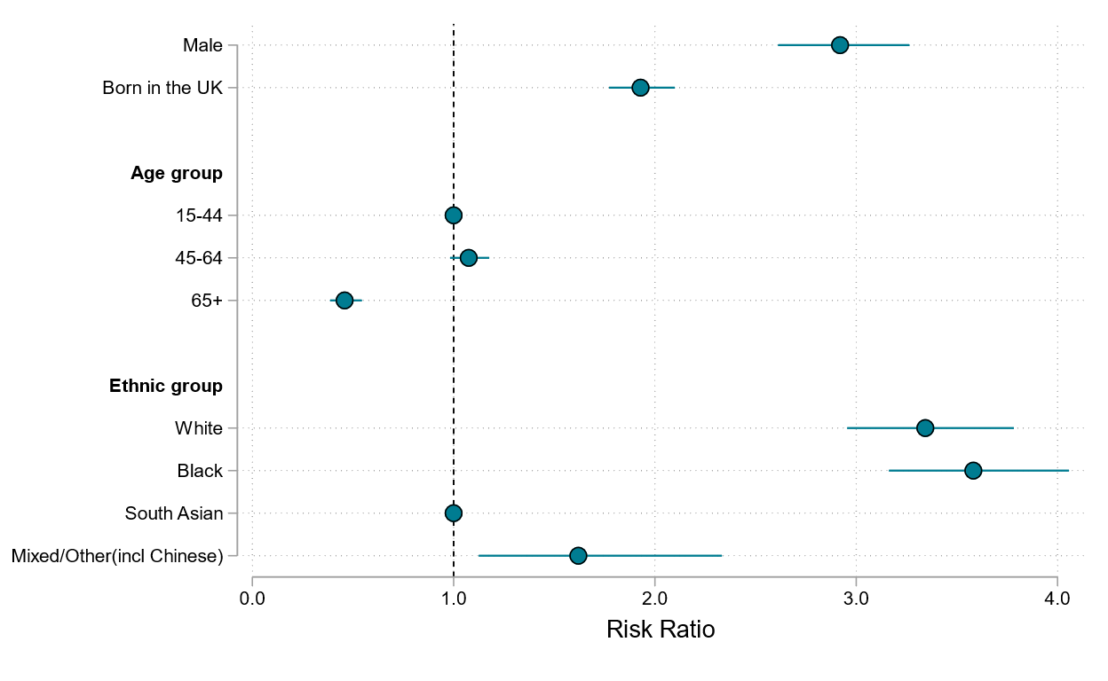
Demographic risk factors for at least one SRF in people notified with TB, England, 2019 to 2021 combined
Males compared with females are approximately 3 times more likely to have one or more social risk factors.
People born in the UK are approximately 2 times more likely to have one or more social risk factors compared with those not born in the UK.
White and black ethnicities are between 3 and 4 times more likely to have one or more social risk factors compared with South Asian ethnicity.
Please see Table 1 of the supplementary data set for the data underlying this analysis.
UK Health Security Agency: TB in England, 2021, TB in Inclusion Health Groups slide set (Version 1.0, published January 2024)

Slide 23
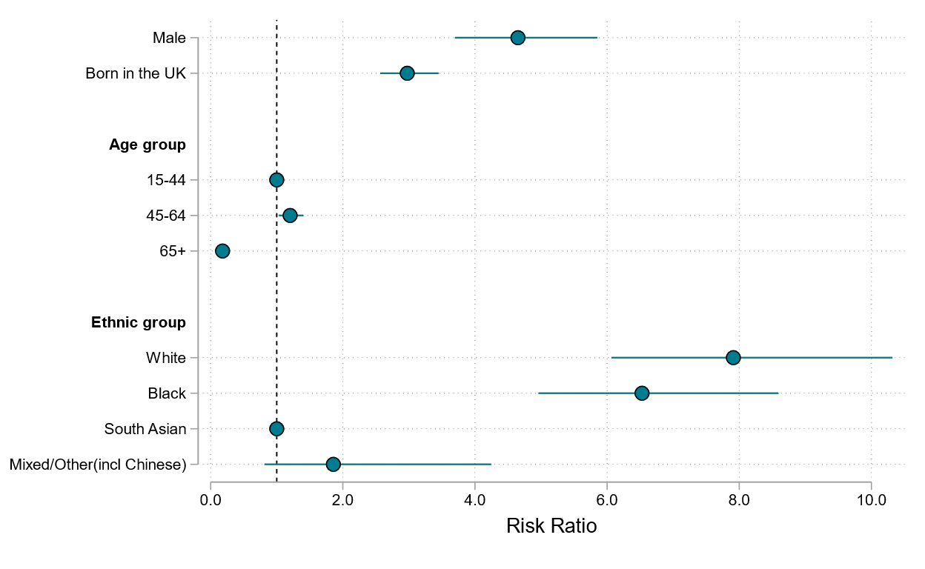
Demographic risk factors for at least 2 SRF in people notified with TB, England, 2019 to 2021 combined
Males compared with females are approximately 5 times more likely to have at least 2 social risk factors.
People born in the UK are approximately 3 times more likely to have at least 2 social risk factors compared with those not born in the UK.
White and Black ethnicities are between 6.5 and 8 times more likely to have at least 2 social risk factors compared with South Asian ethnicities.
Please see Table 2 of the supplementary data set for the data underlying this analysis.
UK Health Security Agency: TB in England, 2021, TB in Inclusion Health Groups slide set (Version 1.0, published January 2024)

Slide 24
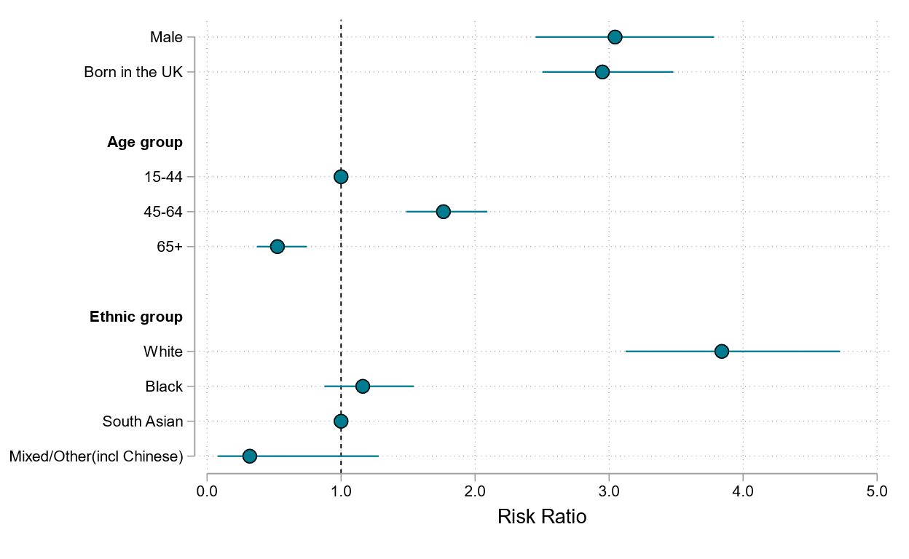
Demographic risk factors for current alcohol misuse in people notified with TB, England 2019 to 2021
Males compared with females are approximately 3 times more likely to have current alcohol misuse.
People born in the UK are approximately 3 times more likely to have current alcohol misuse compared with those not born in the UK.
People with white ethnicities are approximately 3.75 times more likely to have current alcohol misuse compared with South Asian ethnicities.
Please see Table 3 of the supplementary data set for the data underlying this analysis.

Slide 25
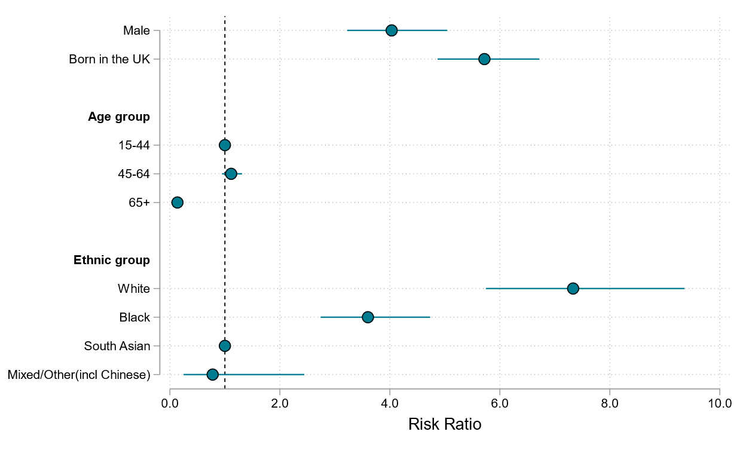
Demographic risk factors for history of drug misuse in people notified with TB, England 2019 to 2021
Males compared with females are approximately 4 times more likely to have a history of drug misuse.
People born in the UK are approximately 5.75 times more likely to have history of drug misuse
compared to those not born in the UK.
People aged 65 years old or over are approximately 0.10 times as likely (90% reduced risk) to have history of drug misuse compared with those aged between 15 to 44 years old.
White and black ethnicities are between 7.25 and 3.5 times more likely to have history of drug misuse compared with South Asian ethnicities.
Please see Table 4 of the supplementary data set for the data underlying this analysis.

Slide 26
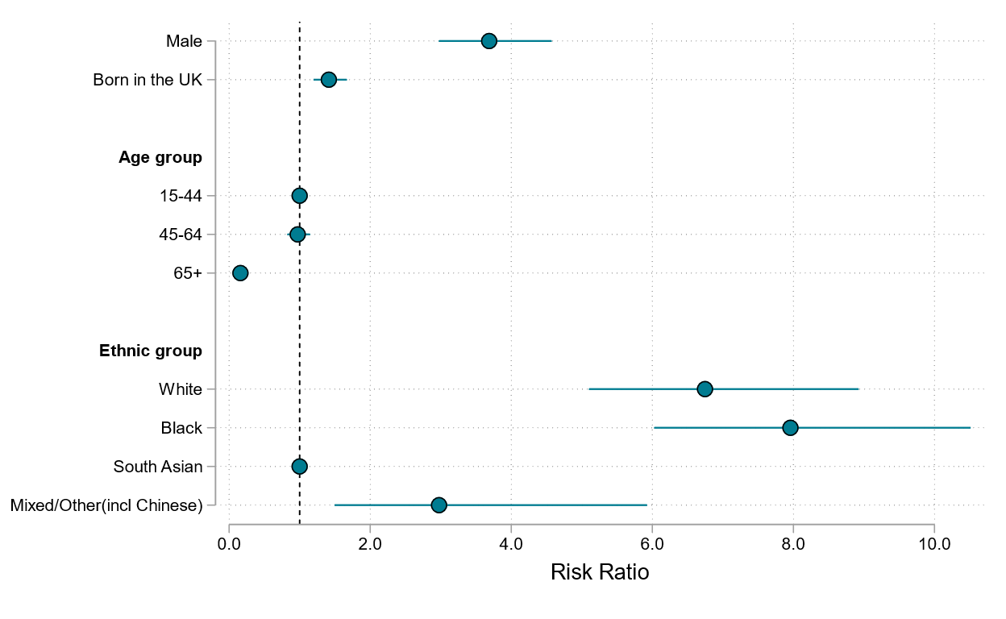
Demographic risk factors for history of homelessness in people notified with TB, England 2019 to 2021
Males are approximately 3.75 times more likely to have history of homelessness.
People born in the UK are approximately 1.5 times more likely to have history of homelessness compared with those not born in the UK.
White, black and mixed/other ethnicities are approximately 7, 8 and 3 times more likely to have history of homelessness compared with South Asian ethnicities, respectively.
Please see Table 5 of the supplementary data set for the data underlying this analysis.

Slide 27
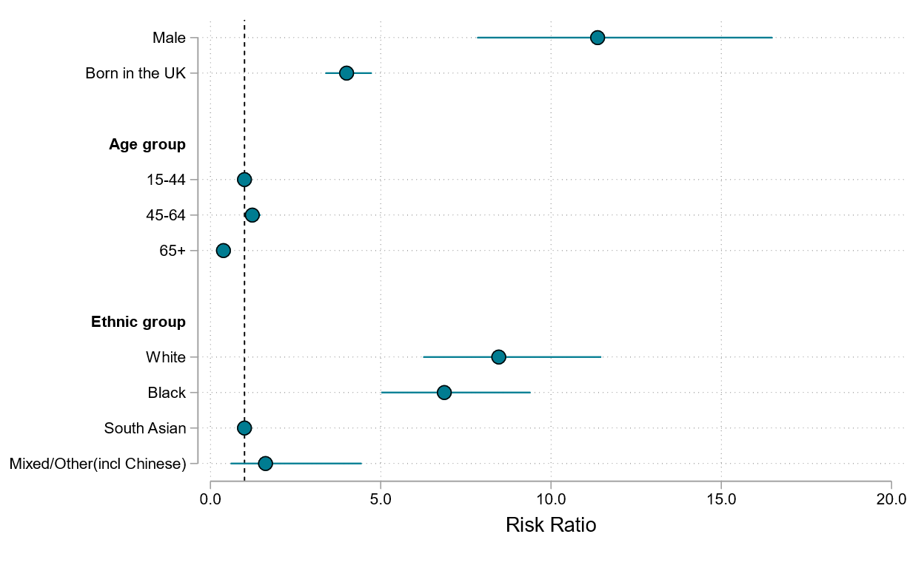
Demographic risk factors for history of imprisonment in people notified with TB, England 2019 to 2021
Males are approximately 11 times more likely to have history of imprisonment.
People born in the UK are approximately 4 times more likely to have history of imprisonment compared with those not born in the UK.
People aged 65 years old or over are approximately 0.25 times less likely (75% reduced risk) to have history of imprisonment compared with those aged 15 to 44 years old.
White and black ethnicities are between 8.5 and 7 times more likely to have history of imprisonment compared with South Asian ethnicities.
Please see Table 6 of the supplementary data set for the data underlying this analysis.

Slide 28
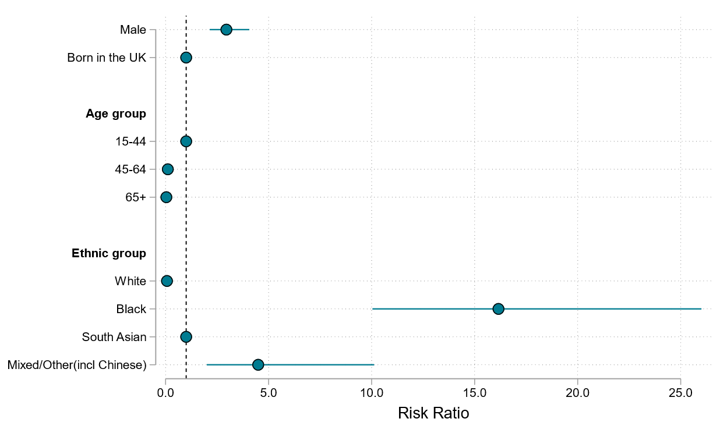
Demographic risk factors for asylum seeker status in people notified with TB, England 2019 to 2021
Males compared with females are approximately 3 times more likely to have asylum seeker status.
People aged between 45 and 64 and those aged 65 years old or over are approximately 0.1 times less likely to have asylum seeker status compared with those aged between 15 and 44 years old.
Black and mixed/other ethnicities are between 16 and 5 times more likely to have asylum seeker status, whilst white ethnicities are approximately 0.1 times less likely to have asylum seeker status compared with South Asian ethnicities.
Please see Table 7 of the supplementary data set for the data underlying this analysis.

Slide 29
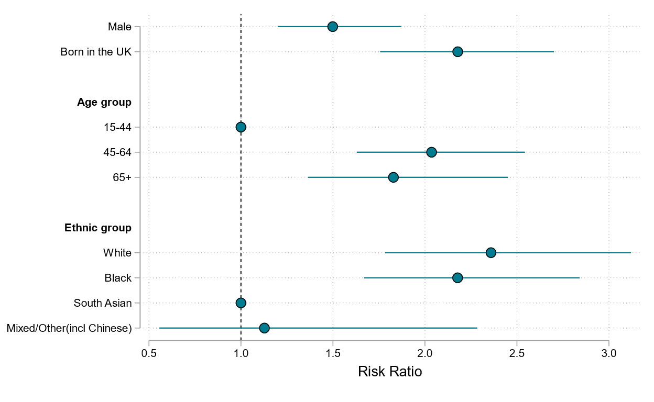
Demographic risk factors for current mental health needs in people notified with TB, England 2019 to 2021
Males are approximately 1.5 times more likely to have current mental health needs
People born in the UK are approximately 2.25 times more likely to have current mental health needs compared with those not born in the UK
People aged 45 to 64 and those aged 65 years old or over are between 2 and 1.75 times more likely to have current mental health needs compared with 15 to 44 years olds.
White and black ethnicities are approximately 2.25 times more likely to have current mental health needs compared with South Asian ethnicities.
Please see Table 8 of the supplementary data set for the data underlying this analysis.

Slide 30
Proportion of one or more SRF in people notified with TB by UK born or non-UK born and ethnicity or country of birth, England, 2018 to 2021
Place of birth | Ethnic group | At least one SRF (n) | At least one SRF (%) | Two or more SRFs (n) | Two or more SRFs (%)
UK born | White | 601 | 22.9 | 294 | 11.7
UK born | Black Caribbean | 85 | 39.9 | 45 | 21.1
UK born | Black-African | 51 | 23.3 | 18 | 8.4
UK born | South Asian | 112 | 13.2 | 35 | 4.2
UK born | Other | 83 | 29.0 | 37 | 13.2
Non-UK born | Eritrea | 197 | 41.9 | 65 | 14.3
Non-UK born | India | 163 | 4.9 | 26 | 0.8
Non-UK born | Romania | 111 | 14.4 | 30 | 4.1
Non-UK born | Sudan | 96 | 42.7 | 32 | 15.0
Non-UK born | Pakistan | 96 | 5.3 | 16 | 0.9
Non-UK born | Somalia | 84 | 17.0 | 29 | 6.0
Non-UK born | Poland | 82 | 30.3 | 42 | 16.3
Non-UK born | Afghanistan | 52 | 22.6 | 12 | 5.3
Non-UK born | Ethiopia | 51 | 35.9 | 19 | 13.8
Non-UK born | Lithuania | 49 | 30.8 | 30 | 21.1
Table showing individual SRFs for these groups is available in Supplementary Table 17 of TB Incidence and Epidemiology Supplementary Data set 2022.

Slide 31
Section 5: How do social risk factors affect risk of infectious or drug resistant TB, co-morbidities and adverse TB treatment outcomes in people notified with TB? England, 2019 to 2021
TB Unit
UK Health Security Agency, London UK.

Slide 32
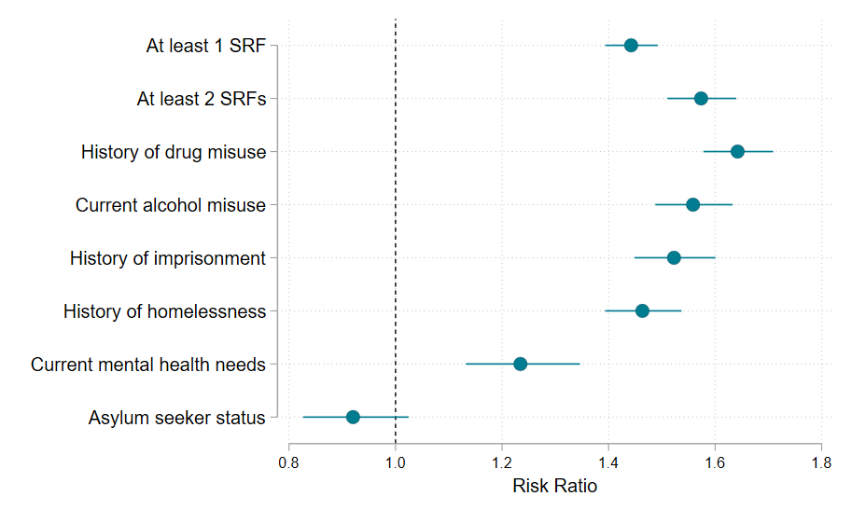
Association of social risk factors with pulmonary disease in England, 2019 to 2021 (aggregated data)
All social risk factor groups had a significantly increased risk of pulmonary disease with the exception of asylum seekers.
People with a history of drug misuse had the greatest increase in risk at approximately 1.65 times higher.
All analyses are adjusted for age and sex
Please see Table 9 of the supplementary data set for the data underlying this analysis.

Slide 33
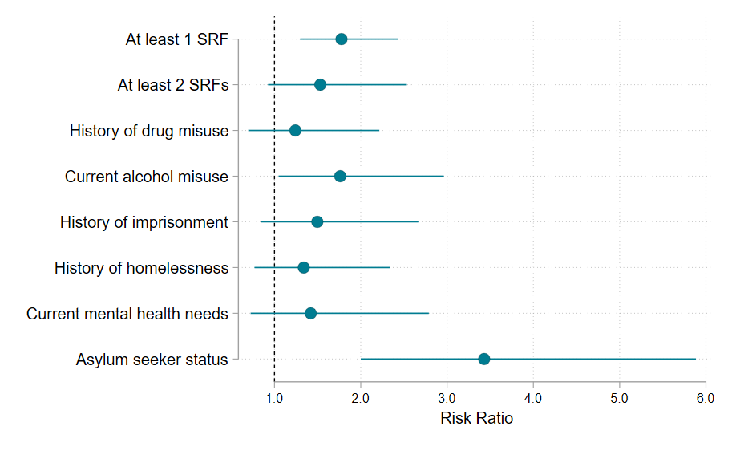
Association of social risk factors with multi-drug resistant (MDR-TB) in England, 2019 to 2021 (aggregated data)
People with at least 1 social risk factor and current alcohol misuse were approximately 1.75 times more likely to have MDR-TB than those without a SRF.
Asylum seekers were approximately 3.4 times more likely to have MDR-TB compared with non-asylum seekers.
Other risk factor groups did not have a significantly different risk of having MDR-TB.
All analyses are adjusted for age and sex
Please see Table 10 of the supplementary data set for the data underlying this analysis.

Slide 34
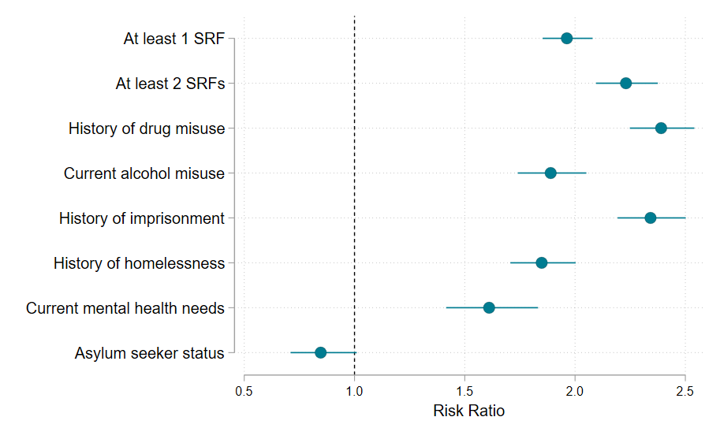
Association of social risk factors with being in a genomic cluster in England, 2019 to 2021 (aggregated data)
All social risk factor groups had a significantly increased risk of being in a genomic cluster with the exception of asylum seekers, with the largest increase in those with a history of drug misuse with an approximately 2.4 times greater risk, and those with history of imprisonment, with 2.3 times the risks.
All analyses are adjusted for age and sex
Please see Table 11 of the supplementary data set for the data underlying this analysis.

Slide 35
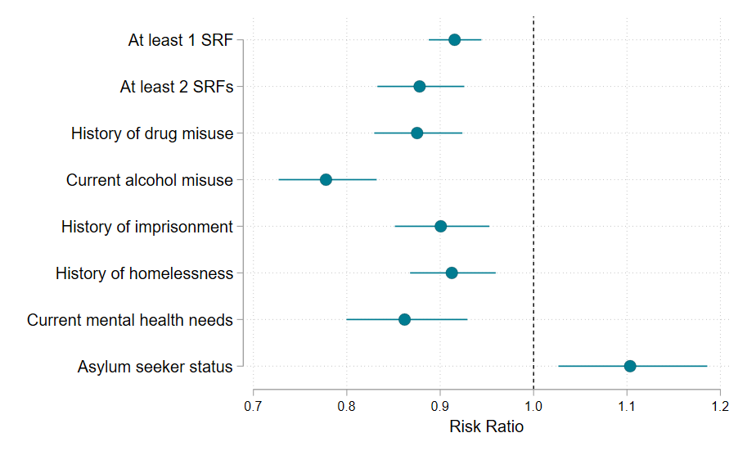
Association of social risk factors with TB treatment completion in England, 2019 to 2021 (aggregated data)
With the exception of asylum seekers, all social risk factor groups were significantly less likely to complete TB treatment, with the largest risk in those with current alcohol misuse with approximately 0.75 times (25% decreased) risk.
In contrast, asylum seekers were more likely to complete TB treatment, with 1.1 times the risk, when compared with those who are not asylum seekers.
All analyses are adjusted for age and sex
Please see Table 12 of the supplementary data set for the data underlying this analysis.

Slide 36
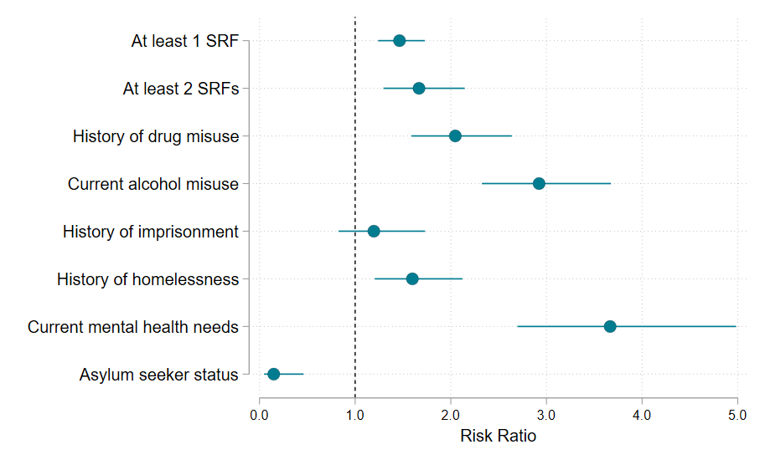
Association of social risk factors with death as last recorded TB treatment outcome in England, 2019 to 2021 (aggregated data)
With the exception of asylum seekers and history of imprisonment, all social risk factor groups have a significantly increased risk of death as last recorded outcome of TB treatment, with the largest risk in those with current mental health needs at approximately 3.70 more than people without an SRF.
Asylum seekers have a significantly decreased risk of death as TB treatment outcome, with approximately 0.15 times the risk.
All analyses are adjusted for age and sex
Please see Table 13 of the supplementary data set for the data underlying this analysis.

Slide 37
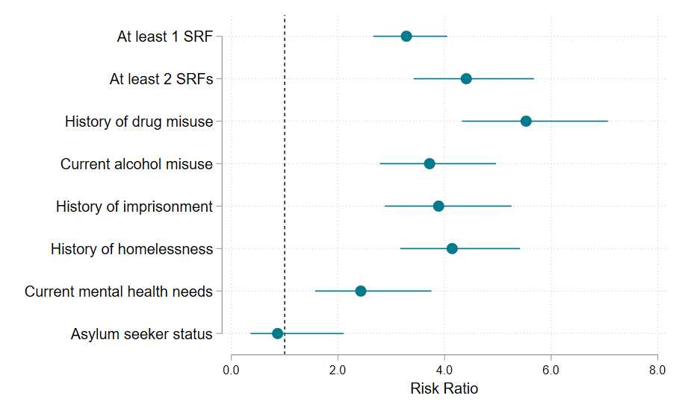
Association of social risk factors with co-infection with Hepatitis B or C in England, 2019 to 2021 (aggregated data)
All social risk factor groups have a significantly increased risk of being co-infected with hepatitis B or C viruses, with the exception of asylum seekers, with the largest in those with a history of drug misuse with an approximately 5.5 times greater risk.
All analyses are adjusted for age and sex
Please see Table 14 of the supplementary data set for the data underlying this analysis.

Slide 38
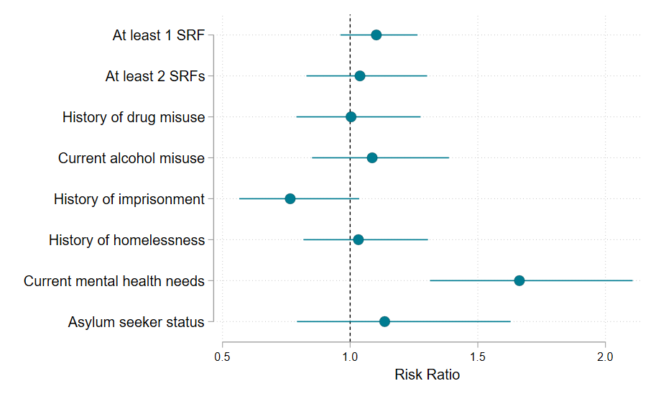
Association of social risk factors with severe TB disease in England, 2019 to 2021 (aggregated data)
People with current mental health needs are the only group with a significantly increased risk of having severe form of TB disease, with approximately 1.65 times greater risk.
This association may result from the greater impact of severe TB disease on mental health.
All analyses are adjusted for age and sex
Please see Table 15 of the supplementary data set for the data underlying this analysis.

Slide 39
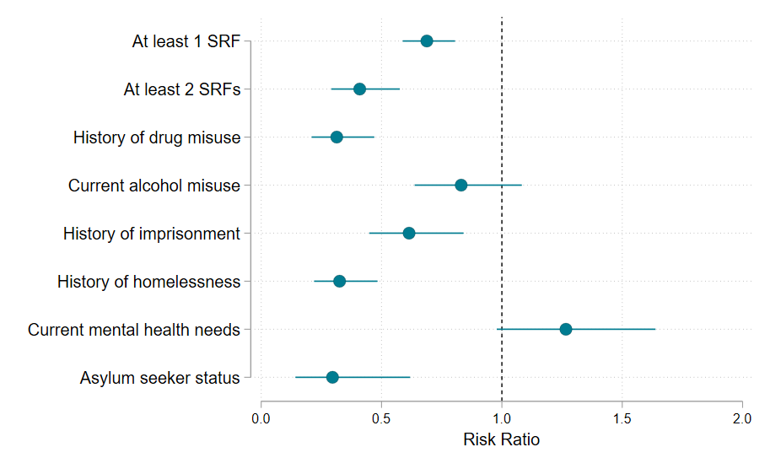
Association of social risk factors with co-morbid diabetes in England, 2019 to 2021 (aggregated data)
With the exception of current alcohol misuse and current mental health needs, all social risk factor groups are significantly less likely to have diabetes as a co-morbidity, between approximately 0.30 and 0.70, equivalent to a 70% to 30% decreased risk.
All analyses are adjusted for age and sex
Please see Table 16 of the supplementary data set for the data underlying this analysis.

Slide 40
Section 6: TB notification rates in those with Social risk factors, England, 2021
TB Unit
UK Health Security Agency, London UK.

Slide 41
Rates of TB in people in England and Wales and in those with social risk factors, England, 2021
Social Risk Factor as captured by NTBS | Population at risk | Notified with TB | Rate | 95% CI | Caveats & sources of population at risk denominators
All TB notifications (England and Wales) | 59,641,829 | 4, 515 | 7.6 | (7.4 to 7.8)
Prison – current only (England and Wales) | 88,139 | 22 | 28.1 | 17.6 to 42.5) | Current prison in NTBS may not include those in remand or on release at the time of notification or NTBS record completion resulting in possible underestimate of rate. Population denominator is number in prison including remand in June 2021
Prison – current and within the last 5 years (England and Wales) | 409,184 | 98 | 24.0 | (19.4 to 29.2) | Current and last 5 years will include those with recent prison history. Population at risk denominator is the sum of the last 5 years of prison population and will be an over-estimate due to long-stay prisoners – resulting in a possible underestimate of rate.
Prison – current and within the last 5 years (England and Wales) | 302,498 | 98 | 32.7 | (26.6 to 39.8) | Population denominator is prison population in 2021 plus probation population in 2021. This will include recently released from prison and other groups in recent contact with the justice system but not currently in prison and may result in an underestimate or overestimate of rate
All TB notifications (England) | 56,536,419 | 4,425 | 7.8 | (7.6 to 8.1)
Homeless – current only | 274,405 | 65 | 30.2 | (18.3 to 30.2) | Population denominator – estimated number homeless on any given night in 2021 as defined by Shelter Homelessness in England 2021, Table 1. Definitions are broadly similar between NTBS and Population Denominator
Drug misuse – current only | 1,000,000 | 92 | 9.2 | (7.4 to 11.3) | NTBS definition is regular use of cocaine, amphetamines and elicit opiates. Population denominator is an estimate of all class A drug use in the last year in people aged 16-59. Differences in definitions may result in under- or over-estimate of rates.
History of drug misuse (Ever misused drugs | 6,656,000 | 212 | 3.2 | (2.8 to 3.6) | Population denominator includes ever used a class A drug use in people aged 16 to 59. This may result in an underestimate of rate.
Asylum seekers notified in 2021 who entered the UK from 2018 to 2021 | 179,538 | 88 | 50.4 | (40.1 to 61.7) | Population denominator is no of asylum applications in 2021, 2020, 2019 and 2018. Table Asy_01b asylum-summary-mar-2023-tables.ods (live.com)

Slide 42
Section 7: Definitions of Social Risk Factors

Slide 43
Social risk factor definitions
Field Name | Definition | Values | Further Information
Patient's ability to self-administer treatment is affected by alcohol misuse or abuse | Is patient's ability to self-administer treatment affected by alcohol in the absence of DOT? | Yes No Unknown
Patient has a history of drug misuse | Is the patient misusing drugs, or has misused drugs in the past? | Yes -Current -In the past 5 years -More than 5 years ago No Unknown | Problem drug use is defined as illicit injecting drug use or long duration/ regular use of illicit opiates, cocaine and/or amphetamines.
Patient has a history of homelessness | Is patient currently homeless or has been in the past? | Yes -Current -In the past 5 years -More than 5 years ago No Unknown | Includes people sleeping rough, living in temporary accommodation such as bed and breakfast, hostels, hotels, and squats and people who are involuntarily dependent on friends.
Patient has a history of imprisonment | Is the patient a prisoner or been a prisoner in the past? | Yes -Current -In the past 5 years -More than 5 years ago No Unknown | Include any history of incarceration within the UK including incarceration in a prison or a remand centre.
Patient has mental health problem | Does the persons have a mental health problem likely to affect their ability to effectively take anti-TB treatment? | Yes No Unknown | Most likely with major mental health such as schizophrenia or depression/anxiety, but could be more minor problems if their TB treatment may be affected in the opinion of the clinical team.
Patient is an asylum seeker | Is the patient seeking asylum in the UK? | Yes No Unknown
Patient is an immigration detainee* | Is the patient currently being held in an immigration detention centre? | Yes No Unknown

Slide 44
Contact information Principal Epidemiologist, TB Unit, UKHSA: Sharon.Cox@ukhsa.gov.uk General Queries: TBSection@ukhsa.gov.uk More information on access to UKHSA data can be found here

