Slide 1
TB awareness for staff in prisons and other places of detention
Public Health England group developing national prisons TB resources
March 2021

Slide 2
Using this slide pack
This slide pack can be used for presenting to a group or for your own learning.
You can add to or amend the information to make the slides specific to your local needs
You can use the notes provided in a few sections below the slides to assist with your script
Notes:
If presenting to a group:
You can use the notes section below the slides to assist with your script.
You can add further information to the slides specific to your organisation.
Don’t forget to delete this slide beforehand.
If you are reading the slides for your own learning:
Make sure you read the notes section below the slides for further information about the bullet points on the slides.
To print out slides with the notes - go to
‘File’ then ‘Print’
Under ‘Settings’ in the ‘Slides’ menu click the drop-down arrow next to ‘Full Page Slides’
Under ‘Print Layout’, click ‘Notes Pages’
Then click the ‘Print’ button

Slide 3
Learning objectives
To provide basic awareness of TB
To understand symptoms, explaining differences between active and latent TB
Understanding risk factors for developing TB
Understanding of diagnosis and treatment of TB
Increase knowledge on public health management of TB incidents in prisons including isolation, bed watch contact tracing and discharge planning
Participants will have an understanding to support prisoners with TB

Slide 4
Glossary of acronyms
CXR Chest X-ray
DOT Directly Observed Therapy
LTBI Latent TB Infection
TB Tuberculosis
PPE Personal Protective Equipment

Slide 5
Who will deliver these slide sets?
TB nurses
Members of Health Protection Team
Public health practitioners
Healthcare professionals in prison

Slide 6
Overview
What is TB?
How is TB spread?
Active or Latent TB
Symptoms of TB
Risk factors for TB
Diagnosis
Treatment
What happens when a case of TB is diagnosed in prison
Contact screening

Slide 7
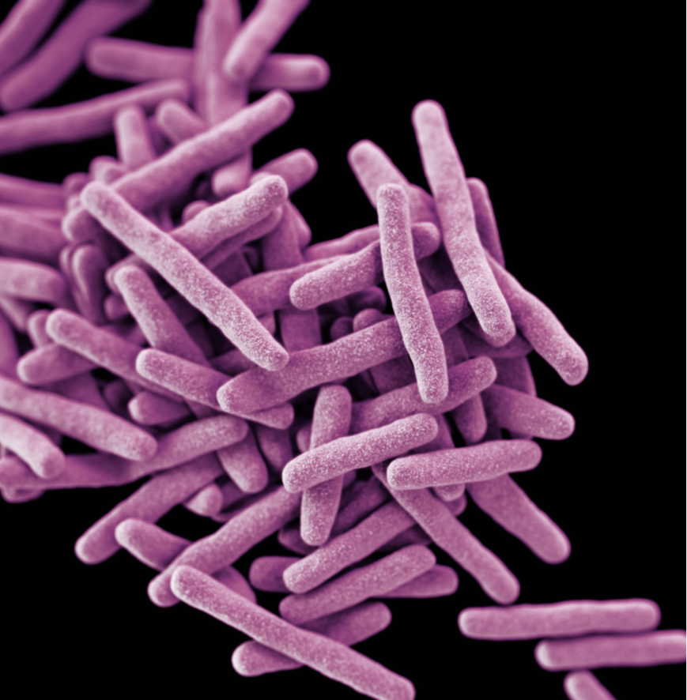
What is TB?
Tuberculosis (TB) is a bacterial infection
(caused by Mycobacterium tuberculosis)
TB most commonly affects the lungs but occurs in any part of the body, including the abdomen, bones and brain – this is referred to as ‘Active TB’
Only pulmonary, laryngeal or tonsillar TB including miliary TB is infectious
Delays in treatment can cause serious illness and even death, if left untreated
Most people exposed never develop symptoms. The bacteria can live in an inactive form in the body – this is referred to as ‘Latent TB Infection’ (LTBI)
Courtesy CDC
Notes:
New cases of TB in England have fallen to their lowest levels since records began in 1960.
44% drop in new diagnosis from 2011 to 2018.

Slide 8
How is TB spread?
It is spread by inhaling tiny droplets from the coughs and sneezes of an infected person
It is not spread by sharing crockery/cups, by kissing, spitting or by holding hands
It is difficult to catch TB and usually requires very close prolonged contact
Image from msdh.ms.gov
Notes:
On average a person with untreated active TB passes the illness onto 10-15 people each year

Slide 9
Active or Latent TB
Notes:
This slide demonstrates the differences between Active TB and Latent (LTBI) TB.
Active: infectious, has symptoms and requires long treatment with specific antibiotics
Latent: NOT infectious, no symptoms and can be treated with specific antibiotics usually over a short time. Can ‘reactivate’ and become Active TB, so important to identify those with LTBI and treated accordingly.

Slide 10
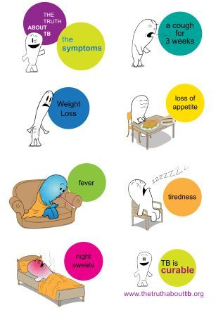
Symptoms of active TB
Dry or productive cough (>3 weeks)
Fevers (high temperatures)
Night sweats
Weight loss
Fatigue
Loss of appetite
Chest pains
Coughing up blood

Slide 11
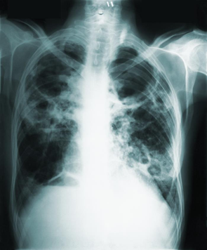
Risk factors for developing TB
Transmission within prison settings
Other comorbidities eg HIV, diabetes
Homelessness
Substance misuse
History of imprisonment
New immigrants, refugees
Poor nutrition
Smoking
Immunosuppression
Living in over-crowded conditions
courtesy CDC
Notes:
Highlight that prisoners, people that are/have been homeless and/or misuse drugs/alcohol are twice as likely to have Active infectious TB and are twice as likely to die from it than other people. Therefore the population in YOUR care are most at risk of TB, so recognising symptoms, early referral for treatment and reduction in transmission are a vital part of your role.

Slide 12
Social risk factors and TB 2014 to 2018

Slide 13
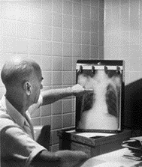
How do we diagnose that someone has TB?
Symptom check at healthcare reception screening
If at any point TB is suspected, the following tests will be undertaken:
- Chest X-rays
Sputum samples
Blood tests
courtesy CDC

Slide 14
TB is treatable and curable
Notes:
TB is usually curable in UK – treatment lasts up to 6 weeks – combination of antibiotics.
Generally people stop being infectious after about 2 weeks of treatment but not everyone – Healthcare will liaise with community TB nurses about the case and follow specific risk assessment.
Patients should comply with their treatment as prescribed to prevent drug resistance as this can be more difficult to treat.

Slide 15
Treatment
Combination of different antibiotics
Standard treatment is for 6 months but can be extended to 12 months
If treatment is stopped or incomplete, TB can return and can lead to drug resistant strains of TB which are harder to treat
Treatment can lead to side effects, and patients should have regular check ups
All prisoners with TB should have Directly Observed Therapy (DOT)
Treatment should be taken on an empty stomach one hour before breakfast
It is very important for prisoners to have their treatment on time
Notes:
Standard treatment for TB is a minimum of 6 months:
2 months (initial phase) of Isoniazid, Rifampicin, Pyrazinamide and Ethambutol. Known as standard quadruple therapy.
Followed by:
4 months (continuation phase) of Isoniazid and Rifampicin. Known as standard dual therapy.
N.B. If there is central nervous system involvement the continuation phase of treatment is extended to 10 months making a 12 month full treatment plan.
TB treatment is taken all together on an empty stomach one hour before breakfast; compliance is essential for cure.

Slide 16
What happens when a case or suspected case is identified in prison?
During investigations/first 2 weeks of treatment:
The case should be placed in ‘clinical’ isolation on suspicion
The case should not leave their isolation room unless absolutely necessary – if they have to, they should wear a surgical mask
Use of bathrooms etc should be at different times to other prisoners
Prison staff should not enter the cells of prisoners with active infectious / suspected TB unless absolutely necessary and should consult healthcare if they need to spend time in the prisoner’s cell.
The wearing of masks by prison staff is usually not required
No special precautions are required regarding crockery, cutlery, books, bed linen etc. that have been used by the case
Notes:
Clinical isolation is NOT the same as segregation.
Isolate on suspicion but if not pulmonary or laryngeal then no need to isolate.
PPE not required due to limited contact time with case.
TB is difficult to catch from an infectious person, as it requires prolonged close contact. Healthy adults have a good immune system that usually ‘kills’ TB bacteria if it enters the lungs. Most people would not become infected when they come into contact with an infected person.
For these reasons, it is not necessary for prison staff to wear PPE when going about their usual daily work activities.
However, you should not be putting yourselves at unnecessary risk of exposure, so do not enter cells of prisoners with active TB/suspected active TB unless it is absolutely necessary. Spend as short a time as possible in the cell and wear appropriate PPE if required (be advised by Healthcare if it is necessary).

Slide 17
What happens when bed watch is required?
A risk assessment should be undertaken if bed watch is required. This will be undertaken by the hospital medical team or healthcare staff depending on location of case at the time
If bed watch is required during the prisoner’s ‘infectious period’ prison officers should sit outside the room
If a patient is on bed watch with long periods of close contact with a patient then a risk assessment is required to include PPE
The prison management should keep a list of all officers who undertake bed watch

Slide 18
Contact screening
Usually led by the local TB service supported by the prison staff
Undertaken to identify anyone who might have been infected by the case
Start with closer contacts such as cell mates, co-workers and household
Usually consists of:
symptom check
skin or blood test
CXR
Please ensure that patient confidentiality is maintained at all times.
Notes:
Important because 1% of contacts screened have active TB
10% of contacts screened have latent TB infection
60% of child contacts under 2 years will go onto develop active TB

Slide 19
Discharge planning
Prisoners are generally placed on medical hold until no longer infectious
Healthcare should inform local TB services/GP if planned release or transfer to another facility
Patients should be given at least one week’s supply of medication
Patient should be given the contact details of their local TB services
Notes:
Stress the importance of the planning for a prisoner to be released/transferred
Liaison with TB services/support teams to ensure they continue with treatment

Slide 20
All prison staff: everyone has a duty of care
Healthcare staff:
Identify cases early (symptom check, sputum and CXR)
Inform the TB service and HPT of any suspected or confirmed TB cases as soon as possible
Provide information about cell contacts and other contacts
Identify a lead nurse for TB/case manager for each TB incident/case
Liaise with TB service and jointly develop a care plan/pathway for cases of TB or LTBI
Manage cases in conjunction with TB services on day-to-day basis
Formulate isolation plan and inform prison staff
Prison officers/detention officers:
Look out for signs and symptoms in prisoners
Refer symptomatic prisoners to healthcare for medical assessment and inform healthcare in person
Facilitate and enable Healthcare to deliver plan of care and treatment - enable access to medication
Follow case specific isolation plan

Slide 21
Resources available for TB in prisons (developed by PHE, HMPPS and NHS)
Tuberculosis: information for prisons and immigration removal centre staff
Information on TB for people in prison provides general information on TB to raise awareness in prisons
Got TB? Read this!
for those in prison with TB

Slide 22
Summary
TB is not an easy infection to catch
Only active TB is potentially infectious
People with active TB usually stop being infectious after 2 weeks of treatment
Transmission can be prevented by early diagnosis, implementation of infection control processes and respiratory precautions
The use of PPE by prison officers is not usually required unless advised otherwise by healthcare staff
It is crucial that people with TB receive their treatment every day as prescribed even after transfer or release
Collaboration between prison healthcare, prison staff, TB services and PHE is paramount

Slide 23
Now it’s time to see what you can remember?

Slide 24
Test your knowledge about TB!
Question | True | False
TB is a disease that only occurs in the lungs
Latent TB infection is not infectious
If someone with TB coughs, those around them will automatically catch the infection
You can catch TB by sharing eating utensils with an infected person
TB can be passed from person to person via coughs/sneezes
Someone can have TB of the lungs or throat with minimal risk of passing the infection on to others
Only certain groups of people develop TB
Most people with TB will die as a result of the infection

Slide 25
Test your knowledge about TB! (answers)
Question | True | False
TB is a disease that only occurs in the lungs |  | x it can occur anywhere in the body
Latent TB infection is not infectious | x
If someone with TB coughs, those around them will automatically catch the infection |  | x
You can catch TB by sharing eating utensils with an infected person |  | x
TB can be passed from person to person via coughs/sneezes | x
Someone can have TB of the lungs or throat with minimal risk of passing the infection on to others | x (eg if on effective treatment)
Only certain groups of people develop TB |  | x anyone can develop TB, however, some groups are more at risk
Most people with TB will die as a result of the infection |  | x there is very effective treatment available

Slide 26
Acknowledgements
Authors
Anita Turley, Clare Humphreys, Olabisi Williams and Anjana Roy
Contributors
Abi Bartlett, Bridget Langstaff, Diane Fiefield, Emma Threadgold, Grainne Nixon, Jane DeBurgh, June Chambers, Paul Moore, Sarah Dowle, Simone Thorn Heathcock and Sophia Makki.
TB Alert, national TB team for infographics, Stephanie Dennis(admin support)
Sign off
National Health & Justice Network PHE, chaired by Éamonn O'Moore
Publication reference
PHE publishing gateway number GW-1121

