Slide 1
Annual epidemiological spotlight on HIV in the South West: 2019 data
Field Service
For queries relating to this document, please contact fes.southwest@phe.gov.uk
PHE publications gateway number: GOV-9347

Slide 2
About Public Health England
Public Health England exists to protect and improve the nation’s health and wellbeing and reduce health inequalities. We do this through world-leading science, research, knowledge and intelligence, advocacy, partnerships and the delivery of specialist public health services. We are an executive agency of the Department of Health and Social Care, and a distinct delivery organisation with operational autonomy. We provide government, local government, the NHS, Parliament, industry and the public with evidence-based professional, scientific and delivery expertise and support.
Public Health England 133-155 Waterloo Road Wellington House London SE1 8UG Tel: 020 7654 8000 www.gov.uk/phe Twitter: @PHE_uk Facebook: www.facebook.com/PublicHealthEngland
Prepared by: Josh Forde and Paul Crook, Field Service, South East and London. For queries relating to this document, please contact fes.southwest@phe.gov.uk
© Crown copyright 2021
You may re-use this information (excluding logos) free of charge in any format or medium, under the terms of the Open Government Licence v3.0. To view this licence, visit OGL. Where we have identified any third-party copyright information you will need to obtain permission from the copyright holders concerned.
Published August 2021
PHE publications gateway number: GOV-9347

Slide 3
Summary of 2019 data for South West residents
244 new HIV diagnoses in South West residents in 2019 (6% of all England diagnoses)
This represents a rise of 11% from 2018
51% of new diagnoses were in men who have sex with men (MSM)
The number of new diagnoses in MSM remained the same in 2019 to 2018
16% of new diagnoses were in black Africans
44% of diagnoses were late (2017 to 2019)
5,030 people live with diagnosed HIV in the South West
4 local authorities in the South West had a diagnosed HIV prevalence in excess of 2 per 1,000 population aged 15 to 59 years in 2019, which is the threshold for expanded HIV testing. They were Bournemouth, Christchurch and Poole (2.8), Bristol (2.6), Swindon (2) and Torbay (2.1)
An estimated 6% of people living with HIV in England remain undiagnosed
99% of those living with diagnosed HIV in the South West are on antiretroviral therapy (ART)
98% of those on ART are virally suppressed

Slide 4
Figure 1: New HIV diagnosis per 100,000 population aged 15 years or older by PHE centre of residence, 2019
Source: Public Health England, HIV and Aids New Diagnosis Database (HANDD); Office for National Statistics (ONS) revised 2019 population estimates (6 May 2020). The number of new diagnoses will depend on accessibility of testing as well as infection transmission.

Slide 5
Figure 2: New HIV diagnoses per 100,000 population aged 15 years or older by upper tier local authority of residence, South West residents, 2019
Source: Public Health England, HIV and Aids New Diagnosis Database (HANDD); Office for National Statistics (ONS) revised 2019 population estimates (6 May 2020). The number of new diagnoses will depend on accessibility of testing as well as infection transmission. The Isles of Scilly have been merged with Cornwall.

Slide 6
Figure 3: New HIV diagnoses and deaths, South West residents, 2010 to 2019
Source: Public Health England, HIV and Aids New Diagnosis Database (HANDD). The number of new diagnoses will depend on accessibility of testing as well as infection transmission. *Numbers may rise as further reports are received. This will impact on interpretation of trends in more recent years.

Slide 7
Figure 4: New HIV diagnoses by probable exposure category (adjusted for missing information), South West residents, 2010 to 2019
Source: Public Health England, HIV and Aids New Diagnosis Database (HANDD). The number of new diagnoses will depend on accessibility of testing as well as infection transmission.

Slide 8
Figure 5: Number of new HIV diagnoses by age group and gender (A) and probable exposure category in males (B), South West residents, 2019
(A)
(B)
Source: Public Health England, HIV and Aids New Diagnosis Database (HANDD). The number of new diagnoses will depend on accessibility of testing as well as infection transmission.

Slide 9
Figure 6: Number of new HIV diagnoses by ethnic group (adjusted for missing ethnic group information), South West residents, 2010 to 2019
Source: Public Health England, HIV and Aids New Diagnosis Database (HANDD). The number of new diagnoses will depend on accessibility of testing as well as infection transmission.

Slide 10
Figure 7: Number of new HIV diagnoses by world region of birth (adjusted for missing information), South West residents, 2010 to 2019
Source: Public Health England, HIV and Aids New Diagnosis Database (HANDD). The number of new diagnoses will depend on accessibility of testing as well as infection transmission.

Slide 11
Figure 8: Number of MSM South West residents diagnosed with HIV by whether born in the UK or abroad, 2010 to 2019
Source: Public Health England, HIV and Aids New Diagnosis Database (HANDD). The number of new diagnoses will depend on accessibility of testing as well as infection transmission.

Slide 12
Figure 9: Percentage of new HIV diagnoses that were diagnosed late by local authority of residence, South West, aged 15 years and over, 2017 to 2019*
Source: Public Health England, HIV and AIDS New Diagnosis Database, HIV & AIDS Reporting System * Only includes new diagnoses for which CD4 count was reported within 91 days of diagnosis; late diagnosis defined as CD4 count <350 cells/mm3. The underlying population will impact on the proportion diagnosed late, for example MSM are less likely to be diagnosed late. The Isles of Scilly have been merged with Cornwall.
.

Slide 13
Figure 10: Percentage of new HIV diagnoses that were diagnosed late by probable exposure category (A) and ethnic group (B), South West residents, aged 15 years and over, 2017 to 2019*
(A)
(B)
Withheld due to small numbers
Source: Public Health England, HIV and AIDS New Diagnosis Database, HIV & AIDS Reporting System
* Only includes new diagnoses for which CD4 count was reported within 91 days of diagnosis; late diagnosis defined as CD4 count <350 cells/mm3.

Slide 14
Figure 11: Diagnosed HIV prevalence per 1,000 residents aged 15 to 59 years by PHE Centre, 2019
Source: Public Health England, HIV & AIDS Reporting System (HARS); Office for National Statistics (ONS) revised 2019 population estimates (6 May 2020).

Slide 15
Figure 12: Number of residents living with diagnosed HIV and accessing care, South West, 2010 to 2019
Source: Public Health England, HIV & AIDS Reporting System (HARS)

Slide 16
Figure 13: Number of residents living with diagnosed HIV and accessing care by probable route of transmission (adjusted for missing information), South West, 2019
Source: Public Health England, HIV & AIDS Reporting System (HARS).

Slide 17
Figure 14: Percentage of residents with diagnosed HIV and accessing care by age group, South West, 2010 and 2019
Source: Public Health England, HIV & AIDS Reporting System (HARS).

Slide 18
Figure 15: Diagnosed HIV prevalence per 1,000 residents by ethnic group (aged 15 to 59 years), South West, 2019
Source: Public Health England, HIV & AIDS Reporting System (HARS); Office of National Statistics (ONS) population estimates by ethnicity (2011).

Slide 19
Figure 16: Diagnosed HIV prevalence per 1,000 residents aged 15 to 59 years by local authority, South West, 2019
Source: Public Health England, HIV & AIDS Reporting System (HARS); Office for National Statistics (ONS) revised 2019 population estimates (6 May 2020).

Slide 20
Figure 17: Diagnosed HIV prevalence per 1,000 residents aged 15 to 59 years by local authority, South West, 2019
Source: Public Health England, HIV & AIDS Reporting System (HARS); Office for National Statistics (ONS) revised 2019 population estimates (6 May 2020).

Slide 21
Figure 18: Diagnosed HIV prevalence per 1,000 residents (all ages) by middle super output area, South West, 2019
Source: Public Health England, HIV & AIDS Reporting System (HARS); Office for National Statistics (ONS) revised 2019 population estimates (6 May 2020).

Slide 22
Figure 19: HIV test coverage: South West residents, 2015 to 2019
Source: Public Health England, GUMCAD *‘Eligible attendee’ is defined as a patient attending a specialist sexual health service (SHS) at least once during a calendar year. Patients known to be HIV positive1, or for whom a HIV test was not appropriate2, or for whom the attendance was related to Sexual and Reproductive Health (SRH) care only3 are excluded.

Slide 23
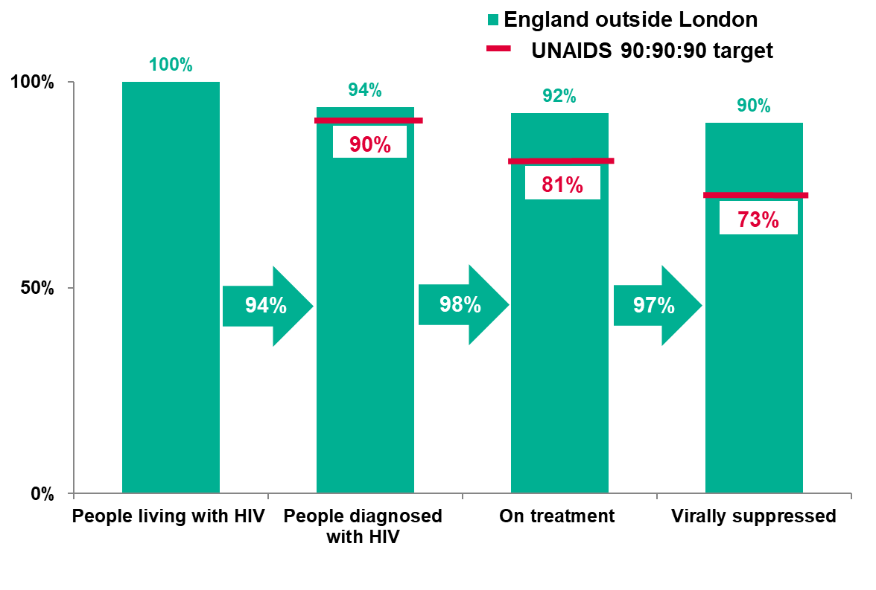
Figure 20: HIV treatment cascade for adults living with HIV, England excluding London, 2019
Source: Public Health England, HIV & AIDS Reporting System (HARS), Multi-parameter evidence synthesis (MPES)

Slide 24
Acknowledgements
Spotlight report produced by Josh Forde, Geraldine Leong, Rosalind Douglas, National HIV surveillance team, Paul Crook from Public Health England.
Local sexual health and HIV clinics for supplying the HIV data.
Institute of Child Health.
PHE Centre for Infectious Disease Surveillance and Control (CIDSC) HIV and STI surveillance teams for collection, analysis and distribution of data.

Slide 25
Further information
‘Small numbers’ are defined as sub-five non-zero counts relating to populations of less than 10,000 or for late new HIV diagnoses any proportion where the numerator and/or denominator is sub-five and non-zero.
Please access the online Sexual and Reproductive Health Profiles for further information on a whole range of sexual health indicators.
For more information on local sexual health data sources please access the PHE guide.
More information on STIs in South West.
National HIV report: 2019 data.
For more information, please contact Field Epidemiology Services at fes.southwest@phe.gov.uk

