Slide 1
The national flu immunisation programme 2021 to 2022
Training for healthcare practitioners
Notes:
This resource is designed to update health care practitioners involved in delivering the national flu immunisation programme for the 2021/22 flu season and includes information elating to both inactivated vaccines and the live attenuated influenza vaccine used for the childhood flu programme.
This resource is designed to be used by anyone involved in the flu programme. Not all slides will be required for training – trainers should select slides depending on audience background, role in the programme and length of training session.
This resource does not cover vaccine administration technique. If staff are required to deliver flu vaccinations they should refer to their line manager for additional training.
Note: For the purposes of this resource, the term ‘influenza’ will be replaced by the term ‘flu’ unless it relates to a specific virus/strain.

Slide 2
Flu vaccination programme and COVID-19
    During 2020/21, the flu vaccination programme was extended, and more groups were eligible to receive flu vaccine than in previous years.
    Although flu activity was low during 2020/21, flu activity during 2021/22 may be high. This is because the non-pharmaceutical interventions such as shielding and social distancing that were in place during 2020/21 have now been lifted and more of the population may be susceptible to flu this year.
As there may be winter outbreaks of COVID-19, protecting those at high risk of flu, who are also those most vulnerable to hospitalisation as a result of COVID-19, is vitally important.
Immunisers should wear personal protective equipment (PPE) in keeping with the current advice at the time of delivering the flu vaccine.
    This slideset will focus on the national flu programme recommendations for 2021/22. Those involved in delivering this year’s flu vaccine programme should ensure that they are aware of the specific guidance that they should follow in order to safely and effectively deliver flu vaccines during the ongoing COVID-19 pandemic. This includes, but is not limited to, guidance on PPE and infection control measures.

Slide 3
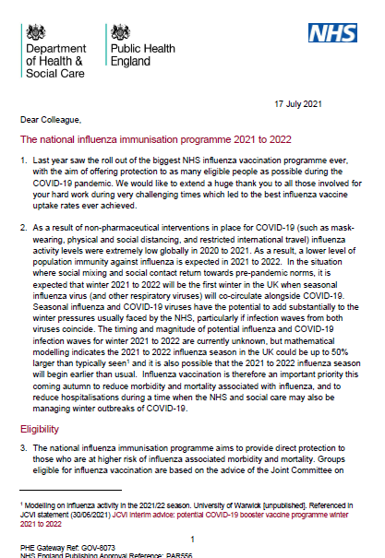
Essential further reading
Please ensure that you read the national flu immunisation programme 2021 to 2022 letters available on the PHE Annual flu programme webpage
In addition to providing key information about this year’s flu programme. It is recommended that you regularly check this webpage during the flu vaccination period as any further information that becomes available about the flu vaccine programme will be published there.

Slide 4
Key messages
flu immunisation is one of the most effective interventions we can provide to reduce harm from flu and pressures on health and social care services during the winter
it is important to increase flu vaccine uptake in clinical risk groups because of increased risk of death and serious illness if people in these groups catch flu
influenza during pregnancy may be associated with perinatal mortality, prematurity, smaller neonatal size, lower birth weight and increased risk of complications for mother
vaccination of health and social care workers protects them and reduces risk of spreading flu to their patients, service users, colleagues and family members
by preventing flu infection through vaccination, secondary bacterial infections such as pneumonia are prevented. This reduces the need for antibiotics and helps prevent antibiotic resistance
for a number of years, only around half of patients aged six months to under 65 years in clinical risk groups have been vaccinated
the childhood flu programme should reduce the impact of seasonal flu on children and reduce transmission of flu within the community
by reducing transmission of flu, it should also avert many cases of severe flu and flu-related deaths in older adults and people in clinical risk groups
Notes:
The key change to the childhood flu programme in the 2021/22 flu season is that in addition to primary school aged children, children in School Year 7 to 11 in secondary school will also be offered the vaccine. This means that all school aged children (4 years old to 15 on 31 August 2021) will be included in the programme.
Morbidity and mortality attributed to flu is a key factor in NHS winter pressures and a major cause of harm to individuals especially vulnerable people. The annual flu immunisation programme helps to reduce GP consultations, unplanned hospital admissions and pressure on A&E and is therefore a critical element of the system-wide approach for delivering robust and resilient health and care services during the winter.
Following a recommendation in 2012 by the Joint Committee on Vaccination and Immunisation (JCVI) that the routine annual flu vaccination programme should be extended to include children, a phased introduction of this extension began in 2013. In 2013, flu vaccine was offered to all two and three year old children, and to four to ten year olds (up to and including pupils in school year 6) in seven different geographical pilot areas.
For the 2014/15 flu season, flu vaccine was offered to all four year old children as well as to all two and three year old children. The geographical pilots of primary school aged children started in 2013/14 continued and there were also several different geographical pilots in secondary school aged children in Years 7 and 8.
In 2015/16, flu vaccine was offered to all two, three and four-year-olds, to children of school year 1 and 2 age and to all primary school-aged children in areas that participated in previous primary school pilots.
In 2016/17, flu vaccine was offered to all two, three and four-year-olds, to children of school year 1, 2 and 3 age and to all primary school-aged children in areas that participated in previous primary school pilots.
In 2017/18, flu vaccine was offered to all two, three and four-year-olds, to children of school year 1, 2 , 3 and 4 age and to all primary school-aged children in areas that participated in previous primary school pilots. This was the first flu season that Reception Year children (aged 4-5 years) were offered flu vaccination in their reception class, rather than through general practice
In the 2018/19 flu season, flu vaccine was offered to all children aged two to nine years old (but not ten years or older) on 31 August 2018 and to all primary school-aged children in former primary school pilot areas.
In the 2019/20 flu season, flu vaccine was offered to all children aged two to ten years (but not eleven years or older) on 31 August 2019. It should also be offered to children from six months of age in clinical risk groups.
During the 2020 to 2021 season, the national programme was extended to include children of Year 7 (aged 11 rising to 12 years old), with no pilot areas.
https://assets.publishing.service.gov.uk/government/uploads/system/uploads/attachment_data/file/995616/Childhood_flu_annual_report_2020_to_2021.pdf

Slide 5
Aims of resource
The purpose of this training resource is to:
develop the knowledge base of healthcare practitioners regarding the 2021 to 2022 seasonal flu vaccination programme
support healthcare practitioners involved in discussing flu vaccination with those eligible by providing evidence based information
promote high uptake of flu vaccination in all eligible groups by increasing the knowledge of those involved in delivering the vaccination programme
provide information on the administration of flu vaccines
Notes:
Key roles of healthcare practitioners in relation to the flu programme are as follows:
to understand the evidence base for the administration of the flu vaccination
to advise individuals and parents/carers of children who are eligible to receive the flu vaccination that it is strongly recommended that they/their children are vaccinated against flu
to safely administer the appropriate flu vaccine
to ensure any adverse effects are managed and reported appropriately

Slide 6
Learning outcomes
On completion of this resource, healthcare practitioners will be able to:
describe the cause of flu
understand how flu is transmitted and the possible effects of flu
understand the evidence base for the administration of flu vaccination to children, those aged 50 years and over and those in clinical risk groups
explain which vaccines will be used and the precautions and contraindications to the administration of flu vaccines
explain the sequence of steps in flu vaccine administration
explain the possible side effects from flu vaccines
understand the importance of their role in promoting and providing evidence based information about flu vaccination to patients
identify sources of additional information

Slide 7
Key roles of healthcare practitioners
Key roles of healthcare practitioners in relation to the flu programme are:
to be able to describe the evidence base for the administration of the flu vaccination to all eligible groups
to advise parents/carers of children who are eligible to receive the flu vaccination that it is strongly recommended that children are vaccinated against flu
to safely administer flu vaccines in accordance with the vaccine schedule
to ensure any adverse effects are managed and reported appropriately
The national flu immunisation programme 2021 to 2022

Slide 8
UK flu vaccination programme
Late 1960s: annual flu immunisation recommended to directly protect those in clinical risk groups who are at a higher risk of influenza associated morbidity and mortality
2000: flu vaccine policy extended to include all people aged 65 years or over
2010: pregnancy added as a clinical risk category for routine flu immunisation
2013: phased introduction of an annual childhood flu vaccination programme for all children aged 2-16y began with vaccine offered to all children aged 2 and 3 years and seven geographical pilots in primary school aged children
2014: phased introduction of childhood flu vaccination programme continued with vaccine offered to all children aged 2, 3 and 4 years and geographical pilots in primary and secondary school aged children
2015: in addition to vaccinating 2, 3, and 4 year olds in primary care, the programme began nationally in primary schools in a phased roll-out starting with the youngest school-aged children first.
Between 2016 and 2019: phased introduction of childhood flu vaccination programme continued with a year on year addition of the next school year
  2020: offer to all children aged 2 to 11 years old (but not 12 years or older) on 31 August
  2020 and to those aged 50 to 64 years
  2021: offer to all children aged 2 to 15 years old (but not 16 years or older on 31 August 2021 and to those aged 50 to 64 years
Notes:
In the 2021/22 flu season, flu vaccine should be offered to all children who are aged 2 to 15 years old (but not 16 years or older) on 31 August 2021. It should also be offered to children from six months of age in clinical risk groups.
During 2020/21, flu vaccine was offered to those aged 50 to 64 years as this age group has a higher risk of morbidity, mortality and hospitalisation relating to Covid. This offer has been extended to include the 2021/22 programme as Covid is expecting to be circulating this winter.

Slide 9
Influenza overview
flu is an acute viral infection of the respiratory tract (nose, mouth, throat, bronchial tubes and lungs)
it is a highly infectious illness which spreads rapidly in communities
even people with mild or no symptoms can infect others
most cases in the UK occur during an 8 to 10 week period during the winter
The national flu immunisation programme 2021 to 2022

Slide 10
Influenza viruses
A viruses
  cause outbreaks most years and are the usual cause of epidemics and pandemics
  live and multiply in many different animals and may spread between them
  birds, particularly wildfowl, are the main animal reservoir
  B viruses
  tend to cause less severe disease and smaller outbreaks
  predominantly found in humans
  burden of disease mostly in children

Slide 11

Flu A virus
Genetic material (RNA) in the centre
Two surface antigens:
Haemagglutinin (H) (blue)
Neuraminidase (N) (red)
There are 18 different types of H and 11 different types of N
The role of haemagglutinin is to bind to the cells of the infected person
The role of neuraminidase is to release the virus from the cell surface
The national flu immunisation programme 2021 to 2022
Notes:
Schematic model of a flu A virus.
There are two antigens on the surface, as illustrated.
The role of the H antigen is to bind to the cells of the host. There are 18 different types of H.
The role of the N antigen is to release the virus from the cell surface. There are 11 different types of N.
The different types of H and N are identified by numbers, hence H1N1 or H3N2 for example.

Slide 12
Genetic changes in the flu virus – what this means
Changes in the surface antigens (H and N) result in the flu virus constantly changing
antigenic drift: minor changes (natural mutations) in the genes of flu viruses that occur gradually over time
antigenic shift: when two or more different strains combine. This abrupt major change results in a new subtype. Immunity from previous flu infections/vaccinations may not protect against the new subtype, potentially leading to a widespread epidemic or pandemic
Because of the changing nature of flu viruses, WHO monitors their epidemiology throughout the world. Each year WHO makes recommendations about the strains of influenza A and B which are predicted to be circulating in the forthcoming winter.
These strains are then included in the flu vaccine developed each year
Notes:
The World Health Organization (WHO) convenes a group that reviews the global influenza situation (once each year for the northern hemisphere and once for the southern hemisphere) and recommends which flu strains should go in the seasonal vaccine to be produced by manufacturers for the following season six to eight months later. This recommendation is based on information about the circulating viruses and epidemiological data from around the world at that time.
In previous years, most influenza vaccines were trivalent, containing two subtypes of influenza A and one B virus but quadrivalent vaccines with an additional B virus have been developed in recent years. The first authorised quadrivalent flu vaccine was made available for use in the UK in 2013. The use of quadrivalent flu vaccines containing a B strain from each of the two B strain lineages is expected to improve the matching of the vaccine to the circulating B strain(s).

Slide 13
Features of flu
  easily transmitted by large droplets, small-particle aerosols and by hand to mouth/eye contamination from a contaminated surface or respiratory secretions of infected person
  people with mild or no symptoms can still infect others
  incubation period 1 to 5 days (average 2 to 3 days) though may be longer especially in people with immune deficiency
  Common symptoms include:
  sudden onset of fever, chills, headache, muscle and joint pain and extreme fatigue
  dry cough, sore throat and stuffy nose
  in young children gastrointestinal symptoms such as vomiting and diarrhoea may be seen
Notes:
Serological studies in healthcare professionals have shown that approximately 30 to 50% of flu infections can be asymptomatic but the proportion of flu infections that are asymptomatic may vary depending on the characteristics of the influenza strain.
In healthy individuals, flu is usually unpleasant but self-limiting with recovery within 5-7 days.

Slide 14
Possible complications of flu
Common:
  bronchitis
  otitis media (children), sinusitis
  secondary bacterial pneumonia
Less common:
  meningitis, encephalitis, meningoencephalitis
  primary influenza pneumonia
Risk of most serious illness is higher in
      children under six months
      older people
      those with underlying health conditions such as respiratory disease, cardiac disease, long-term neurological conditions or immunosuppression
      pregnant women (flu during pregnancy may be associated with perinatal mortality, prematurity, smaller neonatal size and lower birth weight)
Notes:
The risk of serious illness from flu is higher among children under six months of age, older people and those with underlying health conditions such as respiratory disease, cardiac disease or immunosuppression, as well as pregnant women. These groups are at greater risk of complications from flu such as bronchitis or pneumonia.

Slide 15
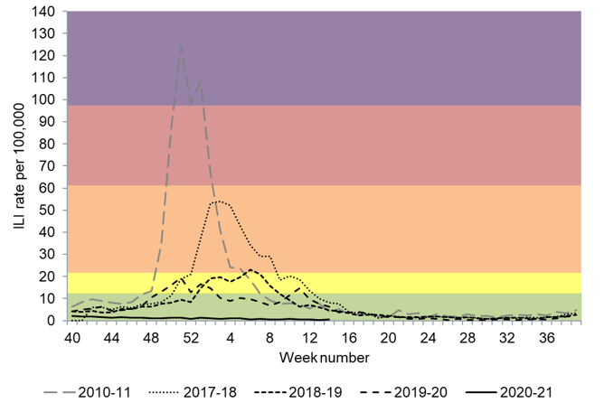

Flu epidemiology
Flu activity usually between September to March (weeks 37 and 15)
impact of flu varies each year: extremely low levels of flu were seen across the UK in the 2020/21 season
Hospital and ICU/HDU admissions were below baseline for the duration of the season and much lower than rates seen in previous years
Weekly all age GP influenza-like illness rates for 2020 to 2021 and past seasons, England (RCGP)
The national flu immunisation programme 2021 to 2022
Notes:
The impact of flu on the population varies from year to year and is influenced by changes in the virus that, in turn, influence the proportion of the population that may be susceptible to infection and the severity of the illness.
The graph shows the rate of influenza/influenza-like illness episodes in England and Wales per 100,000 consultations in primary care for the 2010/11, 2017/18, 2018/19, 2019/20 and 2020/21 seasons. The data show that flu viruses circulate each winter season, but the degree of activity varies substantially.
In the 2020 to 2021 season, extremely low levels of flu activity were seen across the UK but during this season, public health messaging, social and physical distancing measures, national lockdowns, local and international travel restrictions and the wearing of face coverings were in place due to COVID-19. Hospital and ICU/HDU admissions were much lower than seen in previous years.
This compares to the 2018 to 2019 season when low levels of influenza activity in the community were observed in the UK with A(H1N1)pdm09 being the dominant influenza A sub-type, later followed by A(H3N2). Peak hospitalisation rates were slightly lower than seen in the 2017/18 season, though they still reached high impact. The burden of hospitalisation for flu was mainly in middle-age and older adults. Peak ICU rates were similar to last flu season – reaching high impact with the burden mainly in young and middle-age adults.
In the 2019 to 2020 season, activity started to increase from week 47, low levels of activity were seen in England, and medium levels in Scotland, Northern Ireland and Wales.

Slide 16
When to vaccinate
those eligible should be given flu vaccination as soon as vaccine is available so that people are protected when flu begins to circulate in the community
ideally most vaccination should be completed before the end of December before flu circulation usually peaks
flu can circulate considerably later than this however so clinical judgement should be applied to assess needs of individual patients and whether it is appropriate to continue to offer vaccination from January to March
this decision should take into account level of flu-like illness in community and fact that the immune response following flu vaccination takes about two weeks to develop fully
as antibody levels likely to reduce in subsequent seasons and there may be changes to circulating strains from one season to next, annual revaccination is important
The national flu immunisation programme 2021 to 2022
Notes:
Although influenza activity is not usually significant in the UK before the middle of November, the influenza season can start early and therefore the ideal time for immunisation is between September and early November. After immunisation, protective immune responses may be achieved within 14 days. Protection afforded by the vaccine is thought to last for at least one influenza season. However, as the level of protection provided in subsequent seasons is likely to reduce and there may be changes to the circulating strains from one season to the next, annual revaccination is important.

Slide 17
Rollout of the childhood flu vaccination programme in England
Extension of the seasonal flu vaccination programme to children aims to lower the public health impact of flu by:
providing direct protection by preventing cases of flu infection in children
providing indirect protection by lowering flu transmission from children:
      to other children, adults and to those in the clinical risk groups of any age
Reducing flu transmission in the community averts many cases of severe flu and flu-related deaths in older adults and people with clinical risk factors
Annual administration of flu vaccine to children is expected to substantially reduce flu-related illness, GP consultations, hospital admissions and deaths
    the programme has been rolled out over a number of flu seasons and has included geographical piloting in different age groups. Each year, more age groups have been added to the national programme and in the 2021 to 2022 flu season, all children aged 2 years to 15 years (but not 16 years or older) on 31 August 2021) are eligible for vaccination
with concerns about co-circulation of the SARs-CoV-2 virus during the 2020 to 2021 flu season, it is particularly important to reduce transmission of flu in the community.
Notes:
In July 2012, the JCVI recommended extending the annual flu programme to include healthy children aged 2 to their seventeenth birthday in order both to lower the potentially serious impact of flu in vaccinated children and also to have a more profound effect on flu transmission. Children are the main source of transmission in the population, and extending the flu programme to include healthy children should therefore reduce the spread of infection from children to other children, to adults and to those in clinical risk groups of any age. JCVI recognised that implementation of this programme would be challenging and due to the scale of the programme it is being phased in.
The children’s programme began in 2013/14 with all two- and three-year-olds being offered vaccination through general practice and geographic pilots in primary school-aged children. In 2014/15 this offer was extended to four-year-olds through general practice, with pilots in primary and secondary school-aged children (in years 7 and 8). In 2015/16 the programme was extended to include children of appropriate age in school years 1 and 2 and in 2016/17, the offer of flu vaccine to extended to children in school year 3. In 2017/18, children in reception class and school years 1 to 4 were offered flu vaccine in school and pre-school age children (2y and 3y) were offered flu vaccine in primary care. In 2018/19, children in reception class and school years 1 – 5 were offered flu vaccine in school and pre-school age children (2y and 3y) continued to be offered the vaccine in primary care. Children of school age that are in an at risk group can also access the vaccine in primary care. In 2019/20, children in school year 6 were offered the vaccine and for 2020/21, school year 7 has been included so all children aged 2 to 11 (but not 12 years or older) on 31 August 2020 were be offered the vaccine.
During 2021/22, all those aged 2 and 3 years, primary school aged children and those in secondary school year 7 to 11 (aged 4 to 15 years on 31 August 2021) were offered flu vaccine.
An analysis of data comparing the level of flu-related demand on NHS services in 2014/15 primary school pilot areas with non-pilot areas indicates that immunisation of children does have a significant impact. Results were obtained from a range of surveillance indicators including GP consultations for influenza-like illness, swab positivity in primary care, laboratory confirmed hospitalisations and percentage of respiratory emergency department attendances. The key findings were:
• the GP consultation rate for ‘influenza-like illness’ among primary school aged children was 94% lower compared to non-pilot areas
• A&E respiratory attendances by primary school aged children were 74% lower
• hospital admissions of primary school aged children caused by confirmed influenza were 93% lower
• a positive impact could also be measured among the adult population. The GP consultation rate for ‘influenza-like illness’ among adults was 59% lower compared to non-pilot areas
Children aged 2 to 15 years (but not 16 on 31 August 2021) are eligible for flu vaccination during 2021/22. Children aged 6 months to 2 years and in a clinical risk group remain eligible due to their underlying medical condition or treatment.

Slide 18
Flu vaccine eligibility: 2021 to 2022 flu season
all children aged 2 to 15 (but not 16 years or older) on 31 August 2021
people aged six months to under 50 years in clinical risk groups
all pregnant women (including those who become pregnant during flu season)
people aged 50 years and over (including those becoming 65 years by 31 March 2021)
people living in long-stay residential care homes or other long-stay care facilities
carers
household contacts of immunocompromised individuals
all frontline heath and social care workers
The national flu immunisation programme 2021 to 2022
Notes:
“Long stay care facilities” does not include prisons, young offender institutions, university halls of residence or boarding schools (except if children in boarding school are of primary school age or school year 7 to 11)
“Carers” are those who are in receipt of a carer’s allowance, or those who are the main carer of an older or disabled person whose welfare may be at risk if the carer falls ill
Vaccination should also be offered to close contacts immunocompromised individuals, specifically individuals who expect to share living accommodation on most days over the winter and, therefore, for whom continuing close contact is unavoidable. Child contacts of very severely immunocompromised individuals should be given inactivated vaccine rather than the live vaccine that would normally be recommended for children under 18 years.
This list is not exhaustive, and the healthcare practitioner should ensure they are aware of all eligible groups listed in the flu programme letter and apply clinical judgement to take into account the risk of flu exacerbating any underlying disease that a patient may have, as well as the risk of serious illness from flu itself. Flu vaccine should be offered in such cases even if the individual is not in the clinical risk groups specified above

Slide 19
Clinical risk groups
increasing flu vaccine uptake in clinical risk groups is important because of increased risk of death and serious illness if people in these groups catch flu
for a number of years only around half of patients aged six months to under 65 in clinical risk groups have been vaccinated
vaccine uptake for all clinical risk groups needs to improve
for 2021 to 2022, uptake ambition for ‘aged under 65 ‘at risk’, including pregnant women’ is ‘at least 75% in all clinical risk groups, and to maintain higher rates where those have already been achieved
Strategies to improve vaccine uptake should be tailored to each risk group to ensure optimum uptake of vaccine in each of them.
further information on flu vaccination for those with learning disabilities can be found on the Gov.UK website
https://www.gov.uk/government/publications/flu-vaccinations-for-people-with-learning-disabilities/flu-vaccinations-supporting-people-with-learning-disabilities
The national flu immunisation programme 2021 to 2022
Notes:
For a number of years only around half of patients aged six months to under 65 in clinical risk groups have been vaccinated
Vaccine uptake for those in clinical risk groups needs to improve, particularly for those who are at the highest risk of severe disease and mortality from flu but have low rates of vaccine uptake, including those with chronic liver disease and people with learning disabilities.
Uptake ambitions for each eligible group have been set out in the annual flu letter for 2021/22

Slide 20
Clinical risk groups who should receive flu vaccine (1)
Clinical risk category | Examples (this list is not exhaustive and decisions should be based on clinical judgement)
Chronic respiratory disease | Asthma that requires continuous or repeated use of inhaled or systemic steroids or with previous exacerbations requiring hospital admission. Chronic obstructive pulmonary disease (COPD) including chronic bronchitis and emphysema; bronchiectasis, cystic fibrosis, interstitial lung fibrosis, pneumoconiosis and bronchopulmonary dysplasia (BPD). Children who have previously been admitted to hospital for lower respiratory tract disease. see precautions section on live attenuated influenza vaccine
Chronic heart disease | Congenital heart disease, hypertension with cardiac complications, chronic heart failure, individuals requiring regular medication and/or follow-up for ischaemic heart disease.
Chronic kidney disease | Chronic kidney disease at stage 3, 4 or 5, chronic kidney failure, nephrotic syndrome, kidney transplantation.
Chronic liver disease | Cirrhosis, biliary atresia, chronic hepatitis
Chronic neurological disease | Stroke, transient ischaemic attack (TIA), Parkinson’s disease, motor neurone disease. Conditions in which respiratory function may be compromised due to neurological disease (eg polio syndrome sufferers). Clinicians should offer immunisation, based on individual assessment, to clinically vulnerable individuals including those with cerebral palsy, learning disabilities, multiple sclerosis and related or similar conditions; or hereditary and degenerative disease of the nervous system or muscles; or severe neurological disability
Learning disability
Diabetes | Type 1 diabetes, type 2 diabetes requiring insulin or oral hypoglycaemic drugs, diet controlled diabetes.
The national flu immunisation programme 2021 to 2022
Notes:
Flu vaccine should be offered to the eligible groups set out in the table.
[Note to trainers: Although difficult to read the detail on this slide in a lecture theatre/classroom situation, this table is presented here in order to show immunisers that under each risk group category, individual conditions are listed and detailed. Healthcare practitioners should refer to the Green Book influenza chapter for further detail about clinical risk groups included in the national flu immunisation programme. This chapter is regularly updated, sometimes during the flu season, and can be found at: www.gov.uk/government/collections/immunisation-against-infectious-disease-the-green-book]

Slide 21
Clinical risk groups who should receive flu vaccine (2)
Clinical risk category | Examples (this list is not exhaustive and decisions should be based on clinical judgement)
Immunosuppression (see contraindications and precautions section on live attenuated influenza vaccine) | Immunosuppression due to disease or treatment, including patients undergoing chemotherapy leading to immunosuppression, bone marrow transplant, HIV infection at all stages, multiple myeloma or genetic disorders affecting the immune system (eg IRAK-4, NEMO, complement disorders) Individuals treated with or likely to be treated with systemic steroids for more than a month at a dose equivalent to prednisolone at 20mg or more per day (any age), or for children under 20kg, a dose of 1mg or more per kg per day. It is difficult to define at what level of immunosuppression a patient could be considered to be at a greater risk of the serious consequences of influenza and should be offered influenza vaccination. This decision is best made on an individual basis and left to the patient’s clinician. Some immunocompromised patients may have a suboptimal immunological response to the vaccine.
Asplenia or dysfunction of the spleen | This also includes conditions such as homozygous sickle cell disease and coeliac syndrome that may lead to splenic dysfunction.
Pregnant women | Pregnant women at any stage of pregnancy (first, second or third trimesters). (see precautions section on live attenuated influenza vaccine)
Morbid obesity (class III obesity)* | Defined as a Body Mass Index of 40 and above *Many of this patient group will already be eligible due to complications of obesity that place them in another risk category
The national flu immunisation programme 2021 to 2022

Slide 22
Why vaccinate these risk groups?
Influenza-related population mortality rates and relative risk of death among those aged six months to under 65 years by clinical risk group in England, September 2010 – May 2011
 | Number of fatal flu cases (%) | Mortality rate per 100,000 population | Age-adjusted relative risk
In a risk group | 213 (59.8) | 4.0 | 11.3 (9.1-14.0)
Not in any risk group | 143 (40.2) | 0.4 | Baseline
Chronic renal disease | 19 (5.3) | 4.8 | 18.5
Chronic heart disease | 32 (9.0) | 3.7 | 10.7 (7.3-15.7)
Chronic respiratory disease | 59 (16.6) | 2.4 | 7.4 (5.5-10.0)
Chronic liver disease | 32 (9.0) | 15.8 | 48.2 (32.8-70.6)
Diabetes | 26 (7.3) | 2.2 | 5.8 (3.8-8.9)
Immunosuppression | 71 (19.9) | 20.0 | 47.3 (35.5-63.1)
Chronic neurological disease (excluding stroke/transient ischaemic attack) | 42 (11.8) | 14.7 | 40.4 (28.7-56.8)
Total | 378 | 0.8
The national flu immunisation programme 2021 to 2022
Notes:
Increasing flu vaccine uptake in clinical risk groups is important because of the increased risk of serious illness should people in these groups catch flu. The table above shows flu mortality by clinical risk group and the increased risk of death for those in these groups.

Slide 23
Pregnant women
All pregnant women are recommended to receive the inactivated flu vaccine irrespective of their stage of pregnancy
pregnant women are at increased risk from complications if they contract flu
having flu during pregnancy may be associated with premature birth and smaller birth size and weight
flu vaccination during pregnancy provides passive immunity against flu to infants in the first few months of life
studies on safety of flu vaccine in pregnancy show that inactivated flu vaccine can be safely and effectively administered during any trimester of pregnancy
no study to date has demonstrated an increased risk of either maternal complications or adverse fetal outcomes associated with inactivated flu vaccine
women should be offered flu vaccine every time they are pregnant
The national flu immunisation programme 2021 to 2022
Notes:
All pregnant women are recommended to receive the inactivated flu vaccine irrespective of their stage of pregnancy.
There is good evidence that pregnant women are at increased risk from complications if they contract flu .In addition, there is evidence that having flu during pregnancy may be associated with premature birth and smaller birth size and weight and that flu vaccination may reduce the likelihood of prematurity and smaller infant size at birth associated with an influenza infection during pregnancy. Furthermore, a number of studies show that flu vaccination during pregnancy provides passive immunity against flu to infants in the first few months of life. A review of studies on the safety of flu vaccine in pregnancy concluded that inactivated flu vaccine can be safely and effectively administered during any trimester of pregnancy and that no study to date has demonstrated an increased risk of either maternal complications or adverse fetal outcomes associated with inactivated influenza vaccine.
The ideal time for flu vaccination is before flu starts circulating. However, even after flu is in circulation, vaccine should continue to be offered to those at risk and newly pregnant women. If a woman becomes pregnant after the usual vaccinating period of October to January, it is still worth considering offering the vaccine if flu is still circulating in the community. Women should be offered the vaccine every time they are pregnant as the flu virus constantly mutates and therefore the strains included in the vaccine are reviewed annually.

Slide 24
Residential care/nursing home residents and staff
those living in long-stay residential care homes or other long-stay care facilities where rapid spread is likely to follow introduction of infection and cause high morbidity and mortality should be offered influenza vaccine (this does not include prisons, young offender institutions, university halls of residence, or boarding schools unless of primary school age)
The community pharmacy seasonal influenza advanced service framework will be amended to enable community pharmacies to vaccinate both residential care/nursing home residents and staff in the home setting in a single visit to increase uptake rates
GP practices are also able to vaccinate in the residential/care home, residents and staff who are registered with the practice

Slide 25
Health and social care workers
vaccination of health and social care workers protects them and reduces risk of spreading flu to their patients, service users, colleagues and family members
evidence that vaccination significantly lowers rates of flu-like illness, hospitalisation and mortality in the elderly in long-term healthcare settings
reduces transmission of flu to vulnerable patients, some of whom may have impaired immunity and may not respond well to immunisation
frontline health and social care workers have a duty of care to protect their patients and service users from infection
vaccination of frontline workers also helps reduce sickness absences and contributes to keeping the NHS and care services running through winter pressures
NHS and social care bodies have a responsibility to ensure, as far as is reasonably practicable, that health and social care workers are free of, and are protected from exposure to infections that can be caught at work
(Health and Social Care Act 2008, Code of Practice on the prevention and control of infections)
The national flu immunisation programme 2021 to 2022
Notes:
Frontline health and social care workers have a duty of care to protect their patients and service users from infection. This includes getting vaccinated against flu.
Flu outbreaks can occur in health and social care settings with both staff and their patients/service users being affected when flu is circulating in the community. It is important that health and social care workers protect themselves by having the flu vaccine, and, in doing so, they reduce the risk of spreading flu to their patients, service users, colleagues and family members.
Vaccination of healthcare workers against flu has been shown to significantly lower rates of flu-like illness, hospitalisation and mortality in the elderly in long-term healthcare settings. Vaccination of staff in acute care settings may provide similar benefits. Flu immunisation of frontline health and social staff care staff may reduce the transmission of infection to vulnerable patients, some of whom may have impaired immunity, increasing their risks of flu and who may not respond well to immunisation.
Vaccination of health and social care workers also helps reduce the level of sickness absenteeism that can jeopardise the NHS and care services. This is essential in the winter when pressures on these services increase. and will contribute to keeping the NHS and care services running. This is particularly important when responding to winter pressures.
Immunisation should be provided to healthcare and social care workers in direct contact with patients/clients to protect them and to reduce the transmission of flu within health and social care premises, to contribute to the protection of individuals who may have a suboptimal response to their own immunisations, and to avoid disruption to services that provide their care. This includes:
health and social care staff directly involved in the care of their patients or clients
those living in long-stay residential care homes or other long-stay care facilities where rapid spread is likely to follow introduction of infection and cause high morbidity and mortality (this does not include prisons, young offender institutions, university halls of residence etc.)
those who are in receipt of a carer’s allowance, or those who are the main carer of an elderly or disabled person whose welfare may be at risk if the carer falls ill.
others involved directly in delivering health and social care such that they and vulnerable patients/clients are at increased risk of exposure to influenza (further information is provided in guidance from UK health departments)
All frontline health and social care workers with direct patient/service user contact should be provided with flu vaccination by their employer.
This includes staff in all NHS trusts, general practices, care homes, and domiciliary care
Employers are encouraged to commission a service which makes access to the vaccine easy for all staff, encourage staff to get vaccinated and to monitor the delivery of their programme.
The definition of healthcare workers from the Green Book chapter 12 should be used to identify those eligible as part of the frontline and social care workers programme.
NHS Trusts are asked to complete a self assessment against best practice checklist
NHS England and Improvement (NHSE/I) will continue to support vaccination of social care and hospice workers, with vaccination available through their employer, community pharmacy or their registered GP practice

Slide 26
Vaccination of those not in a clinical risk group
the list of clinical risk groups is not exhaustive, healthcare practitioners should apply clinical judgement to take into account the risk of flu exacerbating any underlying disease as well as the risk of serious illness from flu itself
  flu vaccine should be offered to such cases and will be reimbursed, even if the individual is not in the clinical risk groups specified in the risk groups list
The national flu immunisation programme 2021 to 2022
Notes:
The list of clinical risk groups is not exhaustive, and the healthcare practitioner should apply clinical judgement to take into account the risk of influenza exacerbating any underlying disease that a patient may have, as well as the risk of serious illness from flu itself. Flu vaccine should be offered in such cases even if the individual is not in one of the specified clinical risk groups.

Slide 27
Flu vaccine uptake in England 2015 to 2021 (%)
Target Group | 2020/21 | 2019/20 | 2018/19 | 2017/18 | 2016/17 | 2015/16 | % Uptake ambition for 2021/22
Patients aged 65 years or older | 80.9 | 72.4 | 72.0 | 72.6 | 70.5 | 71.0 | 85
Patients aged six months to under 65 years in risk groups* | 53.0 | 44.9 | 48.0 | 48.9 | 48.6 | 45.1 | 75 (maintain higher rates where this has already been achieved)
Pregnant women in risk group | 57.7 | 56.9 | 60.2 | 62.1 | 58.7 | 40.6 | 75
Pregnant women NOT in risk group | 41.5 | 42.1 | 43.7 | 45.7 | 43.3 | 55.9 | 75
All pregnant women | 43.6 | 43.7 | 45.2 | 47.2 | 44.9 | 42.3 | 75 (maintain higher rates where this has already been achieved)
Health and social care workers | 76.8 | 74.3 | 70.3 | 68.7 | 63.2 | 50.6 | 100% offer
*The pregnant women and healthcare workers who are also in one or more clinical risk groups may also be included in the <65 years at risk category
Notes:
During 2020/21, vaccine uptake increased in patients aged 65 years and older, in those aged 6 months to 65 years and in an at risk group and in health and social care workers. There was a slight decrease in vaccine uptake in pregnant women.

Slide 28
Flu vaccine uptake by individual clinical risk group in 2020 to 2021 (%) GP registered patients aged 6 months to under 65 years
Risk group | 6 months to under 2 years | 2 years to under 5 years | 5 years to under 16 years | 16 years to under 65 | Total under 65 years
Patients with Diabetes | 17.3 | 57.8 | 58.5 | 68.0 | 67.9
Patients with Chronic Kidney Disease | 28.6 | 55.7 | 44.5 | 61.8 | 61.4
Patients with immunosuppression | 22.8 | 56.7 | 50.9 | 60.9 | 60.4
Patients with Chronic Neurological Disease (including Stroke/TIA, Cerebral Palsy or MS) | 19.6 | 53.8 | 43.9 | 54.7 | 53.7
Patients with Chronic Respiratory Disease | 37.0 | 62.4 | 53.0 | 58.5 | 57.9
Patients with Chronic Heart Disease | 25.4 | 55.8 | 45.0 | 56.8 | 55.8
Patients with Chronic Liver Disease | 23.6 | 53.9 | 41.9 | 47.6 | 47.5
Patients with Asplenia or dysfunction of the spleen | 24.4 | 56.7 | 42.3 | 44.2 | 44.1
Patients with morbid obesity (BMI>=40) (no other risk factor) | 0 | 52.5 | 37.0 | 32.5 | 32.5
The national flu immunisation programme 2021 to 2022
Notes:
Uptake was 53% for all aged six months to under 65 years at-risk compared to 44.9% in 2019/20
In those in an at risk group, vaccine uptake varies by age and by risk group.
Vaccine uptake needs to improve for all age groups and all risk groups
https://portal.immform.phe.gov.uk (viewed on 18 May 2021)

Slide 29
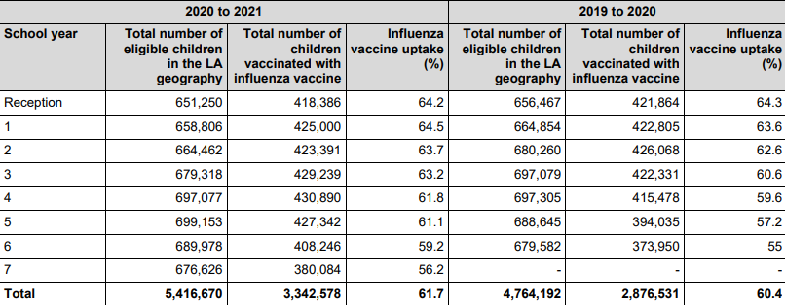
2020 to 2021 childhood flu uptake
All 2 and 3 year olds were offered vaccination through GP surgeries. Combined uptake was 56.7% compared to 43.8% in 2019 to 2020.
The national flu immunisation programme 2021 to 2022

Slide 30
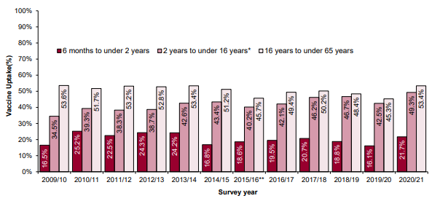
Vaccine uptake for children in a clinical risk group (2020 to 2021)
Target groups for vaccination | % vaccine uptake
Six months to under two years in a clinical risk group | 21.7
Two years to under 5 years in a clinical risk group | 55.9
5 years to under 16 years in a clinical risk group | 48.6
Vaccine uptake figures show that uptake in children in clinical risk groups is higher in the age group where all children (healthy and clinical risk group) have been offered flu vaccination
Vaccine uptake in those aged 6 months to under 2 years remains the lowest in uptake by age band
Vaccine uptake in the under 65 at-risk by age group
The national flu immunisation programme 2021 to 2022
Notes:
Only one age band decreased in uptake from the previous season, which was patients with diabetes aged 6 months to 2 years which declined by 0.1%.All other groups increased.
vaccine uptake is particularly low in the younger age groups with clinical conditions that put them at most risk of complications from flu
immunisers should make sure that all at-risk children have the opportunity to receive flu vaccine
parents of at-risk children eligible to receive vaccine at school can choose to receive vaccine in general practice, especially if school session is later in the year and parent does not want their child to wait

Slide 31
Vaccine uptake for Health and social care workers
During 2020 to 2021, 76.7% of HSCWs were vaccinated (874028 doses given) which is a slight increase from 2019/20 (74.3%)
  All doctors 77.3% (76%)
  GPs 83.1% (67.2%)
  Total qualified nurses 76.6% (73.2%)
  Practice nurses 84.8% (71.7%)
trusts/employers must ensure that 100% of health and social care staff directly involved in delivering care are offered flu vaccine and encouraged to be immunised
in 2021 to 2022, NHS England will continue to support vaccination of social care and hospice workers. Eligible groups will remain the same as in 2020/21 and vaccination will be available through community pharmacy or their registered general practice. This scheme is intended to complement, not replace, any established occupational health schemes that employers have in place to offer flu vaccination to their workforce
see Public Health England's Campaign Resource Centre for further information and resources for health and social care worker vaccination
The national flu immunisation programme 2021 to 2022
Notes:
It is the responsibility of the NHS and social care bodies to ensure, as far as is reasonably practicable, that health and social care workers are free of, and are protected from exposure to infections that can be caught at work. Trusts/ employers should ensure that health and social care staff directly involved in delivering care are encouraged to be immunised and that processes are in place to facilitate this.
Responsibility for funding and administering the seasonal flu vaccine to staff (other than those in clinical risk groups) lies with employers. This includes GP practices who need to have arrangements in place.

Slide 32
Influenza vaccines and their components
Two main types of vaccine available:
  inactivated – given by injection
  live attenuated – given by nasal application
None of the flu vaccines can cause clinical influenza in those that can be vaccinated
both the live and inactivated flu vaccines are quadrivalent vaccines – they contain two subtypes of Influenza A and both B virus types and may provide better protection against the circulating B strain(s)
the inactivated vaccine is recommended for children who cannot receive live attenuated vaccine
Notes:
Inactivated flu vaccines given by intramuscular injection have been used in the UK for many years. The live intranasal influenza vaccine (LAIV) was introduced into the UK schedule in 2013. However, a live intranasal flu vaccine called FluMist (same vaccine as Fluenz, different trade name) was introduced in the US schedule in 2003 so although the live vaccine is newer, there is well over a decade’s experience of widespread use of the vaccine in the US.
In previous years, most inactivated flu vaccines were trivalent, containing two subtypes of influenza A and one B virus. However, quadrivalent vaccines, containing two subtypes of influenza A and both B virus types have been developed and are now recommended for all eligible groups including pregnant women and those in an at risk group under 50 years of age. The live intranasal vaccine is a quadrivalent vaccine (hence the ‘Tetra’ part of the name Fluenz Tetra). An inactivated quadrivalent vaccine was made available for the first time in 2013 and is the preferred vaccine for children who are contraindicated to receive the LAIV .
NB The Fluenz vaccine used in the 2013/14 flu season was a trivalent live vaccine. Fluenz Tetra was first used in the 2014/15 flu season and has been used since.
We now have 8 years experience using Fluenz LAIV vaccine in the UK.

Slide 33
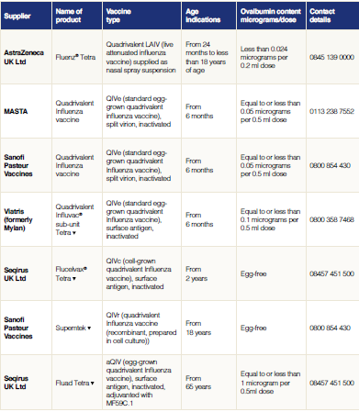
Influenza vaccines available for 2021 to 2022
Notes:
There are a number of different flu vaccines available each year and it is important to be aware of the age indications and the ovalbumin content of each of them.

Slide 34
Flu vaccine presentation and dosage
inactivated influenza vaccines are for intramuscular (IM) administration and are supplied as suspensions in pre-filled syringes containing a 0.5ml dose
if the SmPC for IM inactivated flu vaccine states young children can be given either a 0.25ml or a 0.5ml dose, JCVI have advised that 0.5ml dose should be given
the live intranasal flu vaccine is supplied as a nasal spray suspension in a single use, pre-filled, nasal applicator with a divider clip. No reconstitution or dilution is required. Each vaccine contains 0.2ml (administered as 0.1 ml per nostril)
some flu vaccines are restricted for use in particular age groups
the SmPC for individual products should always be referred to when ordering vaccines for particular patients
The national flu immunisation programme 2021 to 2022
Notes:
Inactivated flu vaccine for intramuscular (IM) administration is supplied as a suspension in a pre-filled syringe. They should be shaken well before they are administered
Some SmPCs for IM inactivated flu vaccines indicate that young children can be given either a 0.25ml or a 0.5ml dose. JCVI has advised that where these alternative doses are indicated in the SPC, the 0.5ml dose should be given to infants aged six months or older and young children because there is evidence that this dose is effective in young children.
All but one of the flu vaccines available in the UK are inactivated, do not contain live viruses and cannot cause clinical influenza in those that can be vaccinated. In previous years, most of the available flu vaccines were prepared from viruses grown in embryonated hens eggs. For 2021/22, flu vaccines are available that are cell based, egg based or recombinant. The flu vaccines available in the UK for the 2021/22 flu season are listed in the “The national flu immunisation programme 2021/22” letter available on the GOV.UK website.
The LAIV is supplied as a single use prefilled nasal applicator that is ready to use. No reconstitution or dilution is required.

Slide 35
Inactivated influenza vaccine
For the 2021/22 flu season (northern hemisphere winter) it is recommended that quadrivalent vaccines contain the following:
Egg-based Vaccines
an A/Victoria/2570/2019 (H1N1)pdm09-like virus;
an A/Cambodia/e0826360/2020 (H3N2)-like virus;
a B/Washington/02/2019 (B/Victoria lineage)-like virus; and
a B/Phuket/3073/2013 (B/Yamagata lineage)-like virus.
Cell- or recombinant-based Vaccines
an A/Wisconsin/588/2019 (H1N1)pdm09-like virus;
an A/Cambodia/e0826360/2020 (H3N2)-like virus;
a B/Washington/02/2019 (B/Victoria lineage)-like virus; and
a B/Phuket/3073/2013 (B/Yamagata lineage)-like virus.
This vaccine composition differs from the 2020/21 vaccine composition

Slide 36
Adjuvanted influenza vaccine (aQIV)
Adjuvanted trivalent influenza vaccine (aTIV) was used in the UK in the 2018 to 2019 and 2019 to 2020 flu seasons in 65y and over age group and was used widely elsewhere. It has been used for 20 years and over 93 million doses have been distributed worldwide and it has an excellent safety record
Adjuvanted vaccines have higher immunogenicity and effectiveness than non-adjuvanted, normal dose vaccines in older people
An adjuvanted quadrivalent vaccine (aQIV) has replaced aTIV for 2021 to 2022. This vaccine contains two subtypes of Influenza A (H3N2 and H1N1pdm09) and two type B virus
an adjuvant (MF59) has been added to the vaccine to enhance the immune response to counter the effect of immunosenescence (age related reduction in immune response)
MF59 adjuvant is an oil-in-water emulsion of squalene oil which is a naturally occurring substance found in humans, animals and plants. In humans, it is made in the liver and circulates in the bloodstream
aQIV is made using an egg-based manufacturing process
The national flu immunisation programme 2021 to 2022

Slide 37
Quadrivalent influenza cell culture vaccine (QIVc)
QIVc (Flucelvax TETRA) was first licenced in the US in 2016 and was licensed in the UK in December 2018
Flucelvax TETRA is a quadrivalent vaccine containing two subtypes of Influenza A (H3N2 and H1N1pdm00) and both B virus lineages. As the vaccine contains both lineages of B viruses it may provide better protection against circulating flu B strain(s) than trivalent flu vaccines
QIVc has a similar safety profile to other flu vaccines (similar rate and type of adverse reactions reported). More than 100 million doses of cell-based vaccine have been distributed worldwide with no serious safety concerns
the cell-based vaccine manufacturing process uses an animal cell line (Madin-Darby Canine Kidney, or MDCK) to grow the influenza virus rather than the traditional egg based manufacturing methods
this manufacturing process eliminates the risk of egg-adaptation and may result in the vaccine containing virus that is a closer match to wild-type circulating flu viruses
Flucelvax tetra is licenced for use in those aged 2 years and over and is egg free
The national flu immunisation programme 2021 to 2022

Slide 38
QIVr
Supemtek (QIVr) is a quadrivalent flu vaccine made using recombinant DNA technology
it does not require the use of, or growth of flu virus during the manufacturing process which means that the antigen in the vaccine cannot adapt or mutate and should therefore be an exact match to the flu A and B strains contained in the vaccine
it also contains 3 times the amount of flu virus antigen contained in the other flu vaccines currently used in the UK in order to enhance the immune response made to it
the type and rates of local and systemic reactions following vaccination with Supemtek are similar to those seen following vaccination with other flu vaccines (injection site tenderness, headache, fatigue, muscle ache and joint pain)
since eggs are not required to grow the flu virus, cell-based flu vaccines contain no egg and they also do not contain any live virus, antibiotics or gelatine

Slide 39
QIVe
the egg-grown quadrivalent influenza vaccine (QIVe) protects against 4 strains of flu: 2 A types and both B types
this vaccine can be considered for use in at risk adults and pregnant women aged less than 65 years if the recommended vaccines are not available. Any impact of egg adaptation is likely to be limited to influenza seasons dominated by well-matched H3N2 strains
JCVI supports a preference for QIVc and QIVr over QIVe

Slide 40
High dose trivalent influenza vaccine (TIV-HD)
High dose trivalent influenza vaccine is not available in the UK market during 2021 to 2022
Trivalent Influenza Vaccine High Dose (TIV-HD) was first licenced in the US in 2009 and was licensed in the UK in January 2019
TIV-HD is a trivalent inactivated flu vaccine containing 2 subtypes of Influenza A and one type B virus
TIV-HD contains four times the amount of antigen contained in standard-dose inactivated influenza vaccines. The additional antigen content is intended to enhance the immune response to counter the effect of immunosenescence in those aged 65 and over
TIV-HD has been proven to be safe and effective
TIV-HD is made using an egg-based manufacturing process
The national flu immunisation programme 2021 to 2022

Slide 41
Inactivated influenza vaccine for children contraindicated to receive LAIV
children for whom LAIV is medically contraindicated should be offered a suitable alternative inactivated flu vaccine
for children in clinical risk groups under 18 years of age where LAIV is contraindicated or otherwise unsuitable:
      QIVe should be offered to children less than 2 years of age
      QIVc should ideally be offered to children aged 2 years and over who access the vaccine through general practice. Where QIVc vaccine is unavailable, GPs should offer QIVe unless contraindicated
if the inactivated vaccine supplied by PHE is not used, please be aware that not all inactivated flu vaccines are licensed for children and some contain too much ovalbumin for egg allergic children
always check SmPC for vaccine suitability before administration
The national flu immunisation programme 2021 to 2022
Notes:
The inactivated flu vaccines are interchangeable; the second dose, if required, should be given at least four weeks after the first dose in accordance with the manufacturer’s SmPC for that vaccine.

Slide 42
Live attenuated influenza vaccine (LAIV)
a live attenuated intranasal spray is the recommended vaccine for the childhood flu programme
the live attenuated (weakened) influenza vaccine (LAIV) has been shown to be more effective in children compared with inactivated influenza vaccines
it may offer some protection against strains not contained in the vaccine as well as to those that are and has the potential to offer better protection against virus strains that have undergone antigenic drift
since this vaccine is comprised of weakened whole live virus, it replicates natural infection which induces better immune memory (thereby offering better long-term protection to children than from the inactivated vaccines)
in addition to being attenuated, the live viruses in LAIV have been adapted to cold so that they cannot replicate efficiently at body temperature
LAIV has a good safety profile in children aged two years and older
The national flu immunisation programme 2021 to 2022
Notes:
The quadrivalent live attenuated intranasal influenza vaccine used in the UK is called Fluenz Tetra. The majority of published literature is about Fluenz (a trivalent vaccine used prior to the addition of the other B strain) but most of this will apply to Fluenz Tetra
LAIV has been shown to be more effective in children compared with inactivated flu vaccines and it may offer some protection against strains not contained in the vaccine as well as to those that are and has potential to offer better protection against strains that have undergone antigenic drift compared to the original virus strains in the vaccine
Since this vaccine is comprised of weakened whole live virus, it replicates natural infection which induces better immune memory. This should mean it also offers better long-term protection to children than they may get from the inactivated vaccines.
LAIV contains live viruses that have been attenuated (weakened) and adapted to cold so that they cannot replicate efficiently at body temperature. The vaccine viruses replicate in the cooler nasal mucosa but not at body temperature in the lungs. This means they cannot cause clinical flu in immunocompetent children.
The live intranasal vaccine has a good safety profile in children aged two years and older and has been used for over a decade in the United States. The vaccine was extensively tested prior to it’s launch in the Unites States market. Since then there has been extensive post launch surveillance in the USA, involving millions of doses in children with no evidence found of any safety concerns. It has also been used in the past four flu seasons in the UK where hundreds of thousands of children have been safely vaccinated. As with all vaccines and medicines, MHRA closely and continuously monitors the safety of LAIV.

Slide 43
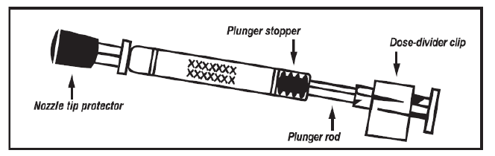

The LAIV used in the UK is Fluenz Tetra
  generic name: influenza vaccine (live attenuated, nasal)
  Licensed from 24 months to less than 18 years of age
  nasal spray (suspension) in a prefilled nasal applicator
      the suspension is colourless to pale yellow, clear to opalescent. Small white particles may be present
  supplied as pack containing 10 doses (single use prefilled nasal applicators)
  ready to use (no reconstitution or dilution required)
  each applicator contains 0.2ml (administered as 0.1ml per nostril)
Image courtesy of AstraZeneca
Notes:
Fluenz Tetra is a live attenuated vaccine (a weakened form of flu virus which cannot cause disease but which protects against flu). It is a cold adapted virus which means it cannot replicate at body temperature.
This is a nasal vaccine and must not be injected.
It is supplied in a box containing 10 prefilled nasal applicators.
Live attenuated influenza vaccine (Fluenz Tetra) has been shown to provide greater protection for children than inactivated influenza vaccine. This vaccine is the preferred vaccine for children aged two to less than 18 years.
It became available in the UK for the 2012/13 flu season. It has been used in USA (same vaccine but under the name FluMist) for many years and millions of doses have been given.

Slide 44
Porcine gelatine
the LAIV contains a highly purified form of gelatine derived from pigs
gelatine is used in LAIV as a stabiliser - it protects the live viruses from the effects of temperature
gelatine is commonly used in a range of pharmaceutical products, including many capsules and some vaccines
there is no other live attenuated flu vaccine available that does not contain porcine gelatine. The manufacturer of LAIV (Fluenz Tetra) tested 40 potential stabilisers – gelatine was chosen because without it, stability was significantly reduced
in order to prevent localised outbreaks in the 2021 to 2022 flu season, an inactivated flu vaccine may be offered to those children whose parents refuse the live attenuated influenza vaccine (LAIV) due to the porcine gelatine content
The national flu immunisation programme 2021 to 2022
Notes:
See PHE’s website (www.gov.uk/government/news/vaccines-and-gelatine-phe-response) for Q&As and more information on vaccines and gelatine

Slide 45
Acute and severe asthma
in 2019, JCVI advised that children with asthma on inhaled corticosteroids may safely be given LAIV irrespective of the dose prescribed
LAIV is not recommended for children and adolescents currently experiencing an acute exacerbation of symptoms including - those who have had increased wheezing and/or - needed additional bronchodilator treatment in the previous 72 hours
Such children should be offered a suitable inactivated influenza vaccine to avoid a delay in protection
children who require regular oral steroids for maintenance of asthma control, or have previously required intensive care for asthma exacerbation should only be given LAIV on the advice of their specialist
As these children may be at higher risk from influenza infection, those who cannot receive LAIV should receive a suitable inactivated influenza vaccine
Children with significant asthma and aged under nine years who have not been previously vaccinated against influenza will require a second dose (of either LAIV or inactivated vaccine as appropriate).
The national flu immunisation programme 2021 to 2022
Notes:
In 2019, JCVI advised that, on the basis of recent data, children with asthma on inhaled corticosteroids may safely be given LAIV, irrespective of the dose prescribed. LAIV is not recommended for children and adolescents currently experiencing an acute exacerbation of symptoms including those who have had increased wheezing and/or needed additional bronchodilator treatment in the previous 72 hours. Such children should be offered a suitable inactivated influenza vaccine to avoid a delay in protection.
There are limited safety data in children who require regular oral steroids for maintenance of asthma control, or have previously required intensive care for asthma exacerbation – such children should only be given LAIV on the advice of their specialist. As these children may be at higher risk from influenza infection, those who cannot receive LAIV should receive a suitable inactivated influenza vaccine. Children with significant asthma and aged under nine years who have not been previously vaccinated against influenza will require a second dose (of either LAIV or inactivated vaccine as appropriate).

Slide 46
Inadvertent administration of LAIV
if an immunocompromised individual receives LAIV, the degree of immunosuppression should be assessed
if patient is severely immunocompromised, antiviral prophylaxis should be considered
otherwise they should be advised to seek medical advice if they develop flu-like symptoms in the four days following administration of the vaccine
if antivirals are used for prophylaxis or treatment, the patient should also be offered inactivated flu vaccine in order to maximise their protection in the forthcoming flu season (this can be given straight away)
The national flu immunisation programme 2021 to 2022
Notes:
If an immunocompromised individual receives LAIV then the degree of immunosuppression should be assessed. If the patient is severely immunocompromised, antiviral prophylaxis should be considered, otherwise they should be advised to seek medical advice if they develop flu-like symptoms in the four days (the usual incubation period) following administration of the vaccine. If antivirals are used for prophylaxis or treatment, then in order to maximise their protection in the forthcoming flu season, the patient should also be offered inactivated influenza vaccine. This can be given straight away.

Slide 47
LAIV and ‘viral shedding’
    LAIV does not create an external mist of vaccine virus in the air when children are being vaccinated and others in the room should not be at risk of ‘catching’ the vaccine virus
    administration of the intranasal vaccine delivers just 0.1ml of fluid straight into each nostril and almost all the fluid is immediately absorbed into the child’s nose
    although vaccinated children are known to shed virus a few days after vaccination, the vaccine virus that is shed is less able to spread from person to person than natural flu infection
    the amount of virus shed is normally below the levels needed to pass on infection to others and the virus does not survive for long outside of the body. This is in contrast to natural flu infection, which spreads easily during the flu season

Slide 48
Risk of transmission of live vaccine virus
there is a theoretical potential for transmission of live attenuated flu virus to immunocompromised contacts
transmission risk is for one to two weeks following vaccination
following extensive use of the live attenuated influenza vaccine in US, there have been no reported instances of illness or infections from the vaccine virus among immunocompromised patients inadvertently exposed to vaccinated children
however, if close contact with very severely immunocompromised patients (such as bone marrow transplant patients requiring isolation) is likely or unavoidable (for example other household members) consider an appropriate inactivated flu vaccine instead
Notes:
There is a theoretical potential for transmission of live attenuated influenza virus in the LAIV to immunocompromised contacts for one to two weeks following vaccination. In the US, where there has been extensive use of the live attenuated influenza vaccine, there have been no reported instances of illness or infections from the vaccine virus among immunocompromised patients inadvertently exposed. Where close contact with very severely immunocompromised patients (such as bone marrow transplant patients requiring isolation) is likely or unavoidable (for example, household members), however, appropriate alternative inactivated influenza vaccines should be considered.

Slide 49
Exposure of healthcare professionals to live attenuated influenza vaccine viruses
theoretically there may be some low level exposure to the vaccine viruses for those administering LAIV and/or from recently vaccinated patients
in the US, where there has been extensive use of LAIV, there have not been any reported instances of illness or infections from the vaccine virus among healthcare professionals inadvertently exposed
risk of acquiring vaccine viruses from the environment is unknown but probably low
the vaccine viruses are cold-adapted and attenuated and therefore unlikely to cause symptomatic flu
as a precaution, very severely immunosuppressed individuals should not administer LAIV
other healthcare workers who have less severe immunosuppression or are pregnant, should follow normal clinical practice to avoid inhaling the vaccine and ensure that they themselves are appropriately vaccinated
The national flu immunisation programme 2021 to 2022
Notes:
In theory, healthcare workers may have low level exposure to live attenuated influenza vaccine viruses during administration of the vaccine and/or from recently vaccinated patients. The vaccine viruses are cold-adapted and attenuated and are unlikely to cause symptomatic flu. In the US, where there has been extensive use of the live attenuated flu vaccine, no transmission of vaccine virus in healthcare settings ever has been reported and there have been no reported instances of illness or infections from the vaccine virus among healthcare professionals inadvertently exposed. Thus, the Centers for Disease Control and Prevention has considered that the risk of acquiring vaccine viruses from the environment is unknown but is probably low. As a precaution, however, very severely immunosuppressed individuals should not administer live attenuated influenza vaccine. Other healthcare workers who have less severe immunosuppression or are pregnant, should follow normal clinical practice to avoid inhaling the vaccine and ensure that they themselves are appropriately vaccinated.

Slide 50
2021 to 2022 flu vaccine recommendations for those aged 65 years and over
aQIV should be offered as it is considered to be more effective than standard dose non-adjuvanted trivalent and egg-based quadrivalent influenza vaccines
• QIVc or QIVr are suitable for use in this age group if aQIV is not available.
* it is recommended that those who become 65 before 31 March 2021 are vaccinated as above
evidence suggests that these vaccines are superior to standard egg-based inactivated trivalent and quadrivalent vaccines (TIVe/QIVe) in terms of effectiveness for those aged 65 years and over

Slide 51
Flu vaccine for adults aged 18 to under 65 year olds in clinical risk groups
three vaccines will be available for the 2021 to 2022 flu season for this patient group:
      The cell cultured quadrivalent influenza cell culture vaccine (QIVc) or the recombinant quadrivalent influenza vaccine (QIVr)
      The egg grown quadrivalent inactivated influenza vaccine (QIVe) as an alternative if QIVc or QIVr are not available
quadrivalent vaccines are recommended as these may provide better protection against the circulating flu B strain(s) which are more likely to affect this younger patient group than older people
evidence to date suggests that QIVc is as effective in this patient group as QIVe. However there may be a potential advantage to the use of QIVc as there is no risk of egg adaptation causing a reduction in vaccine effectiveness

Slide 52
Flu vaccine for children
at risk children aged 6 months to 2 years offer QIVe
at risk children aged 2 years up to 18th birthday, offer live attenuated influenza vaccine (LAIV) unless contraindicated or otherwise unsuitable*
aged 2 and 3 years on 31 August 2021, all primary school aged children and those in year 7 to 11 in secondary school (ages 4 to 15 on 31 August 2021) offer LAIV unless contraindicated
*If LAIV is contraindicated or otherwise unsuitable, offer QIVc

Slide 53
Number of doses
2 doses of the inactivated flu vaccines are required to achieve adequate antibody levels in younger children
however, a single dose of LAIV should provide protection to previously unvaccinated healthy children
only modest additional protection provided by a second dose of LAIV
only children who are in clinical risk groups aged 6 months to less than 9 years who have not received flu vaccine previously should be offered a second dose of LAIV, given at least 4 weeks apart (if no contraindications – otherwise offer inactivated vaccine)
The national flu immunisation programme 2021 to 2022
Notes:
Two doses of the inactivated flu vaccines are required to achieve adequate antibody levels in younger children.
A single dose of LAIV should provide protection to previously unvaccinated healthy children however.
Only modest additional protection provided by a second dose of LAIV.
JCVI advise greater population health impact can be achieved if the limited quantity of LAIV available is given as one dose schedule to larger number of children.
Only children aged 6 months to less than nine years who are in clinical risk groups and have not received flu vaccine previously should be offered a second dose of LAIV

Slide 54
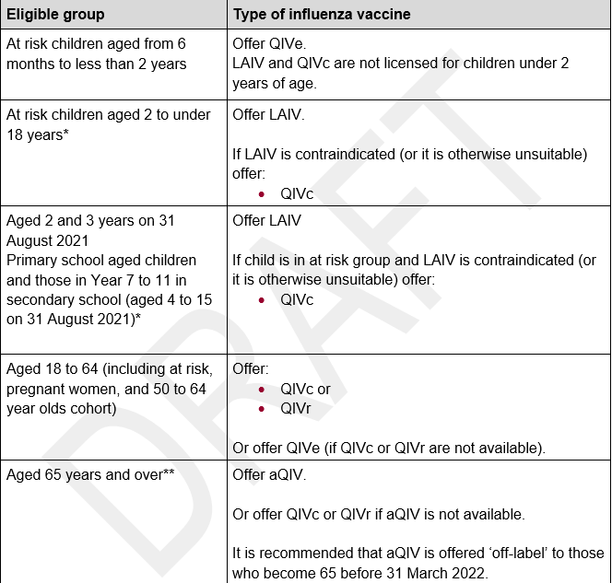
Summary table of which flu vaccines to offer children and adults
The national flu immunisation programme 2021 to 2022
Notes:
Immunisers should be alert to the recommendations for influenza vaccine according to age and eligibility. Infants younger than six months of age are not eligible to receive influenza vaccine as there is no licenced product for this age group, they can only benefit from passively acquired immunity following maternal vaccination. Infants aged six months to two years who are in an at risk group are eligible to receive quadrivalent inactivated influenza vaccine from the age of six months. LAIV is licenced for use in those aged two years to less than 18 years so all of those children in this age group who are eligible for influenza vaccination (those in an at risk group and those eligible for the universal childhood flu programme aged two years to 15 years) should be offered LAIV unless it is contraindicated due to it being a live vaccine or if it is unsuitable due to the porcine gelatine content.

Slide 55
Contraindications to LAIV
There are very few individuals who cannot receive any flu vaccine Where live attenuated flu vaccine cannot be given to a child, it is likely that inactivated vaccine could be given instead
Where there is doubt, expert advice should be sought promptly so that the period the individual is left unvaccinated is minimised
Contraindications for all flu vaccines:
confirmed anaphylactic reaction to a previous dose of flu vaccine
confirmed anaphylactic reaction to a component of flu vaccine (for example to gelatine in LAIV) or residue from the manufacturing process (gentamicin), except egg proteins (see slide on egg allergy)
Additional contraindications for LAIV :
        clinically severely immunocompromised due to a condition or immunosuppressive therapy such as:
        acute and chronic leukaemias
        lymphoma
        HIV infection not on highly active antiretroviral therapy (HAART)
        cellular immune deficiencies
        high dose corticosteroids
        receiving salicylate therapy
        known to be pregnant
Also contraindications for children with acute and severe asthma - see specific slide
The national flu immunisation programme 2021 to 2022
Notes:
Confirmed anaphylaxis is rare. Other allergic conditions such as rashes may occur more commonly and are not contraindications to further immunisation. A careful history of the event will often distinguish between true anaphylaxis and other events that are either not due to the vaccine or are not life threatening. In the latter circumstance, it may be possible to continue the immunisation course. Specialist advice must be sought on the vaccines and the circumstances in which they could be given. The risk to the individual of not being immunised must be taken into account.
The live attenuated influenza vaccine (Fluenz Tetra) should not be given to children or adolescents who are clinically severely immunodeficient due to conditions or immunosuppressive therapy such as: acute and chronic leukaemias; lymphoma; HIV infection not on highly active antiretroviral therapy (HAART); cellular immune deficiencies; and high dose corticosteroids. It is not contraindicated for use in children or adolescents with stable HIV infection receiving antiretroviral therapy; or who are receiving topical/inhaled corticosteroids or low-dose systemic corticosteroids or those receiving corticosteroids as replacement therapy, e.g. for adrenal insufficiency.
Chapter 6 of the Green Book on contraindications and special precautions gives further advice on the use of live vaccines in individuals who are severely immunosuppressed. It states that the definition of “systemic high doses steroids” (and until at least three months after treatment has stopped) would include children who receive prednisolone, orally or rectally, at a daily dose (or its equivalent) of 2mg/ kg/day for at least one week, or 1mg/kg/day for one month. Occasionally, individuals on lower doses of steroids may be immunosuppressed and at increased risk from infections. In those cases, live vaccines should be considered with caution, in discussion with a relevant specialist physician”.
The live attenuated vaccine is contraindicated in children and adolescents receiving salicylate therapy (other than for topical treatment of localised conditions) because of the association of Reye's syndrome with salicylates and wild-type flu infection as described in the SPC for Fluenz Tetra.
Safety data for the live attenuated flu vaccine when given in pregnancy is limited. Whilst there is no evidence of risk with live attenuated flu vaccine, inactivated flu vaccines are preferred for those who are pregnant. There is no need, however, to specifically test eligible girls for pregnancy or to advise avoidance of pregnancy in those who have been recently vaccinated.
Confirmed anaphylaxis is rare. Other allergic conditions such as rashes may occur more commonly and are not contraindications to further immunisation. A careful history of the event will often distinguish between true anaphylaxis and other events that are either not due to the vaccine or are not life threatening. In the latter circumstance, it may be possible to continue the immunisation course. Specialist advice must be sought on the vaccines and the circumstances in which they could be given. The risk to the individual of not being immunised must be taken into account.
The SmPCs for individual products should always be referred to when deciding which vaccine to give. There are very few individuals who cannot receive any flu vaccine. When there is doubt, appropriate advice should be sought promptly from the local screening and immunisation or health protection team or the patient’s consultant so that the period the individual is left unvaccinated is minimised.

Slide 56
Precautions to flu vaccines
Acutely unwell/severe febrile illness:
  defer until recovered
Heavy nasal congestion:
  defer live intranasal vaccine until resolved or, if the child is in a risk group, consider inactivated flu vaccine to provide protection without delay
Use with antiviral agents against flu:
live flu vaccine (LAIV) should not be administered at the same time or within 48 hours of cessation of treatment with flu antiviral agents
administration of flu antiviral agents within two weeks of administration of LAIV may adversely affect the effectiveness of the vaccine
Notes:
Minor illnesses without fever or systemic upset are not valid reasons to postpone vaccination. If the individual is acutely unwell, immunisation may be postponed until they have recovered. This is to avoid confusing the differential diagnosis of acute illness by wrongly attributing any signs or symptoms to the adverse effects of the vaccine.
There are no data on the effectiveness of LAIV when given to children with heavily blocked or runny nose (rhinitis) attributable to infection or allergy. As heavy nasal congestion might impede delivery of the vaccine to the nasopharyngeal mucosa, deferral of administration until resolution of the nasal congestion should be considered or an appropriate alternative intramuscularly administered influenza vaccine should be considered.
There is a potential for influenza antiviral agents to lower the effectiveness of the live attenuated influenza vaccine. Therefore, influenza antiviral agents and LAIV should not be administered concomitantly. LAIV should be delayed until 48 hours following the cessation of treatment with influenza antiviral agents. Administration of influenza antiviral agents within two weeks of administration of LAIV may adversely affect the effectiveness of the vaccine.
Minor illnesses without fever of systemic upset are not valid reasons to postpone vaccination. If the individual is acutely unwell the vaccination may be deferred until they have recovered. This is to avoid confusing the differential diagnosis of any acute illness by wrongly attributing any signs or symptoms to the adverse effects of the vaccine.

Slide 57
Egg allergy in adults
In previous years, most flu vaccines were prepared from flu viruses grown in embryonated hens’ eggs and the final vaccine product contained varying amounts of egg protein as ovalbumin. ovalbumin content for the 2021 to 2022 flu vaccines is published on the GOV.UK Annual flu programme webpage
For the 2021 to 2022 season, those aged 18 years and over are recommended to receive either QIVc or QIVr, both of which are egg free.
Adults with egg allergy can be immunised in any setting using:
  The cell-based quadrivalent inactivated egg-free vaccine, Flucelvax Tetra (QIVc) or the recombinant quadrivalent inactivated egg-free vaccine, Supemtek (QIVr) or
  An inactivated flu vaccine with an ovalbumin content less than 0.12 micrograms/ml (equivalent to <0.06 micrograms for 0.5ml dose)
Adults with severe anaphylaxis to egg which has previously required intensive care should be offered an egg-free vaccine or referred to a specialist for assessment with regard to receiving immunisation in hospital if this is not possible.
The national flu immunisation programme 2021 to 2022
Notes:
For the 2021 to 22 flu seasons, all those aged 18 years and over are recommended to receive wither QIVc or QIVr.
QIVe should only be offered if QIVc and QIVr are not available.
Inactivated influenza vaccines that have a very low ovalbumin content (<0.12 micrograms/ml - equivalent to <0.06 micrograms for a 0.5 ml dose) are available and studies show they may be used safely in individuals with egg allergy. Vaccines with ovalbumin content more than 0.12 micrograms/ml or where content is not stated should not be given to egg-allergic individuals.
Adult patients can also be immunised in any setting using an inactivated influenza vaccine with an ovalbumin content less than 0.12 micrograms/ml (equivalent to 0.06 micrograms for 0.5 ml dose), excepting those with severe anaphylaxis to egg which has previously required intensive care who should be referred to specialists for immunisation in hospital.

Slide 58
Egg allergy in children
children with an egg allergy (including those with previous anaphylaxis to egg) can be safely vaccinated with LAIV in any setting (including primary care and schools)
children who have required admission to intensive care for a previous severe anaphylaxis to egg should be given LAIV in the hospital setting
children with both egg allergy and a clinical risk factor that contraindicate LAIV (eg immunosuppression) should be offered an* inactivated flu vaccine with a very low ovalbumin content (less than 0.12micrograms/ml)
children over age two years with egg allergy can also be given the quadrivalent inactivated egg-free vaccine, Flucelvax Tetra (QIVc)
egg-allergic children with asthma can receive LAIV if their asthma is well-controlled (see previous slide on severe asthma)
*Children in a clinical risk group and aged 6 months to under nine years who have not been previously vaccinated against influenza will require a second dose whether given LAIV or inactivated vaccine
The national flu immunisation programme 2021 to 2022
Notes:
JCVI has advised (JCVI, 2015) that children with an egg allergy – including those with previous anaphylaxis to egg – can be safely vaccinated with LAIV in any setting (including primary care and schools). The only exception is for children who have required admission to intensive care for a previous severe anaphylaxis to egg, for whom no data are available; such children are best given LAIV in the hospital setting. LAIV remains the preferred vaccine for this group and the intranasal route is less likely to cause systemic reactions.
Children with egg allergy but who also have another condition which contraindicates LAIV should be offered an inactivated influenza vaccine with a very low ovalbumin content (less than 0.12 micrograms/ml). Children in a clinical risk group and aged under nine years who have not been previously vaccinated against influenza will require a second dose (of either LAIV or inactivated vaccine as appropriate).

Slide 59
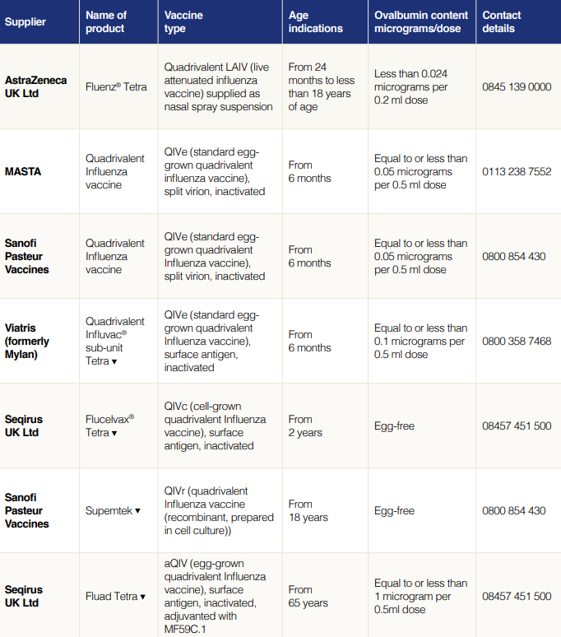
Ovalbumin content of vaccines available for 2021 to 2022

Slide 60
Patients taking anticoagulants or with a bleeding disorder
Individuals on stable anticoagulation therapy (including individuals on warfarin who are up-to-date with their scheduled INR testing and whose latest INR was below the upper threshold of their therapeutic range) can receive intramuscular vaccination
if in any doubt, consult with the clinician responsible for prescribing or monitoring the individual’s anticoagulant therapy
Individuals with bleeding disorders may be vaccinated intramuscularly if, in the opinion of a doctor familiar with the individual's bleeding risk, vaccines or similar small volume intramuscular injections can be administered with reasonable safety by this route
if the individual receives medication/treatment to reduce bleeding, for example treatment for haemophilia, intramuscular vaccination can be scheduled shortly after such medication/treatment is administered
a fine needle (equal to 23 gauge or finer calibre) should be used for the vaccination, followed by firm pressure applied to the site (without rubbing) for at least 2 minutes
influenza vaccines licensed for intramuscular or subcutaneous administration may alternatively be administered by the subcutaneous route.
QIVc (Flucelvax tetra) QIVr (Supemtek) and aQIV (Fluad tetra) are not licensed for subcutaneous administration so should only be administered intramuscularly
The national flu immunisation programme 2021 to 2022

Slide 61
Influenza vaccine effectiveness
vaccine effectiveness (VE) varies from one season to the next. Overall effectiveness has been estimated at between 30-60% (adults aged 18 to 65 years) for flu infection in primary care
there is lower effectiveness in older people although immunisation can provide important protection against flu GP consultation and severe disease/flu confirmed hospital admission
in the last decade, there has generally been a good match between the strains of flu in the vaccine and those circulating but there has often been poorer effectiveness against influenza A (H3N2), particularly in the elderly, where burden of infection from that strain is highest
the JCVI noted potential explanations for the low effectiveness against influenza A(H3N2). These include
        immunosenescence (age related reduction in immune response)
        genetic drift of the circulating viral strain (compared to the vaccine strain e.g. in 2014 to 2015)
        egg adaptation (in recent seasons, changes to the virus during the manufacturing process have arisen with A(H3N2) strain when flu vaccine strains are propagated in eggs which means that the vaccines do not work as well)
      due to extremely low levels of flu during 2020 to 2021, it has not been possible to calculate VE estimates
Notes:
A 2012 meta-analysis included studies when the influenza virus strains in the vaccine were drifted or mismatched with those in circulation and suggested an overall efficacy against confirmed disease of 59% (95% confidence interval 51-67) in adults aged 18 to 65 years. In the elderly, protection produced by the vaccine may be lower², although immunisation has been shown to reduce the incidence of severe disease including bronchopneumonia, hospital admissions and mortality.
A PHE study found that the 2014/15 mid-season estimates of flu vaccine, which is used primarily in adults, provided low protection against flu infection due to one particular subtype, H3N2. This was because a drifted strain of flu A(H3N2) emerged in 2014/15 after the 14/15 A(H3N2) vaccine strain had been selected in February 2014. This resulted in a mismatch between the vaccine strain and the main A(H3N2) strain that circulated in the UK. The study was based on the results from 1,314 patients presenting in primary care across the UK and found that vaccine effectiveness in preventing laboratory confirmed influenza was estimated to be 3% overall (with an upper 95% confidence interval of 35%). This compares to approximately 50% vaccine effectiveness that has typically been seen in the UK over recent years, with generally a good match between the strains of flu in the vaccine and those that subsequently circulate in the population.
End of season flu vaccine effectiveness for the 2020/21 is published in the ’annual flu report’ which also includes details of other respiratory viruses
https://www.gov.uk/government/statistics/annual-flu-reports

Slide 62
Improving vaccine effectiveness in those aged 65 and over
There are a number of potential factors leading to reduced vaccine effectiveness:
Factor | Explanation | Solution
Immunosenescence | Age related reduction in immune response to vaccination | May be addressed by the use of an adjuvanted or higher dose vaccine to boost response in those over 65 years of age against all vaccine strains
Genetic drift of the circulating strain | Genetic changes in the flu virus can create a mismatch between the vaccine virus strains and the circulating wild type strains | The WHO recommendations for the vaccine strains for the forthcoming flu season reflect any changes seen in circulating flu viruses
Egg adaptation | To produce most flu vaccines, the flu viruses are injected into eggs to generate large amounts of flu virus. However, the viruses adapt to live in the egg, leading to changes in the viruses which means they may not exactly match the circulating strain, thus resulting in reduced vaccine effectiveness | Egg adaptation can be addressed using cell based vaccines which do not require the use of eggs in the manufacturing process
The national flu immunisation programme 2021 to 2022

Slide 63
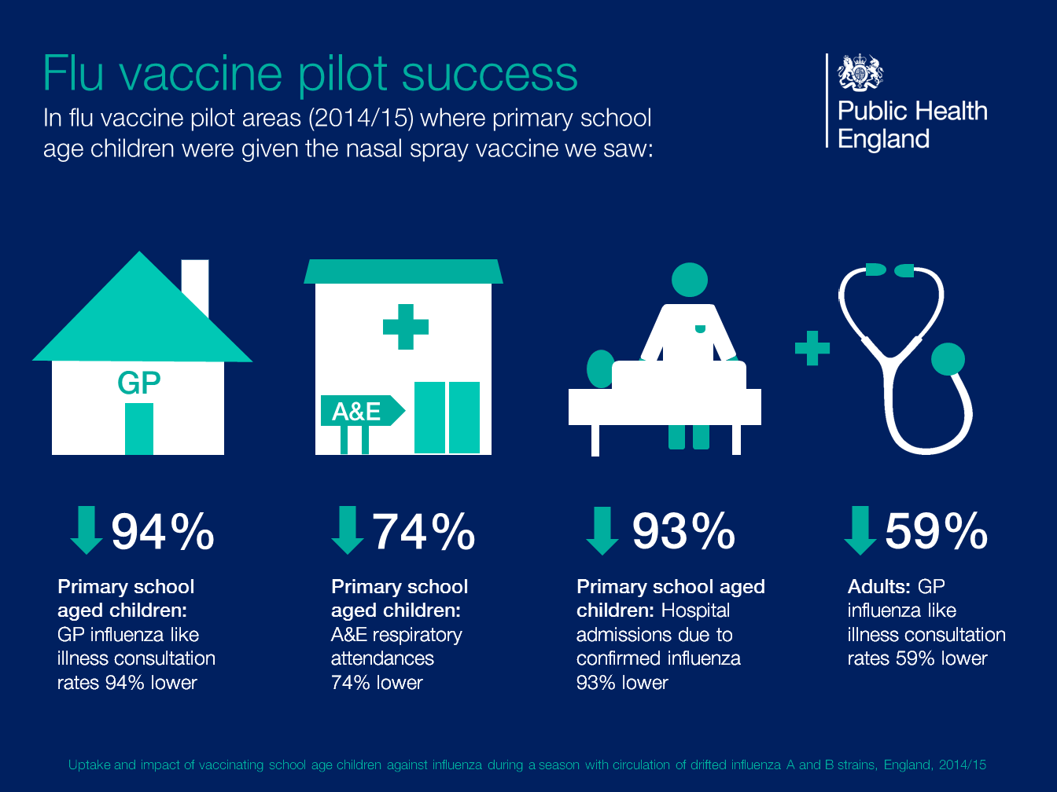
Notes:
Research into the first three years of the programme compared the differences between pilot areas, where the entire primary school age cohort was offered vaccination, to non-pilot areas. The results have shown a positive impact on flu transmission across a range of surveillance indicators from vaccinating children of primary school age. These include reductions in: GP consultations for influenza-like illness, swab positivity in primary care, laboratory confirmed hospitalisations and percentage of respiratory emergency department attendances.

Slide 64
LAIV effectiveness
due to the extremely low levels of flu in the community during 2021 to 2022, it has not been possible to estimate vaccine effectiveness for this season
the results from research into the first 3 years of the children’s flu programme have shown a positive impact on flu transmission from vaccinating children of primary school age
these include reductions in: GP consultations for influenza-like illness, swab positivity in primary care, laboratory confirmed hospitalisations and percentage of respiratory emergency department attendances
overall adjusted vaccine effectiveness (VE) for 2019 to 2020 for 2 to 17 year olds receiving LAIV was 45.4%
        effectiveness against influenza A(H3N2) was 31.2%
        effectiveness against influenza A(H1N1)pmd09 was 53.5%
      the interim evaluation of influenza vaccine effectiveness against influenza B for 2019 to 2020 was > 60% among all ages in primary care, with a lower VE among those aged 18 to 64 years in the European Union primary care setting*.
      (*Eurosurveillance, Vol 25, issue 10,25 March 2020)
Notes:
Due to the extremely low levels of flu circulating in the community during 2020/21, it has not been possible to calculate vaccine effectiveness.
However, since the introduction of the LAIV programme for children in the UK the vaccine effectiveness for laboratory confirmed infection has been good. In 2015/16 it was 57.6% and in 2016/17 it was 65.8%, both within the normal range for this vaccine. Although the overall vaccine effectiveness was lower in 2017/18 at 26.9%, protection varied considerably by strain with vaccine effectiveness against the H1N1pdm09 strain at 90.3% and 60.8% against influenza B, both of which can have an important impact on children.

Slide 65
Vaccine ordering
PHE centrally purchases flu vaccines (live and inactivated) for:
        all children aged 2 to 15 years or not 16 years or over on 31 August 2021
        children in clinical risk groups aged 6 months to less than 18 years
flu vaccines for children can be ordered through the ImmForm website as for other centrally purchased vaccines (www.immform.phe.gov.uk)
providers are responsible for ordering sufficient flu vaccine for all other eligible patients aged 18 years and older directly from manufacturers
providers should ensure they are able to offer the most effective vaccine for each eligible group consistent with national guidance
provided a patient is offered a recommended vaccine for their age, providers are not expected to have to offer a choice between vaccines
initial batches of vaccine may be subject to delay, or fewer doses than planned may be available initially. Providers should remain flexible when scheduling vaccination sessions and be prepared to reschedule if necessary
it is important not to order or hold more than two weeks’ worth of LAIV – stockpiling increases the risk of significant loss if there are cold chain failures. It also increases the risk of out of date vaccine being used as Fluenz Tetra has a short shelf life
The national flu immunisation programme 2021 to 2022
Notes:
All flu vaccines for children are procured by PHE. This includes vaccine for all children aged two to 15 years and for children in risk groups aged six months to less than 18 years.
For children in clinical risk groups under 18 years of age where LAIV is contraindicated (including those aged under two years of age), a suitable inactivated (injectable) vaccine should be offered which can be ordered alongside Fluenz Tetra through the ImmForm website: www.immform.phe.gov.uk
For all other eligible populations apart from children, providers remain responsible for ordering vaccines directly from manufacturers.

Slide 66
Storage of flu vaccine
  Efficacy, safety and quality may be adversely affected if vaccines are not stored at the temperatures specified in the licence
All flu vaccines, inactivated and LAIV, must be stored in accordance with manufacturer’s instructions:
  store between +2⁰C and +8⁰C
  do not freeze
  store in original packaging
  protect from light
Check expiry dates regularly:
  the LAIV has an expiry date 18 weeks after manufacture – this is much shorter than inactivated flu vaccines
  it is important that the expiry date on the nasal spray applicator is checked before use
Notes:
Vaccines should be stored in the original packaging at +2°C to +8°C and protected from light. All vaccines are sensitive to some extent to heat and cold. Heat speeds up the decline in potency of most vaccines, thus reducing their shelf life. Efficacy, safety and quality may be adversely affected if vaccines are not stored at the temperatures specified in the licence. Freezing may cause increased reactogenicity and loss of potency for some vaccines and can also cause hairline cracks in the container, leading to contamination of the contents.
LAIV has a shelf life of 18 weeks that starts at the point of release from the manufacturer. This is a shorter shelf life than other influenza vaccines and some of this time will have passed when the vaccine reaches the place where it is to be administered. It is important that the expiry date on the nasal spray applicator is checked before use. If the expiry date has passed, arrangements should be made to have the vaccine disposed safely.
The vaccine should be stored in the original packaging. This makes it easy to identify in the vaccine fridge and to check batch numbers and expiry dates. The original packaging also provides some protection against fluctuation of temperature and protection from light.
Vaccines are expensive and it is important to minimise wastage through inappropriate storage.

Slide 67
Legal framework for vaccination
A range of mechanisms can be used for the supply and administration of vaccines, including:
Patient prescription written manually or electronically by a registered medical practitioner or other authorised prescriber
  Patient Specific Direction (PSD)
  Patient Group Direction (PGD)
  Written instruction (WI)
PGD templates for the administration of the live and inactivated flu vaccines are available on the PHE website:
https://www.gov.uk/government/collections/immunisation-patient-group-direction-pgd
    Those using national immunisation PGDs developed by PHE must ensure that each PGD is organisationally authorised and signed in section 2 by an appropriate authorising person, in accordance with Human Medicines Regulations 2012 (HMR2012)
    Without such authorisation, the PGD is not legal or valid

Slide 68
Vaccine administration (inactivated vaccines)
inactivated flu vaccines should be given intramuscularly into the upper arm (deltoid muscle) of those aged 12 months or older and into the anterolateral aspect of the thigh in infants aged six months to one year of age
due to the presence of adjuvant and therefore increased potential for more local reactions if administered by subcutaneous injection, aQIV should only be administered intramuscularly using a 25mm length needle
inactivated and live flu vaccines can be given at the same time as, or at any interval before or after, other currently used live and inactivated vaccines
if any new vaccines are introduced during the flu vaccination season, please ensure any specific guidance given about concomitant administration for these is followed
if given at the same time, different vaccines should be given at separate sites, preferably in a different limb. If given in the same limb, they should be given at least 2.5cm apart
The national flu immunisation programme 2021 to 2022
Notes:
Inactivated influenza vaccines can be given at the same time as other vaccines. The live attenuated vaccine can also be given at the same time as other live or inactivated vaccines. Although it was previously recommended that, where vaccines cannot be administered simultaneously, a four-week interval should be observed between live viral vaccines, JCVI have now advised that no specific intervals need to be observed between the live attenuated intranasal influenza vaccine and other live vaccines⁶.
Intramuscular vaccines should be given at separate sites, preferably in a different limb. If given in the same limb, they should be given at least 2.5cm apart.

Slide 69
Administration of Live Attenuated Influenza vaccine (LAIV)
  LAIV is different from other flu vaccines – it is a live attenuated nasal vaccine and must not be injected
  do not attempt to attach a needle
  LAIV can be administered at the same time as, or at any interval from other currently used vaccines including live vaccines
  the applicator has a divider clip to enable one application in each nostril
  the patient should breathe normally - they do not need to actively inhale or sniff
  the vaccine is rapidly absorbed so there is no need to repeat either half of dose if patient sneezes, blows their nose or their nose drips following administration
Notes:
LAIV can be given at the same time as other vaccines, including live vaccines³.
Although it was previously recommended that, where vaccines cannot be administered simultaneously; a four-week interval should be observed between live viral vaccines, JCVI have advised that no specific intervals need to be observed between the live attenuated intranasal flu vaccine and other live vaccines

Slide 70
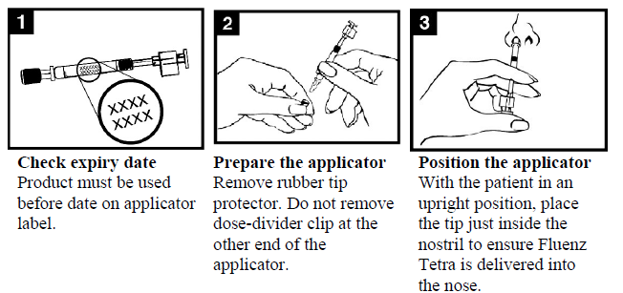
Administration of LAIV
Images taken from Fluenz Tetra® SPC
Notes:
Check the expiry date - the vaccine must be used before the date on the applicator label.
Prepare the applicator - remove the rubber tip protector. Do not remove the dose divider clip at the other end of the applicator.
Position the applicator – with the patient in an upright position, place the tip just inside the nostril to ensure LAIV is delivered into the nose.

Slide 71
Administration of LAIV
Images taken from Fluenz Tetra® SPC
Notes:
Depress the plunger – with a single motion, depress the plunger as rapidly as possible until the dose-divider clip prevents you from going further.
5. Remove the dose-divider clip – for administration in the other nostril, pinch and remove the dose-divider clip from the plunger.
6. Spray in other nostril – place the tip just inside the other nostril and with a single motion, depress the plunger as rapidly as possible to deliver remaining vaccine.

Slide 72
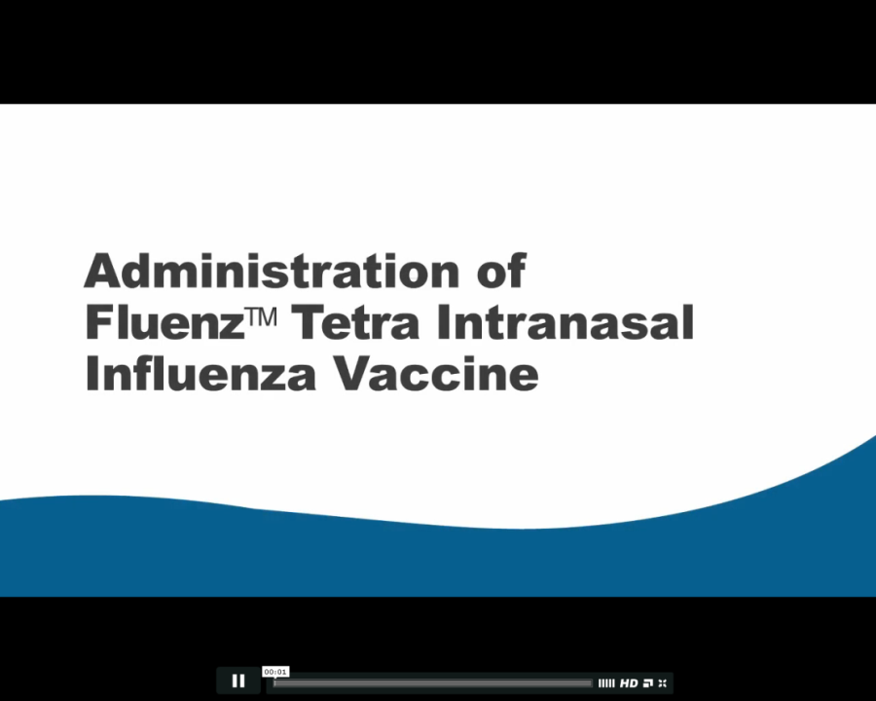
Administration video
A video for health professionals on how to administer the LAIV vaccine has been produced by NHS Education for Scotland (NES).
It is available to view on the NES website at:
http://www.nes.scot.nhs.uk/education-and-training/by-theme-initiative/public-health/health-protection/seasonal-flu/childhood-seasonal-flu-vaccination-programme-resources-for-registered-practitioners.aspx
The national flu immunisation programme 2021 to 2022

Slide 73
Commonly reported adverse reactions
Following inactivated flu vaccine:
pain, swelling or redness at the injection site, low grade fever, malaise, shivering, sweating, fatigue, headache, myalgia and arthralgia
a small painless nodule may also form at the injection site
these symptoms usually disappear within one to two days without treatment
due to the MF59 adjuvant, a higher incidence of mild post-immunisation reactions has been reported with aTIV, compared to non-adjuvanted influenza vaccines
Following live attenuated flu vaccine:
nasal congestion/rhinorrhoea, reduced appetite, weakness, fever and headache
Rarely, after live or inactivated vaccine, immediate reactions such as urticaria, angio-oedema, bronchospasm and anaphylaxis can occur
The national flu immunisation programme 2021 to 2022
Notes:
Pain, swelling or redness at the injection site, low grade fever, malaise, shivering, fatigue, headache, myalgia and arthralgia are among the commonly reported symptoms after intramuscular or intradermal vaccination. A small painless nodule (induration) may also form at the injection site. These symptoms usually disappear within one to two days without treatment. Nasal congestion/rhinorrhoea, reduced appetite, weakness and headache are common adverse reaction following administration of the live attenuated intranasal vaccine (Fluenz Tetra). Immediate reactions such as urticaria, angio-oedema, bronchospasm and anaphylaxis can occur rarely.

Slide 74
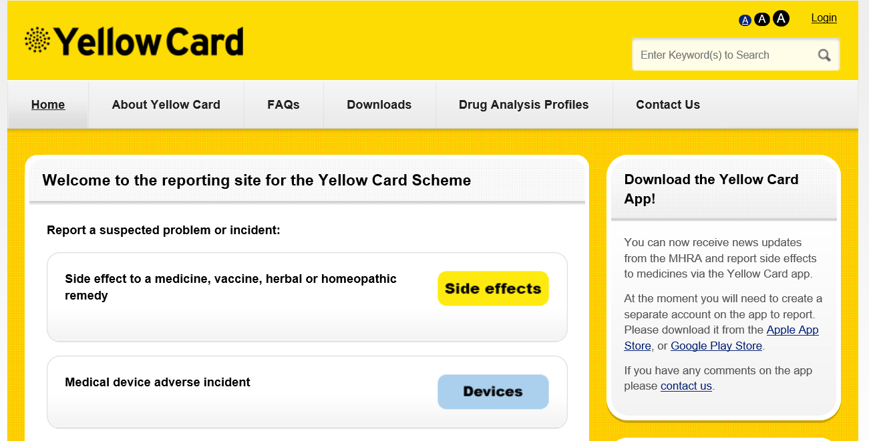

Reporting suspected adverse reactions
All serious suspected reactions following flu vaccination should be reported to the Medicines and Healthcare products Regulatory Agency using the Yellow Card scheme at http://yellowcard.mhra.gov.uk/
Four of the flu vaccines recommended for use during 2020/21 carry a black triangle symbol (▼) (as do all vaccines during the earlier stages of their introduction)
This is to encourage reporting of all suspected adverse reactions
Yellow card scheme: http://mhra.gov.uk/yellowcard:
voluntary reporting system for suspected adverse reaction to medicine/vaccines
success of scheme depends on early, complete and accurate reporting
report even if uncertain about whether vaccine caused condition
see chapter 8 of Green Book for details
Notes:
Four of the vaccines recommended for use during 2021/22 carry a black triangle symbol (▼). This is a standard symbol added to the product information of a vaccine during the earlier stages of its introduction, to encourage reporting of all suspected adverse reactions.
Details of these vaccines can be found in the national flu immunisation programme letter for 202/22
All serious suspected reactions following flu vaccines should be reported to the Medicines and Healthcare products Regulatory Agency using the Yellow Card scheme at http://yellowcard.mhra.gov.uk/.

Slide 75
Recording flu vaccine given
As a wide variety of influenza vaccines are on the UK market each year, it is especially important that the following information be recorded:
vaccine name, product name, batch number and expiry date
dose administered
date immunisation given
route/site used
name and signature of vaccinator
This information should be recorded in:
patient's GP record (or other patient record, depending on location)
personal Child Health Record (the ‘Red Book’) if a child
practice computer system
Child Health Information System if a child
Information on flu vaccines administered outside general practice (e.g. maternity providers, pharmacies) must be passed back to the patient’s GP practice in a timely manner (within 48 hours) so patient records can be updated
=
Notes:
As a wide variety of influenza vaccines are on the UK market each year, it is especially important that the exact brand of vaccine, batch number and site at which each vaccine is given is accurately recorded in the patient records. Where the vaccine is given for occupational reasons, it is recommended that the employer keep a vaccination record. It is important that vaccinations given either at a general practice or elsewhere (for example, at community pharmacies, or antenatal clinics) are recorded on appropriate health records for the individual (using the appropriate clinical code) in a timely manner, including the relevant Child Health Information System. If given elsewhere, a record of vaccination should be returned to the patient’s general practice to allow clinical follow up and to avoid duplicate vaccination.

Slide 76
Data collection
flu vaccine uptake data is collected via the web-based ImmForm system (www.immform.phe.gov.uk) where it is managed and published by PHE
over 95% GP practices are able to make automated data returns where the number of their patients vaccinated is directly extracted from their IT system and put into ImmForm
for data to be accurate and complete, it is critical that any vaccines given outside the surgery, such as those given in pharmacies, are reported to the patient’s GP
data is collected and published monthly on all the groups for whom flu vaccine is indicated at national level and local NHS England team level to enable performance to be reviewed and time to take action if needed
uptake data for HCWs is manually submitted by trusts and area teams via ImmForm
flu vaccine uptake data is published at: www.gov.uk/government/collections/vaccine-uptake
The national flu immunisation programme 2021 to 2022
Notes:
As in previous years, flu vaccine uptake data collections will be managed using the ImmForm website (www.immform.dh.gov.uk). PHE coordinates the data collection and will issue further details of the collection and guidance on the data collection process for the 2021/22 programme. This guidance will be available at: www.gov.uk/government/collections/vaccine-uptake which is where flu vaccine uptake data is also published. Queries concerning data collection content or process should be emailed to influenza@phe.gov.uk. Queries concerning ImmForm login details and passwords should be emailed to helpdesk@immform.org.uk.
More detail about data collection in 2021/22 is available in Appendix I of The national flu immunisation programme 2021/22 available at https://www.gov.uk/government/publications/national-flu-immunisation-programme-plan
Vaccine uptake figures are published at: https://www.gov.uk/government/collections/vaccine-uptake
As in previous years, flu vaccine uptake data collections will be managed using the ImmForm website (www.immform.phe.gov.uk). Monthly data collections will take place over five months during the 2020/21 flu immunisation programme, starting in November for October and September’s uptake. These collections will enable performance to be reviewed at local NHS England Team level during the programme, with time to take action if needed, and for the uptake from the completed programme to be measured. Vaccine uptake figures are published at: https://www.gov.uk/government/collections/vaccine-uptake

Slide 77
Achieving high flu vaccine uptake
Dexter and others (2012) identified independent factors associated with higher vaccine uptake in general practice. These were presented as a GP practice checklist in the annual flu letter for 2019 to 2020 and the key findings are summarised below:
having a lead staff member for planning the flu campaign and producing a written report of practice performance predicted an 8% higher vaccination rate for at-risk patients aged <65 years
sending a personal invitation to all eligible patients and only stopping vaccination when Quality and Outcomes Framework targets were reached, predicted a 7% higher vaccination rate in patients aged ≥65 years
using a lead member of staff for identifying eligible patients, with either a modified manufacturer's or in-house search programme for interrogating the practice IT system, independently predicted a 4% higher vaccination rate in patients aged ≥65 years
the provision of flu vaccine by midwives was associated with a 4% higher vaccination rate in pregnant women
The national flu immunisation programme 2020/21
Notes:
Dexter et al (2012)https://bmjopen.bmj.com/content/2/3/e000851.full
Appendix K: GP practice checklist https://assets.publishing.service.gov.uk/government/uploads/system/uploads/attachment_data/file/788903/Annual_national_flu_programme_2019_to_2020_.pdf

Slide 78
Achieving high flu vaccine uptake
many of the groups who are vulnerable to flu are also more vulnerable to COVID-19. Not only is it important to help protect those most at risk of flu, it is also important to protect the health of those who are vulnerable to hospitalisation and death from COVID-19 by ensuring they do not get flu
for the 2021 to 2022 flu season, immunisers are being asked to make a concerted effort to significantly increase flu vaccination coverage across all eligible groups. Vaccine uptake ambitions for 2021 to 2022 are detailed in Table 1 of the annual flu programme letter
it is essential to increase flu vaccination levels for those who are living in the most deprived areas and from BAME communities. High quality, dedicated and culturally competent engagement with local communities, employers and faith groups will be required

Slide 79
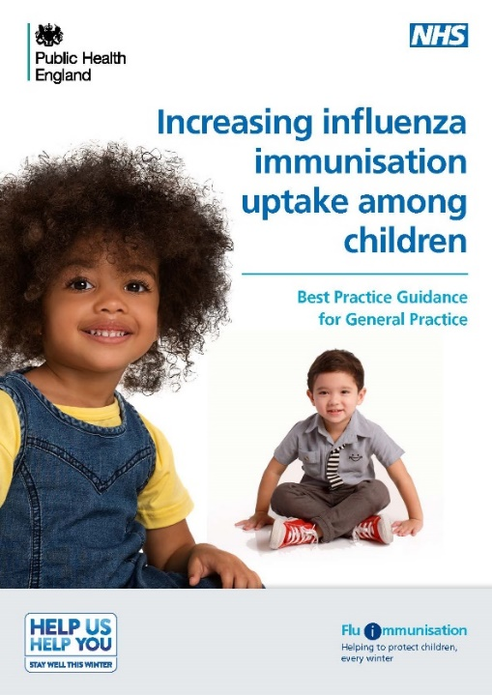
Increasing flu immunisation uptake among children
Best practice guidance for general practice
PHE have produced a summary of key strategies to help to increase flu vaccine uptake in pre-school children (from 2yrs) which consider the following areas:
staff responsibilities
practice goals
identifying eligible children
inviting/contacting parents
ordering vaccines and clinics and appointments
promoting the vaccine offer to parents
ideas to sustain and promote uptake during flu season
recommendations for end of flu season review
Staff involved in delivering flu vaccine to children in any setting are encouraged to consider what strategies they can implement to maximise vaccine uptake whilst taking into account the social distancing and PPE requirements implemented to keep patients safe from COVID-19
Notes:
Note to trainers:
The content of the Best Practice Guidance for Increasing flu immunisation uptake among children is set out on the next seven slides for those trainers who wish/are able to spend time discussing strategies for maximising uptake. These should be considered along with the constraints placed upon services who also need to keep patients safe from COVID-19. Trainers and all those involved in the delivery of the flu programme should regularly check the annual flu programme pages on GOV.UK for updated information on infection prevention and control measures that should be implemented in the delivery of immunisation services.
Flu vaccine: best practice guidance for general practice is available on the PHE website at https://assets.publishing.service.gov.uk/government/uploads/system/uploads/attachment_data/file/635595/Flu_gp_best_practice_guidance.pdf

Slide 80
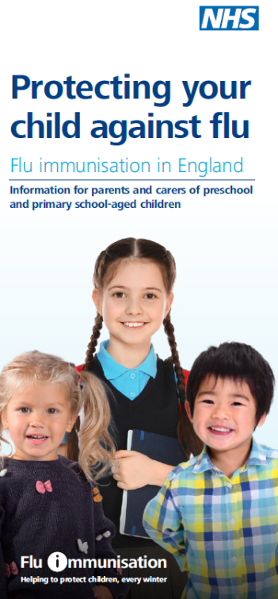
Increasing flu immunisation uptake among children
Best practice guidance for general practice
Staff responsibilities
• every practice should have a lead member of staff with responsibility for running the flu immunisation campaign and all staff should know who the lead person is
• all staff should understand the reason for the programme and have access to PHE resources
• every member of the practice should know their role and responsibilities
• get all staff involved in promoting the vaccine message to parents
• hold regular meetings so that all staff know the practice plan and progress
• include health visitors, midwives, pharmacists and other healthcare professionals linked to your practice in your planning

Slide 81
Increasing flu immunisation uptake among children
Best practice guidance for general practice
Practice goals
• set a higher goal than the previous season
• create computer searches to measure uptake and assess progress towards the goal
• calculate practice income depending on uptake
• advertise the practice goal and have a ‘Blue Peter’ style ‘Totaliser’
Identifying eligible children
• the lead member of staff to identify eligible children
• check accuracy of searches and coding to ensure all eligible children are identified
• make sure the correct flu vaccination codes are in your system and that staff are aware –don’t let hard work go unmeasured
• create IT system reminders so that opportunistic immunisation happens
• create a system for opportunistic identification of eligible children attending the practice for other clinics or with parents and siblings – use flags or sticky notes to alert staff. Don’t send a child away unimmunised

Slide 82

Increasing flu immunisation uptake among children
Best practice guidance for general practice
Invitation/contacting parents
• send a personalised invitation to eligible children – use the parent’s and child’s names, sign your name at the bottom
• phone calls can be more effective than letters; and try text messages for reminders
• ensure that staff phoning patients have a script but can also answer questions and address concerns
• plan phone calls after 4pm when more working parents might be available
• send letters if telephone contact is not possible
• set a date – invite every eligible child before the end of October
• be tenacious – make multiple contacts until child is immunised

Slide 83
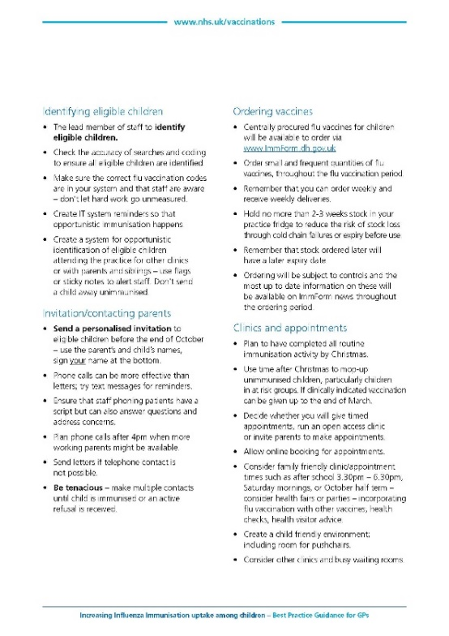
Increasing flu immunisation uptake among children
Best practice guidance for general practice
Ordering vaccines
Centrally procured flu vaccines for children will be available to order via www.ImmForm.phe.gov.uk
Order small and frequent quantities of flu vaccines, spread throughout the flu vaccination period
Remember that you can order weekly and receive weekly deliveries
Hold no more than 2 to 3 weeks stock in your practice fridge to reduce the risk of stock loss through cold chain failures or expiry before use
Remember that stock ordered later will have a later expiry date
Ordering will be subject to controls and the most up to date information on these will be available on ImmForm news throughout the ordering period

Slide 84
Increasing flu immunisation uptake among children
Best practice guidance for general practice
Clinics and appointments
plan to have completed all routine immunisation activity by Christmas
use time after Christmas to mop-up unimmunised children, particularly children in at risk groups. If clinically indicated vaccination can be given up to the end of March
decide whether you will give timed appointments, run an open access clinic or invite parents to make appointments
allow online booking for appointments
consider family friendly clinic/appointment times such as after school 3.30pm – 6.30pm, Saturday mornings, or October half term – consider health fairs or parties – incorporating flu vaccination with other vaccines, health checks, health visitor advice
create a child friendly environment; including room for pushchairs
consider other clinics and busy waiting rooms
Staff involved in delivering flu vaccine to children in any setting are encouraged to consider what strategies they can implement to maximise vaccine uptake whilst taking into account the social distancing and PPE requirements implemented to keep patients safe from COVID-19

Slide 85
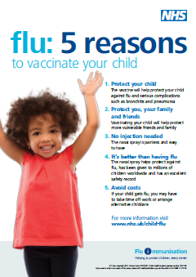
Increasing flu immunisation uptake among children
Best practice guidance for general practice
Promote the vaccination offer to parents
• ensure every parent has a personalised invitation for their child
• display PHE child flu immunisation posters and leaflets in the reception and waiting rooms
• create attractive displays in waiting rooms. Consider posters or banners outside the practice – on a notice board, walls or even on the roof
• place prominent information about the child flu immunisation programme on the practice website
• engage with the local primary school – ask if they can give leaflets to parents with preschool age children and/or display posters on school/parent notice boards
• engage with local pre-school nurseries, children’s centres, libraries, toddler groups in your area. Ask staff to put up posters and issue leaflets to parents of children who are 2 years old and older. Highlight the benefits of their children being immunised to these preschool groups and nurseries

Slide 86
Increasing flu immunisation uptake among children
Best practice guidance for general practice
During the season
Increasing resources in-season is difficult so comprehensive preparation and planning is critical. There are things you can do to help sustain efforts and uptake:
• review your uptake against your goals and financial plan; celebrate/promote success as the programme progresses
• remain tenacious – re-run searches for eligible children
• continue to offer vaccination, even once you have achieved your practice and campaign goals
• keep staff engaged and enthused – consider incentives, promoting staff competition
• ensure all practice staff have their flu jab – it is powerful to be able to say to patients “I’ve had mine”
Post season
• review your campaign, measure and celebrate success – thank everyone involved
• share the review of your campaign with your stakeholders, patient focus group and partners who helped you achieve your goals
• capture lessons learnt and adapt next year’s plan – aim for higher uptake next year

Slide 87
Delivering the programme during the COVID-19 pandemic
patients will need reassurance that appropriate measures are in place to keep them safe from COVID-19 as it is likely to be co-circulating with flu
providers will be expected to deliver the programme according to guidelines on social distancing that are current at the time
providers need to be prepared to make adjustments to the programme in the face of any local restrictions to ensure those at highest risk can continue to be vaccinated
Notes:
www.england.nhs.uk/coronavirus/publication/managing-coronavirus-covid-19-in-general-practice-sop/
www.england.nhs.uk/coronavirus/publication/standard-operating-procedure-community-pharmacy/
www.england.nhs.uk/coronavirus/publication/covid-19-prioritisation-within-community-health-services-with-annex_19-march-2020/
www.england.nhs.uk/coronavirus/publication/novel-coronavirus-covid-19-standard-operating-procedure-community-health-services/
For guidance on immunisation during COVID-19, including personal protective equipment, see: ‘Clinical Guidance for Healthcare professionals on maintaining immunisation programmes during COVID-19’ at: www.england.nhs.uk/coronavirus/wp-content/uploads/sites/52/2020/06/clinical-guidance-for-hcps-on-imms-for-covid-19.pdf

Slide 88

Considerations when delivering the flu vaccine programme during the COVID-19 pandemic
careful appointment planning to minimise waiting times and maintain social distancing when attending
provide patients with information in advance of their appointment to explain what to expect
recall at risk patients if they do not attend
consider other innovative methods such as drive through vaccinations when appropriate to do so
A briefing including frequently asked questions has been published for schools

Slide 89
Infection prevention and control when administering vaccines
individuals should attend for vaccination at premises that are following the recommended infection prevention and control (IPC) guidance. www.england.nhs.uk/coronavirus/primary-care/infection-control/
those displaying symptoms of COVID-19, or who are self-isolating because they are confirmed COVID-19 cases or are contacts of suspected or confirmed COVID-19 cases, should not attend until they have recovered and completed the required isolation period.
healthcare professionals administering the vaccine will need to wear personal protective equipment (PPE) in keeping with current advice at the time. See: www.gov.uk/government/publications/wuhan-novel-coronavirus-infection-prevention-and-control/covid-19-personal-protective-equipment-ppe

Slide 90
Infection control issues
although there are no required infection control precautions specific to the administration of LAIV, providers are expected to deliver the programme according to guidelines that are current at the time and will need to wear the recommended personal protective equipment that is in line with the current advice from the government
routine hand hygiene procedures should be performed before and after each child contact
Disposal of clinical waste:
Used, part-used or out of date/wasted LAIV applicators should be disposed of in a rigid yellow sharps container with yellow lid

Slide 91
Key messages to health and social care workers
    getting vaccinated against flu can help protect you, your patients and family
    everyone is susceptible to flu, even if you are in good health and eat well
    you can be infected with the virus and have no symptoms but can still pass flu virus to others including patients or residents
    good infection control measures reduce spread of flu and other acute respiratory infections in healthcare settings but are not sufficient alone to prevent them
    throughout the last ten years there has generally been a good to moderate match between the strains of flu virus in the vaccine and those that subsequently circulated
    impact of flu on frail and vulnerable patients can be fatal and outbreaks can cause severe disruption in communities, care homes and hospitals
    flu vaccine has a good safety record and will help protect you. It cannot give you flu. Having the vaccination can encourage your colleagues to do likewise
    staff act as positive role models for patients aged 65 and over, those with long-term health conditions and pregnant women to take up the offer too
    duty of care as professionals to patients or residents to do everything in your power to protect them against infection, including being immunised against flu
The national flu immunisation programme 2021 to 2022
Notes:
Misconceptions about flu vaccine are common, including among health and social care workers. The above key messages should be promoted to frontline staff in acute, primary, community and social care services.
Health and social care workers are a very influential group. Patients and service users trust their nurses, doctors, pharmacists and other health and care professionals and their opinions can affect the way they act. A vaccinated member of staff can talk from first-hand experience and reassure them of the benefits of being vaccinated. Staff need to understand the benefits of the vaccine and dispel any myths that may have developed about the vaccine.

Slide 92
Key messages
flu immunisation is one of the most effective interventions we can provide to reduce harm from flu and pressures on health and social care services during the winter but it is important to increase flu vaccine uptake in all groups this year
for a number of years, only around half of patients aged six months to under 65 years in clinical risk groups have been vaccinated
influenza during pregnancy may be associated with perinatal mortality, prematurity, smaller neonatal size, lower birth weight and increased risk of complications for mother
vaccination of health and social care workers protects them and reduces risk of spreading flu to their patients, service users, colleagues and family members
by preventing flu infection through vaccination, secondary bacterial infections such as pneumonia are prevented. This reduces the need for antibiotics and helps prevent antibiotic resistance
those attending for flu vaccination will need reassurance that appropriate measures are in place to keep them safe from COVID-19 as it is likely to be co-circulating with flu
Notes:
Morbidity and mortality attributed to flu is a key factor in NHS winter pressures and a major cause of harm to individuals especially vulnerable people. The annual flu immunisation programme helps to reduce GP consultations, unplanned hospital admissions and pressure on A&E and is therefore a critical element of the system-wide approach for delivering robust and resilient health and care services during winter.

Slide 93
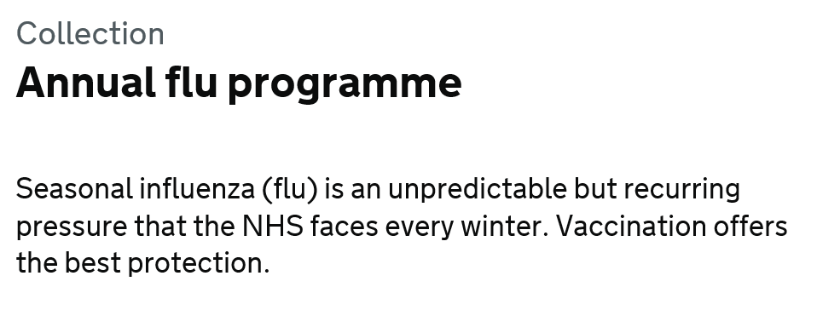


Resources
Letters detailing 2021/22 flu programme
Available at: www.gov.uk/government/publications/national-flu-immunisation-programme-plan
Green Book Influenza chapter Available at: www.gov.uk/government/collections/immunisation-against-infectious-disease-the-green-book
Leaflets, posters, information materials and other resources to support the annual flu programme Available at: www.gov.uk/government/collections/annual-flu-programme
PGD templates for flu vaccines www.gov.uk/government/collections/immunisation-patient-group-direction-pgd
A video for health professionals on how to administer the LAIV vaccine produced by NHS Education for Scotland is available at www.nes.scot.nhs.uk/education-and-training/by-theme-initiative/public-health/health-protection/seasonal-flu/childhood-seasonal-flu-vaccination-programme-resources-for-registered-practitioners.aspx
Summary of Product Characteristics (SPC) for flu vaccines are available at www.medicines.org.uk/emc/
Leaflets and posters prepared specifically for the flu programme. Available at: www.gov.uk/government/organisations/public-health-england/series/annual-flu-programme
Healthcare Workers Flu Immunisation resources (leaflets, posters, guides and resource packs) available at https://campaignresources.phe.gov.uk/resources/campaigns/92-healthcare-workers-flu-immunisation-/resources
Notes:
Further reading
Osterholm, MT, Kelley, NS, Sommer, A, and Belongia, EA (2012) Efficacy and effectiveness of influenza vaccines: a systematic review and meta-analysis. Lancet Infect Dis. 12(1.1), 36-44.
Fleming DM, Watson JM, Nicholas S et al. (1995) Study of the effectiveness of influenza vaccination in the elderly in the epidemic of 1989/90 using a general practice database. Epidemiol Infect 115: 581–9
Wright PF, Thompson J, Vaughn WK et al. (1977) Trials of influenza A/New Jersey/76 virus vaccine in normal children: an overview of age-related antigenicity and reactogenicity. J Infect Dis 136 (suppl): S731–41.
Mangtani P, Cumberland P, Hodgson CR et al. (2004) A cohort study of the effectiveness of influenza vaccine in older people, performed using the United Kingdom general practice research database. J Infect Dis 190(1): 1–10.
Pebody, R et al. (2015) Low effectiveness of seasonal influenza vaccine in preventing laboratory-confirmed influenza in primary care in the United Kingdom: 2014/15 mid-season results. Eurosurveillance. 20. Issue 5. www.eurosurveillance.org/ViewArticle.aspx?ArticleId=21025
Immunisation against infectious disease (‘the Green Book’) Chapter 19 ‘Influenza’. Updated August 2016. Available at: https://www.gov.uk/government/organisations/public-health-england/series/immunisation-against-infectious-disease-the-green-book
Public Health England. Surveillance of influenza and other respiratory viruses in the United Kingdom: Winter 2015 to 2016. Published May 2016. Available at: https://www.gov.uk/government/statistics/annual-flu-reports
Morgan OW, Bramley A, Fowlkes A, et al. Morbid obesity as a risk factor for hospitalization and death due to 2009 pandemic influenza A(H1N1) disease PLoS One. 2010 Mar 15;5(3)
Fezeu L, Julia C, Henegar A, Bitu J et al. Obesity is associated with higher risk of intensive care unit admission and death in influenza A (H1N1) patients: a systematic review and metaanalysis. Obes Rev. 2011 Aug;12(8):653-9
Van Kerkhove MD, WHO Working Group for Risk Factors for Severe H1N1pdm Infection. Risk factors for severe outcomes following 2009 influenza A (H1N1) infection: a global pooled analysis. PLoS Med. 2011 Jul;8(7):e1001053
Public Health England. Influenza immunisation programme for England. GP patient groups. Data collection survey. Season 2015 to 2016. Available at: https://www.gov.uk/government/uploads/system/uploads/attachment_data/file/526033/Seasonal_flu_GP_patient_groups_annual_report_2015_2016.pdf
Neuzil KM, Reed GW, Mitchel EF et al. (1998) Impact of influenza on acute cardiopulmonary hospitalizations in pregnant women. Am J Epidemiol. 148:1094-102
Pebody R et al. (2010) Pandemic influenza A (H1N1) 2009 and mortality in the United Kingdom: risk factors for death, April 2009 to March 2010. Eurosurveillance 15(20): 1957
Pierce M, Kurinczuk JJ, Spark P et al. (2011) Perinatal outcomes after maternal 2009/H1N1 infection: national cohort study. BMJ. 342:d3214.
McNeil SA, Dodds LA, Fell DB et al. (2011) Effect of respiratory hospitalization during pregnancy on infant outcomes. Am J Obstet Gynecol. 204: (6 Suppl 1) S54-7.
Omer SB, Goodman D, Steinhoff MC et al. (2011) Maternal influenza immunization and reduced likelihood of prematurity and small for gestational age births: a retrospective cohort study. PLoS Med. 8: (5) e1000441.
Benowitz I, Esposito DB, Gracey KD et al. (2010) Influenza vaccine given to pregnant women reduces hospitalization due to influenza in their infants. Clin Infect Dis. 51: 1355-61.
Eick AA, Uyeki TM, Klimov A et al. (2010) Maternal influenza vaccination and effect on influenza virus infection in young infants. Arch Pediatr Adolesc Med. 165: 104-11.
Zaman K, Roy E, Arifeen SE et al. (2008) Effectiveness of maternal influenza immunisation in mothers and infants. N Engl J Med. 359: 1555-64.
Poehling KA, Szilagyi PG, Staat MA et al.(2011) Impact of maternal immunization on influenza hospitalizations in infants. Am J Obstet Gynecol. 204:(6 Suppl 1) S141-8.
Dabrera G, Zhao H, Andrews N et al. (2014) Effectiveness of seasonal influenza vaccination during pregnancy in preventing influenza infection in infants, England, 2013/14. Eurosurveillance. Nov 13;19. www.eurosurveillance.org/ViewArticle.aspx?ArticleId=20959
Tamma PD, Ault KA, del Rio C et al. (2009) Safety of influenza vaccination during pregnancy. Am. J. Obstet. Gynecol. 201(6): 547-52.
Department of Health, Public Health England, NHS England. National flu immunisation plan for 2019/20. Published March 2019. Available at: https://www.gov.uk/government/publications/national-flu-immunisation-programme-plan
Joint Committee on Vaccination and Immunisation. JCVI statement on the annual influenza vaccination programme – extension of the programme to children. 25 July 2012. Available at: https://www.gov.uk/government/publications/jcvi-statement-on-the-routine-annual-influenza-vaccination-programme
Potter J, Stott DJ, Roberts MA et al. (1997) The influenza vaccination of health care workers in long-term-care hospitals reduces the mortality of elderly patients. Journal of Infectious Diseases 175: 1-6.
Carman WF, Elder AG, Wallace LA et al. (2000) Effects of influenza vaccination of healthcare workers on mortality of elderly people in long term care: a randomised control trial. The Lancet 355: 93-7.
Hayward AC, Harling R, Wetten S et al. (2006) Effectiveness of an influenza vaccine programme for care home staff to prevent death, morbidity, and health service use among residents: cluster randomised controlled trial. British Medical Journal doi:10.1136/bmj.39010.581354.55
Lemaitre M, Meret T, Rothan-Tondeur M et al. (2009) Effect of influenza vaccination of nursing home staff on mortality of residents: a cluster randomised trial. Journal of American Geriatric Society 57:1580-6.
Belshe RB, Edwards KM, Vesikari T et al. (2007) Live attenuated versus inactivated influenza vaccine in infants and young children. New England Journal of Medicine 356(7): 685-96. http://www.ncbi.nlm.nih.gov/sites/entrez/17301299
Ashkenazi S, Vertruyen A, Aristegui J et al. (2006) Superior relative efficacy of live attenuated influenza vaccine compared with inactivated influenza vaccine in young children with recurrent respiratory tract infections. The Pediatric Infectious Disease Journal 25(10): 870-9. http://www.ncbi.nlm.nih.gov/sites/entrez/17006279
Fleming DM, Crovari P, Wahn U et al. (2006) Comparison of the efficacy and safety of live attenuated cold-adapted influenza vaccine, trivalent, with trivalent inactivated influenza virus vaccine in children and adolescents with asthma. The Pediatric Infectious Disease Journal 25(10): 860-9. http://www.ncbi.nlm.nih.gov/sites/entrez/17006278
Allison MA Daley MF, Crane LA et al. (2006) Influenza vaccine effectiveness in healthy 6 to 21 month-old children during the 2003--2004 season. The Journal of Pediatrics 149: 755-62.
Neuzil KM, Jackson LA, Nelson J et al. (2006) Immunogenicity and reactogenicity of 1 versus 2 doses of trivalent inactivated influenza vaccine in vaccine-naive 5-8-year-old children. Journal of Infectious diseases 194(8): 1032-9. http://www.ncbi.nlm.nih.gov/sites/entrez/16991077
Bracco Neto H, Farhat CK, Tregnaghi MW, et al. (2009) Efficacy and safety of 1 and 2 doses of live attenuated influenza vaccine in vaccine-naive children. Pediatr Infect Dis J. 28: 365-71.
Block S L, Toback SL, Yi T et al. (2009) Efficacy of a single dose of live attenuated influenza vaccine in previously unvaccinated children: a post hoc analysis of three studies of children aged 2 to 6 years. Clin Ther. 31: 2140-7.
Des Roches A, Paradis L, Gagnon R, et al. (2012). Egg-allergic patients can be safely vaccinated against influenza. J Allergy Clin Immunol. 130(5):1213-6.
Centers for Disease Control and Prevention. Prevention and Control of Seasonal Influenza with Vaccines: Recommendations of the Advisory Committee on Immunization Practices — United States, 2013–2014. MMWR September 20, 2013 / 62(RR07);1-43 http://www.cdc.gov/mmwr/preview/mmwrhtml/rr6207a1.htm#LiveAttenuatedInfluenzaVaccines

Slide 94
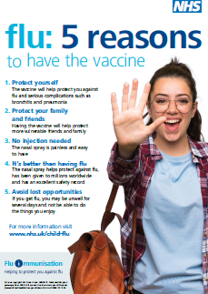
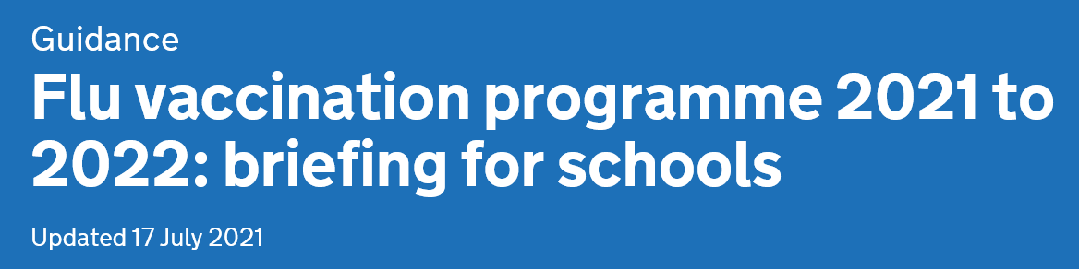
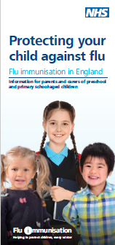


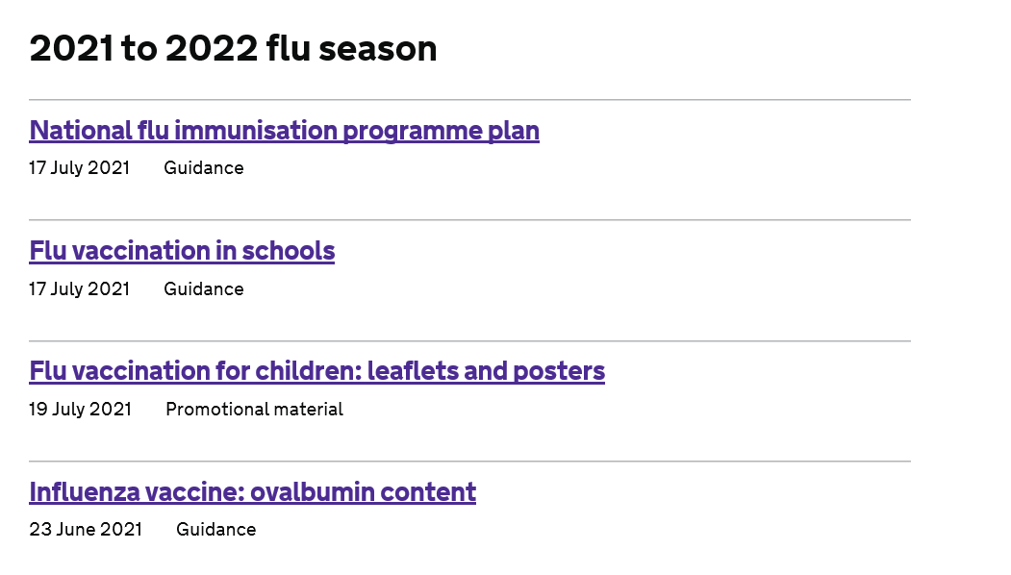
Resources
Flu immunisation: toolkit for programme extension to children. Available at: www.gov.uk/government/publications/flu-immunisation-toolkit-for-programme-extension-to-children
Increasing influenza immunisation uptake among children. Best Practice Guidance for General Practice. Available at www.gov.uk/government/organisations/public-health-england/series/annual-flu-programme
Notes:
Further reading
Joint Committee on Vaccination and Immunisation. JCVI statement on the annual influenza vaccination programme – extension of the programme to children. 25 July 2012. Available at: https://www.gov.uk/government/publications/jcvi-statement-on-the-routine-annual-influenza-vaccination-programme
Wilde J.A, McMillan J.A, Serwint J. et al. (1999) Effectiveness of influenza vaccine in healthcare professionals: a randomised trial. JAMA 281: 908–13
Immunisation against infectious disease (‘the Green Book’) Chapter 19 ‘Influenza’. Updated 21 May 2015. Available at: https://www.gov.uk/government/organisations/public-health-england/series/immunisation-against-infectious-disease-the-green-book
Public Health England. Flu annual report: winter 2016 to 2017. Available at: https://www.gov.uk/government/uploads/system/uploads/attachment_data/file/613493/Surveillance_of_influenza_and_other_respiratory_viruses_in_the_UK_2016_to_2017.pdf
Ruf B.R., Knuf M. (2013) The burden of seasonal and pandemic influenza in infants and children. European Journal of Pediatrics. 2014 Mar;173(3):265-76. doi: 10.1007/s00431-013-2023-6. Epub 2013 May 10
Izurieta H.S., Thompson W.W., Kramarz P., Shay D.K.., Davis R.L., DeStefano F., Black S., Shinefield H., Fukuda K. (2000) Influenza and the rates of hospitalisation for respiratory disease among infants and young children. New England Journal of Medicine 342(4):232-239
Mullooly J.P., Barker W.H. (1982) Impact of type A influenza on children: a retrospective study. American Journal of Public Health 72(9): 1008-1016
Neuzil K.M., Mellen B.G., Wright P.F., Mitchel E.F. Jr, Griffin M.R. (2000) The effect of influenza on hospitalisations, outpatient visits and courses of antibiotics in children. New England Journal of Medicine 342(4):225-231
Poehling K.A., Edwards K.M., Weinberg G.A., Szilagyi P., Staat M.A., Iwane M.K., Bridges C.B., Grijalva C.G., Zhu Y., Bernstein D.I., Herrera G., Erdman D., Hall C.B., Seither R., Griffin M.R., Network NVS (2006) The under recognised burden of influenza in young children. New England Journal of Medicine 31-40 355(1):
Weigl J.A., Puppe W., Schmitt H.J. (2002) The incidence of influenza-associated hospitalisations in children in Germany. Epidemiology and Infection 129(3):525-533
Pitman R.J., Nagy L.D. and Sculpher M.J. (2013) Cost-effectiveness of childhood influenza vaccination in England and Wales: Results from a dynamic transmission model. Vaccine 31(6):927-42
Belshe RB, Edwards KM, Vesikari T et al. (2007) Live attenuated versus inactivated influenza vaccine in infants and young children. New England Journal of Medicine 356(7): 685-96. http://www.ncbi.nlm.nih.gov/sites/entrez/17301299
Ashkenazi S, Vertruyen A, Aristegui J et al. (2006) Superior relative efficacy of live attenuated influenza vaccine compared with inactivated influenza vaccine in young children with recurrent respiratory tract infections. The Pediatric Infectious Disease Journal 25(10): 870-9. http://www.ncbi.nlm.nih.gov/sites/entrez/17006279
Fleming DM, Crovari P, Wahn U et al. (2006) Comparison of the efficacy and safety of live attenuated cold-adapted influenza vaccine, trivalent, with trivalent inactivated influenza virus vaccine in children and adolescents with asthma. The Pediatric Infectious Disease Journal 25(10): 860-9. http://www.ncbi.nlm.nih.gov/sites/entrez/17006278
Allison MA Daley MF, Crane LA et al. (2006) Influenza vaccine effectiveness in healthy 6 to 21 month-old children during the 2003--2004 season. The Journal of Pediatrics 149: 755-62.
Neuzil KM, Jackson LA, Nelson J et al. (2006) Immunogenicity and reactogenicity of 1 versus 2 doses of trivalent inactivated influenza vaccine in vaccine-naive 5-8-year-old children. Journal of Infectious diseases 194(8): 1032-9. http://www.ncbi.nlm.nih.gov/sites/entrez/16991077
Bracco Neto H, Farhat CK, Tregnaghi MW, et al. (2009) Efficacy and safety of 1 and 2 doses of live attenuated influenza vaccine in vaccine-naive children. Pediatr Infect Dis J. 28: 365-71
Block S L, Toback SL, Yi T et al. (2009) Efficacy of a single dose of live attenuated influenza vaccine in previously unvaccinated children: a post hoc analysis of three studies of children aged 2 to 6 years. Clin Ther. 31: 2140-7.
Fluenz Tetra Summary of Product Characteristics. Last text revision: 30 March 2017 . Available at: https://www.medicines.org.uk/emc/medicine/29112
Immunisation against infectious disease (‘the Green Book’) Chapter 5 ‘Immunisation by nurses and other healthcare professionals”. Updated 20 March 2013. Available at: https://www.gov.uk/government/organisations/public-health-england/series/immunisation-against-infectious-disease-the-green-book
Immunisation against infectious disease (‘the Green Book’) ’. Revised recommendations for administering more than 1 live vaccine 24 April 2015. Available at: https://www.gov.uk/government/publications/revised-recommendations-for-administering-more-than-1-live-vaccine
Immunisation against infectious disease (‘the Green Book’) ’. Chapter 6 Contraindications and special considerations. Updated 4 April 2013. Available at: https://www.gov.uk/government/publications/contraindications-and-special-considerations-the-green-book-chapter-6
Centers for Disease Control and Prevention (2013) Prevention and Control of Seasonal Influenza with Vaccines: Recommendations of the Advisory Committee on Immunization Practices — United States, 2013–2014. MMWR September 20, 62(RR07);1-43 http://www.cdc.gov/mmwr/pdf/rr/rr6207.pdf

Slide 95

About Public Health England
Public Health England exists to protect and improve the nation's health and wellbeing, and reduce health inequalities. It does this through world-class science, knowledge and intelligence, advocacy, partnerships and the delivery of specialist public health services. PHE is an operationally autonomous executive agency of the Department of Health.
Public Health England
Wellington House
133-155 Waterloo Road
London SE1 8UG
Tel: 020 7654 8000
www.gov.uk/phe
Twitter: @PHE_uk
Facebook: www.facebook.com/PublicHealthEngland
For enquiries relating to this document, please contact: immunisation.lead@phe.gov.uk
© Crown copyright 2021
You may re-use this information (excluding logos) free of charge in any format or medium, under the terms of the Open Government Licence v3.0. To view this licence, visit OGL or email psi@nationalarchives.gsi.gov.uk. Where we have identified any third party copyright information you will need to obtain permission from the copyright holders concerned.
Published August 2021
PHE publications gateway number: GOV-9301

