Slide 1
Changes to the neonatal BCG programme: - moving the timing of BCG vaccine from at birth to 28-days - introduction of Severe Combined Immunodeficiency (SCID) evaluation

Slide 2
Aim of this session
By the end of this session you should have a better understanding of the changes to the neonatal BCG programme enabling safe practice.

Slide 3
Neonatal BCG immunisation programme
The aim of the BCG Immunisation Programme is to protect those who are at an increased risk from exposure to TB and developing severe disease and prevent morbidity and mortality premature death.
Trails have shown the vaccine to be 60 to 80% effective against the most severe forms of the disease such as TB meningitis and disseminated disease in children.
Notes:
The UK neonatal BCG immunisation programme aims to protect infants who are at increased risk for exposure for TB – these exposures are usually within household settings.
Various trials indicate that BCG has 60-80% protective efficacy against severe forms of TB in children, particularly meningitis and disseminated TB both with increased risk for morbidity and mortality.

Slide 4
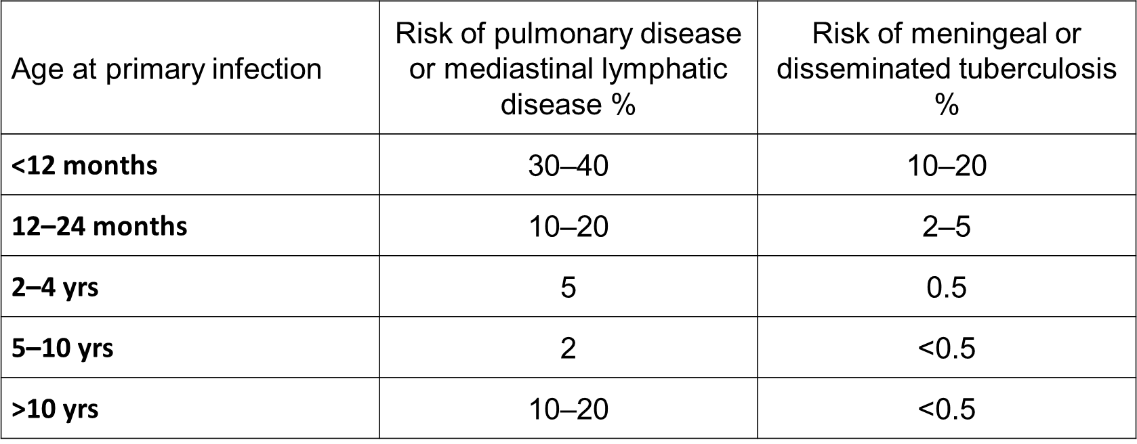
Risk of progression to active disease after infection in immune competent children
Ref: https://erj.ersjournals.com/content/erj/36/4/925.full.pdf
Notes:
Young immune competent children under 2 yrs. of age have a higher risk of progression from TB infection to active disease, while children aged 2–4yrs have a comparatively lower risk for progression of active TB.
However, all children under 5yrs of age are at increased risk of meningeal and/ or disseminated TB.
Majority of disease that manifests in children can occur in the first 6 to 12 months following primary infection.
The risk of progression to disease is much higher in immunocompromised children.

Slide 5
Changes to the BCG programme
1950s
BCG vaccination was first introduced to school age children in the UK
1960s
Selective immunisation of neonates born to new entrants to the UK from countries with high rates of TB was introduced
2005
Continued decline in TB incidence in the UK population resulted in school age BCG immunisation stopped. Become a risk-based programme the key part a neonatal programme targeted at those children most at risk of exposure to TB and progression to active disease
September 2021
Change in timing of BCG immunisation to all eligible babies from at birth to at 28 days to standardised BCG delivery across the country and support the introduction of Severe Combined Immunodeficiency (SCID) evaluationis to ensure that babies with SCID are not given live attenuated BCG vaccine
Notes:
The Joint Committee on Vaccination and Immunisation (JCVI) is responsible for the immunisation programme in the UK and the BCG immunisation programme has undergone several changes in response to changing trends in TB epidemiology - JCVI sanction all changes to the BCG programme. September 2021 change ie, to move the timing of neonatal BCG from at birth to at 28-days is to support the introduction of Severe Combined Immunodeficiency (SCID) evaluation and improve upon existing BCG provision.
Moving the timing of BCG vaccination to when a SCID screening outcome will be available, which will be around 28 days of age, is to ensure that babies with SCID are not given the live attenuated BCG vaccine which is contraindicated in these babies
In 2019 a mapping exercises by NHSE&I was carried out which highlighted a very mix BCG delivery models across England, including the variation in the timing of BCG vaccination to eligible babies – this change will also provide the opportunity to address the current variation in BCG provision delivery model and address the limitations in the existing system for identifying eligible infants and current limited BCG coverage data.
Evaluation, monitoring of the changes will take place as well as review of TB epidemiology following the changes.
Changes to the BCG programme due to changing trends
In 1950 it was recommended for secondary school age children. At that time, we had around 50,000 cases of TB reported each year in the UK, and cases occurred across most sectors of society. The age at which BCG was recommended represented the most effective use of the vaccine for the epidemiology that prevailed at that time in young working adults.
In 1960, selective immunisation of neonates born to new entrants to the UK from countries with high rates of TB was also introduced. This was due to the concern about the high rates of TB in these populations, and the fact that children born into these communities were at higher risk of infection than the general population
Further changes to the programme were made in 2005 following the ccontinued decline in TB incidence in the UK population with the school age BCG immunisation being stopped. The programme become a risk-based programme, the key part being neonatal programme targeted at those children most at risk of exposure to TB and progression to active disease

Slide 6
Eligibility for neonatal BCG
all infants (0 to 12 months) living in areas of the UK where the annual incidence of TB is 40/100,000 or greater
all infants (0 to 12 months) with a parent or grandparent who was born in a country where the annual incidence of TB is 40/100,000 or greater
For country information on prevalence visit GOV.UK
Notes:
BCG vaccination is recommended for all infants aged 0 to 12 mths born in parts of the country where there is a annual TB incidence of 40/100.000 or greater and all infants born with a parent or grandparent born in area of the world where the annual incidence is 40/100,000 or greater
In 2019, there were only 5 local authorities in London (Newham, Brent, Hounslow, Ealing and Redbridge) which met the criteria for universal offer of BCG vaccination at birth

Slide 7
SCID
SCID is a group of rare, usually recessively inherited conditions that cause major immune system problems
about 1 in 40,000 babies born in England have SCID (approximately 16 babies per year)
currently, about 30% of babies are identified by family history
SCID is more common when parents are related to each other
SCID can happen when there is no family history
the delay in finding the remaining 70% means that they have been exposed to infection for longer before receiving treatment
Notes:
Impact
from birth, infections that are not serious for most babies can be life-threatening
without screening or family history the average age of diagnosis is approximately 6 months
if babies with SCID are not treated, they will generally die before they are 1 year old
The sooner these babies are identified the sooner they can be provided with the appropriate treatment
Treatment
Once confirmatory testing (flow cytometry) has diagnosed the type of SCID, the most common treatment is:
Provision of an infection protective environment.
A bone marrow transplant which can repair the body’s defences against infections if done early enough. This is the primary treatment option.
Some types of SCID respond to gene therapy, a technique that involves putting a healthy copy of the affected SCID gene into bone marrow cells.
SCID is treated in specialist centres. The 2 centres in the UK are:
Great Ormond Street hospital, London
Great North Children’s hospital, Newcastle

Slide 8
What is the SCID Evaluation?
need to evaluate how screening for SCID works in practice, as part of a national screening programme
evaluation aims to answer 11 questions and collect robust evidence on the potential benefits and harms
following the evaluation the National Screening Committee (NSC) will decide if SCID is added as a 10th condition to the Newborn blood spot screening
Notes:
The evaluation will provide information on how screening works in practice - if you subscribe to the UKHSA SCID screening Blog you will be able to access SCID –related information / training / resources

Slide 9
SCID screening lab areas
the SCID evaluation will commence on 6 September 2021 and will take place over a 2 year period
the SCID evaluation will cover approximately two-thirds of England
the newborn blood spot (NBS) laboratories taking part are:
London (Great Ormond Street & South East Thames)
Manchester
Birmingham
Newcastle
Sheffield
Notes:
The SCID screening evaluation is taking place in 6 areas across England and will cover about 60% of newborn babies (Manchester, Birmingham, Sheffield, Newcastle, London Great Ormond Street Hospital and London Southeast Thames)
Moving the timing of BCG immunisation to at 28 days after birth relates to the whole of England, not just those areas involved in the SCID evaluation –before being able to administer BCG safely SCID screen outcome must be known for all eligible infants in all areas of the country.
Babies in non-screening areas will be assigned a ‘SCID screening not offered’ outcome
Parents should be reminded in all cases to bring the 'red book' and letter showing the results from newborn blood spot screening to all appointments including those were vaccinations are to be given. This will also assist BCG providers to make sure there is an outcome for SCID screening'

Slide 10
Possible SCID screen outcomes and related actions
SCID screen outcome | Action
SCID screen – ‘suspected’ | the baby will be referred within 1 working day to immunology parent or guardian and the GP will receive a direct communication from the immunology team with the outcome of the immunology appointment and this will include information on whether live vaccines can be given or not the BCG provider must contact the baby’s GP for the outcome letter. GP should also forward this information to BCG provider it is important to have local processes in place to get the immunologist appointment outcome in a timely manner BCG can only be given once confirmation received via immunologist/GP that BCG vaccination can be given
SCID screen – ‘repeat needed’ | defer BCG until repeat SCID screen outcome is known
SCID screen – ‘not offered’ | babies in non-screening areas will be assigned a ‘SCID screening not offered’ outcome arrange or give BCG vaccine
SCID screen – ‘declined’ | ensure parents/guardians are aware of the implications of baby having SCID and giving live vaccines document the discussion arrange or give BCG vaccine
SCID screen - ‘not suspected’ | arrange/give BCG vaccine

Slide 11
Resources to support and monitor the change in moving the timing of neonatal BCG to 28 days?
schedule 2,4 and 6
100% of eligible babies to be offered BCG
80% of eligible babies to have the BCG by 28 days
patient care and data flow pathway
UKHSA PGD has been revised
information for health professional and parents and carers
mechanisms being established for identification (including movers in and out), uptake capture accurate cover data
pathway to ensure SCID screen outcome made available
funding of the neonatal BCG immunisation programme will continue to be funded through the CCG Maternity Tariff
Notes:
A new BCG service specification ( schedule 2) and contract performance and monitoring schedules 4 and 6 have been developed along with a patient care and data flow pathway aiming to address limitations in the current system– if you haven't as yet seen these then please contact your regional commissioners.
Regional commissioners in communication with their local BCG providers to ensure local awareness of the new BCG care and data flow pathway – ensuring robust identification of eligible babies and call and recall
BCG PGD has been reviewed, revised and published. Be aware that a baby that has had a SCID screening suspected result and then immunologists subsequently confirm that the baby can have live vaccines will need a PSD for the BCG vaccination
UKHSA has developed a suite of information training, education and information materials on SCID, BCG and rotavirus for health professionals and parents/carers – these are expected to be published shortly
Work has been undertaken to embed robust systems /mechanisms to support accurate recording numerator and denominator data for eligible infants, enabling calculation of BCG coverage and reliable reporting in all areas of the country.
The pathway requires CHIS to communicate the SCID screening outcome result to the BCG provider – local processes will be in place to support this. If you are unsure how this works, you can contact your regional screening and imms team or S7a commissioner
Work has been carried out to ensure SCID screen outcome is made available to BCG providers –your regional commissioner will have the details.
The NHS neonatal BCG immunisation programme will continue to be funded through the CCG Maternity Tariff.
Top line message BCG providers to vaccinate all eligible babies under their responsibility at 28 days, or at an earlier opportunity providing a SCID screening outcome is available

Slide 12
References and resources
References
The Green Book (chapter 6 and 32)
Effect of BCG vaccination on childhood tuberculous meningitis and miliary tuberculosis worldwide: a meta-analysis and assessment of cost-effectiveness
Tuberculosis contact investigation in low prevalence countries: a European consensus
Resources
Updated UKHSA PGD template
Healthcare professional information and guidance, including training slides
Further information on SCID
For schedules 2, 4 and 6 please contact your regional commissioners

