Slide 1
Variants of concern and areas of enduring transmission
Carolyn Wilkins, Contain Director, NHS Test and Trace and CEO of Oldham Council

Slide 2
Variants
A person’s cells are used by the Sars-Cov-2 (COVID-19) virus to create copies of itself. The copying process is not always accurate: genetic changes can result in variants of the original virus.
In the UK variants are detected by genomic sequencing of samples taken from infected individuals or wastewater. Over 4,000 such mutations have been identified since the start of the pandemic.
These random variations can make the variant more or less transmissible (easily spread) than the original, more or less likely to cause severe disease, and more or less likely to evade the immune response of people who have been vaccinated.
Examples include the ‘alpha’ variant, which was first identified in Kent; and the ‘delta’ variant which was first identified in India.
Sars-Cov-2
‘Original’
Copying process gives rise to some genetic variation
Sars-Cov-2
‘Variant’
e.g. B.1.1.7
Sars-Cov-2
‘Variant’
e.g. B.1.351
Sars-Cov-2
‘Original’
Variation may result in changes to features of the virus
Transmission
Susceptibility to immune response
Severity of resulting disease
Notes:
You might have heard of these, being called "the variant that was first detected in Kent, or India". They are now going to be known by more general Greek letters: alpha, beta, etc.

Slide 3
Variants of Concern
Where we suspect that variations make the virus more easily spread, where the virus can evade the immune response of vaccinated people, or where the virus gives rise to more severe disease they become a Variant Under Investigation
When our suspicions are confirmed they become Variants of Concern, and urgent action is needed to identify where they exist and to minimise the spread of them.
Irrespective of variations, we control the spread of all COVID-19 variants using social distancing measures and vaccination.
But, where variants of concern are detected, local responses such as additional PCR testing and genomic sequencing, surge testing, and local restrictions can be mobilised.
Sars-Cov-2
‘Original’
Copying process gives rise to some genetic variation
Variant of concern
↑
↑
↑
↓
↔
↔
Transmission:
Evades immunity:
Disease severity:
↔
↔
↔

Slide 4
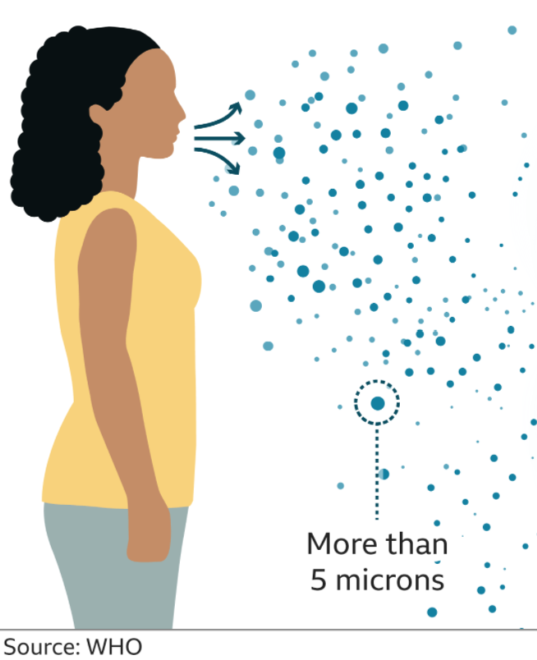
Transmission – a recap
The main way the virus spreads is through the air. Infection occurs when a person breathes in viral particles or when particles in the air come into contact with the eyes, nose or mouth.
This may also happen indirectly, if a person touches virus particles in droplets on surfaces (like a desk) and then touches their eyes, nose, or mouth.
People’s risk of infection is affected by things like:
how much virus is transmitted;
how physically close they are to an infected person; and
how frequently that happens.
The time between exposure to the virus and symptom onset, is on average 5-6 days, but up to 14 days. During this period infected people can be contagious.
Virus dispersed in tiny airborne particles

Slide 5
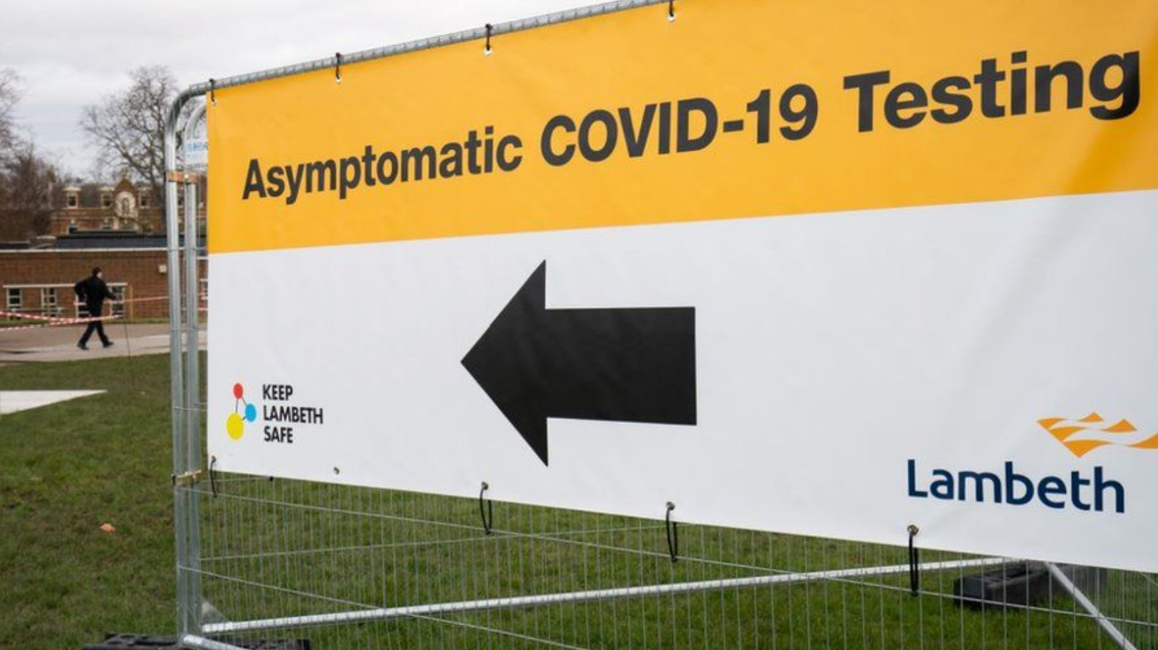
Enduring transmission
Throughout the pandemic some areas of the country have tended to have higher rates of community infection than others. There are many causes for this, including the living conditions of households and the types of employment available locally.
People in key worker roles cannot work from home; people in precarious employment do not find it easy to self-isolate; and in many communities people live in more densely populated areas and in homes that contain more people.
Similarly, in some areas, vaccination rates remain relatively lower than in other places.
In these types of situations the transmission of the virus is harder to stop which leads to enduring transmission of COVID-19.

Slide 6
Disparities of risks and outcomes
Variants of concern and enduring transmission have disproportionate effects in places with particular features, related to deprivation. The most deprived places tend to have the highest rates of infection and rates of death.
Some other features of living, such as multiple generations sharing a house, or forms of communal practice, also correlate with increased risk of exposure, transmission, and infection.
And communities which travel to and from other parts of the world may also have a particular risk of being exposed to variants of concern that have arisen in those parts of the world.
Notes:
It is important for policy to help mitigate some of the burdens of COVID-19 that fall disproportionately on some individuals and communities.
But, these are not just issues about fairness, they are also issues about safety that affect us all: if infected people are not identified and supported to self-isolate, new variants may emerge which are a real threat to all of us, whether or not we are vaccinated.

Slide 7
Disparities of risks and outcomes
The safety of all of us depends on cases being identified and people self-isolating. Some of these measures to combat the virus happen everywhere or for everyone, but with low compliance.
As the national roadmap is implemented, there is also desire to provide more targeted interventions based on risk.
This means that interventions, like surge testing, are more likely to happen in the most deprived areas, in urban environments, and in areas with higher concentrations of particular ethnic communities.
Even where the rules apply universally (such as keeping a record for eight years of people who have been infected), it is likely that particular occupations, groups, and communities will be disproportionately represented in that data.
The reality of targeted action could give rise to unequal social and economic burdens and a sense of stigmatisation; but it also represents a risk-based way of allowing places to emerge safely from national lockdowns. Actions are needed, but the burden of the response is not felt evenly across all people and places.

