Slide 1
Maite de La Gueronniere
DDaT Capability Assessments and Pay Approach
Capability Wednesdays Webinar #1

Slide 2
Nice to meet you
I am Maite, the Programme Manager for
Digital, Data and Technology Capability Implementation in Cabinet Office.
I have been leading on the DDaT capability skills assessments and Pay Approach since September.

Slide 4
Attract, develop and retain
DDaT Professionals
Map DDaT roles to the Capability Framework
Recruit DDaT roles using the Capability Framework
c.15,000 DDaT Professionals x-government
6 roles in critical demand x-government
Know your population and establish a workforce baseline
Set recruitment standards, ensure compensation for new starters is following the Pay Approach.
Assess DDaT skills
Reward with the DDaT Pay Approach
Ensure decisions and interventions are capability-based
Enable capability-based pay in line with government demand trends. Stay competitive with the market.

Slide 5
Scope
Implement DDaT skills assessment to inform capability-based Pay and roll out the Pay Approach
GDS
424 DDaT Professionals
In scope
CODATT 51
CSHR 33
GSS 22
No.10 18
CO
124
Notes:
The DDaT assessment scope is different from the Pay modeling scope since we set a 60% completion target to enable a Business Unit to be modelled.

Slide 6
The DDAT skills assessment

Slide 7
The positioning
A measure of specialist proficiency at a point in time in your current role
Available via an online tool
Linked to the performance management reviews
Based on the DDaT Capability Framework roles - https://www.gov.uk/government/collections/digital-data-and-technology-profession-capability-framework

Slide 8
Pilot timeline

Slide 9
Tracking completion
60%
CODATT
90%
GDS
65%
GSS
59%
CSHR
ADD
27%
No.10
N/A

Slide 10
The tool
Notes:
Benefits of the assessment include the ability to:
identify career paths
target Learning & Development interventions
get specialist expertise being recognised and rewarded fairly
acknowledge progress against a set of skills

Slide 11
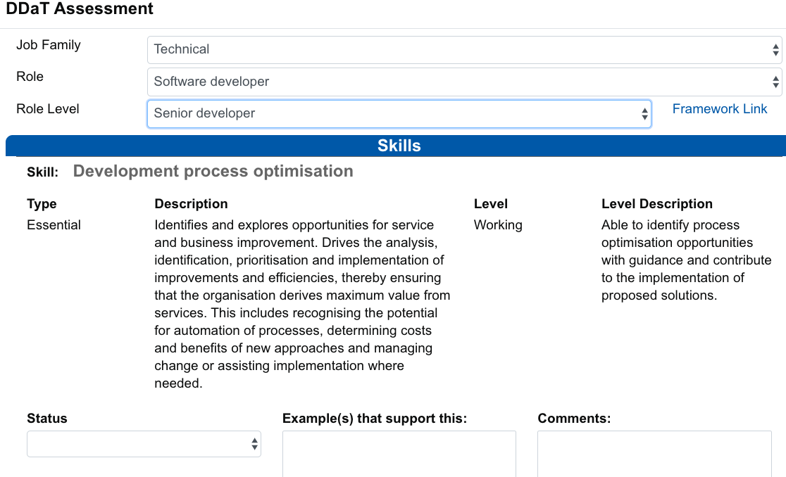
What is being scored?
Notes:
For each job role level (in this example Senior developer) in the Digital, Data and Technology Profession Capability Framework, you will find a list of skills, each of which has a skill level assigned to it.
These 4 skill levels tell you about the level of expertise required for the job role at that level:
Awareness. You know about the skill and have an appreciation of how it is applied in the environment.
Working. You can apply your knowledge and experience of the skill, including tools and techniques. You can adopt those most appropriate for the environment.
Practitioner. You know how to share your knowledge and experience of this skill with others, including tools and techniques. You can define those most appropriate for the environment.
Expert. You have both knowledge and experience in the application of this skill. You are a recognised specialist and adviser in this skill including user needs, generation of ideas, methods and tools. You can lead or guide others in best-practice use.

Slide 12
No incremented scores
 | “Status” recorded
Expected skill level ▼ | Working toward this level | Working at this level | Working above this level
Expert | 1 | 2 | 3
Practitioner
Working
Awareness
And define brackets for Pay levels:
Advanced
Proficient
Developing
Notes:
We have done multiple experiments of scoring systems and came up with a matrix that essentially scores stretch in a skill level. We initially thought we would used incremented scores but simplified our model to be able to translate it into Pay levels more easily.

Slide 13
Pay levels brackets
1
Developing
1.5
Proficient A
2
Proficient B
2.5
Advanced A
3.5
Advanced B
Notes:
More consistency between grades. Increments that allows a real progression rather that big salary jumps.

Slide 14
Q&A session

Slide 15
The DDaT Pay Approach

Slide 16
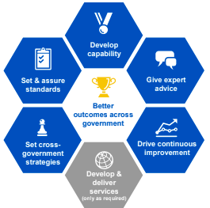
Objectives
Address retention issues by offering a competitive remuneration package which recognises specialist skills
Attract a wide talent pool
To provide a transparent and consistent approach to pay for DDaT professionals
To provide tools for developing the capability of DDaT professionals within Cabinet Office
Introducing the central DDaT professional Pay Approach in Cabinet Office strengthens GDS functional leadership

Slide 17
Pay Options - a genesis
Allowance
A set of constraints
Pay Approach maximas
Pay Approach mid-point allowance budget
Affordability for the organisation
Existing Pay measures (Higher Starting Salaries, Spot rates, Pay Awards)
Fair and consistent
Base
pay
?
Proficiency level
in a Group role
Notes:
Flexibility could be found in Design and Implementation planning.
Pay Approach mid-point allowance budget:
The budget is based on the mid-point allowance between capability levels. Allowances would cover up to 80% of the FTE population in the DDaT critical roles. This is based on the rationale that if operating on the basis of a normal distribution, 80% of employees would be positioned in the ‘Proficient’ and ‘Accomplished’ ranges. ​It is expected that individuals positioned in the ‘Developing’ zone of the salary range would receive allowances only in exceptional circumstances.

Slide 18
Which pay design option would you choose?

Slide 19
Pay Options - a genesis
1. Fixed salary allocated to a proficiency level, fixed allowance above either the pay band mid-point or max-point.
2. Fixed annual package: allowances above the pay band minimum with two pay increments within “Proficient” and “Accomplished” levels.
3. Flexible annual package with flexible splits between salaries and allowances (no set allowances).

Slide 20
Why specialist allowances?
Benefits:
Give progression steps per level
Fair and transparent
Flexible (Higher Starting Salaries, higher end of the Pay Approach)
Pay Award increases on base pay
No crossovers between grades
Easier to refresh and adjust to market trends
The non-pensionable element of the allowance generates a saving that funds half of the Pay Approach implementation.

Slide 21
How to apply the Pay Approach?
£3,000 Fixed Allowance
Total annual
compensation package is:
£55,500 for both Mark and Amal
The differentiator is the amount of base pay submitted to pension contributions since allowances are non-pensionable
Mark
Newcomer, arrived on 01/2020
Senior Developer (Pay Group 1)
Band A / Grade 7
Assessed: Proficient A
London based
£52,500 Base pay
£1,500 Adjusted allowance
Amal
Civil Servant
In a DDaT role since 09/2015
Senior Developer (Pay Group 1)
Band A / Grade 7
Assessed: Proficient A
Annual salary: £54,000
London based
£54,000 Base pay

Slide 22
How to apply the Pay Approach?
Jane
Civil Servant from MOD
In a DDaT role since 09/2017
Senior Developer (Pay Group 1)
Band A / Grade 7 to A*/Grade 6
Assessed: Proficient A
Annual salary: £57,000
London based
£3,200 Adjusted allowance
The 10% promotion is applied on Jane’s base salary. Her allowance is adjusted to meet the A* package
£65, 900 for Proficient A.
£5,700 (10% promotion)
£57,000 Base pay

Slide 23
Q&A session

Slide 24
About implementation

Slide 25
Phased implementation
In April 2019, we agreed to present to the People Committee a plan for the implementation of the Pay Approach.
For the plan to work, we need to factor:
Business priorities: are they specific prioritisation criteria? Where should the immediate implementation focus be?
Affordability: how will this span across financial Years? How does it inform Spending Review planning?
Pace: we said we will introduce capability-based pay in 2020/21 and review all Capability Framework by March 2021.

Slide 26
Phasing of roles
Phase 1 roles have been prioritised based on either being in Pay Group 1 of the DDaT framework, being priority roles for Cabinet Office or having a high turnover, indicating more significant recruitment and retention issues, as well as ensuring overall affordability to transition.
Role | Pay Approach Role Group | Total Headcount | Transition Phase
Data scientist | Group 1 | 11 | 1
Security architect | Group 1 | 5 | 1
Software developer | Group 1 | 110 | 1
Technical architect | Group 1 | 30 | 1
DevOps | Group 1 | 23 | 1
Infrastructure engineer | Group 1 | 4 | 1
Service designer | Group 1 | 12 | 1
Interaction designer | Group 2 | 10 | 1
User researcher | Group 2 | 36 | 1
Graphic designer | Group 3 | 3 | 1

Slide 27
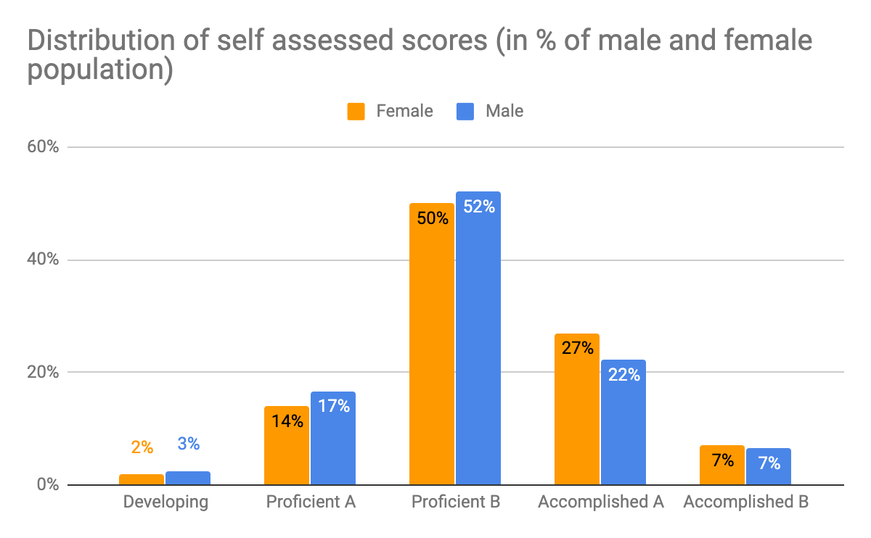
Gender analysis
GDS | Female | Male | Total
Accomplished B | 7 | 13 | 20
Accomplished A | 27 | 44 | 71
Proficient B | 50 | 103 | 153
Proficient A | 14 | 33 | 47
Developing | 2 | 5 | 7
Total | 100 | 198 | 298
Our analysis showed that adopting the Pay Approach will reduce the Gender Pay Gap while meeting equal pay commitments.
Notes:
As at December 2019, there are 177 female staff (36%) in scope for the revised DDaT pay approach, compared with 311 males (64%).
When analysing current salaries for those in scope, male staff tend to earn 5.51% more than female staff. By adopting the revised approach, this gap reduces by 0.77% to 4.74%, showing a positive impact on the overall pay gap for the group.
It is anticipated that bringing new starters onto this approach immediately will further reduce this gap, as all new starters will be recruited onto the same pay rate, depending on their role and capability level.
Additionally, female staff in scope were more likely to be assessed as accomplished (20% of female staff compared with 19% of male staff). This capability level attracts a higher pay package than proficient and developing levels.

Slide 28
Our engagement
Policies
Cabinet Office DDaT Pay Policy
Cabinet Office DDaT Skills assessment Policy
Engagement sessions
Senior Leadership, Staff, Trade Unions, Line Management, DDaT Communities, HR professionals, Finance, communications, wider government
“How do I?” guidance
To recruit, transition and promote using the DDaT skills assessment and Pay Approach

Slide 29
Q&A session

Slide 30
Appendix:
Capability dashboard prototype

Slide 31
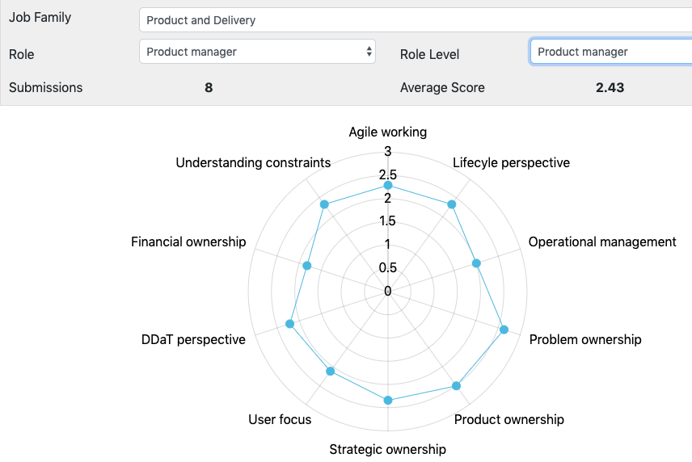
Capability dashboard [prototype]
We are working with GDS
Communities of Practice on a Capability dashboard that could inform L&D interventions

Slide 32
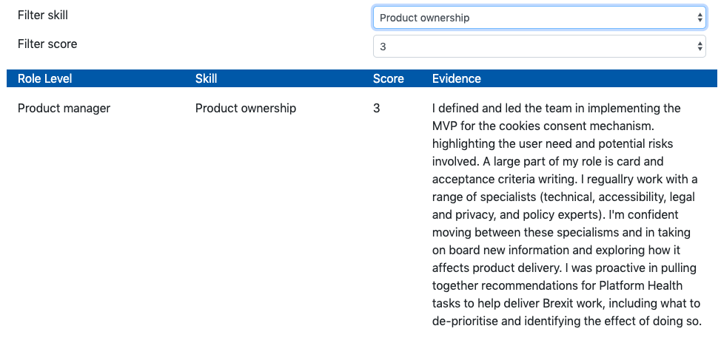
Capability dashboard [prototype]
The qualitative data gathered during the assessment pilot will inform proficiency exemplars

Slide 33
Appendix: Programme Tmap

Slide 34
Transformation map
FY 19/20
FY 20/21
FY 21/22
Attract, develop and retain DDaT capability
Community and central L&D
People survey analysis
Community L&D
Link Talent
Individual reports
Diversity actions for Pay
SLT
Dashboards
Link GPG action plans
CoP Capability
Dashboards
Informs Business plans
L&D Dashboards
Capability
Interventions
Link Recruitment
Appeals
Link L&D budgets
Pre-assessment questionnaire
Diversity actions from assessment
Assessment boards
Link Performance reviews
HR processes
Historical data in report
Reports to CS HR
Ethnicity analysis
Individual/LM
Reports
Assessment pilot
and Pay Approach option
Moderation process
Governance
Submission Workflow
Gender analysis
Tool developments
Diversity

Slide 35
Appendix: process timeline

Slide 36
Mar:
New GDS ATS
20/21
performance
year
Sept:
MYR
Mar:
EOY
21/22
performance
year
Sept:
MYR
Mar:
EOY
Sept - Nov
20/21 annual skills assessment
Mar - Apr
20/21 catch-up
skills assessment
Sept - Nov
21/22 annual skills assessment
Nov - Feb
20/21
Capability interventions
Nov - Feb
20/21
Capability interventions
Oct:
DDaT Pay Board 20/21
Apr:
Annual DDaT Pay Board 20/21
Oct:
DDaT Pay Board 21/22
Apr onwards
New starters
onto Pay Approach
Oct - Mar
Pay implementation (wave 1)
Apr- Sept
Pay Implementation
(wave 2)
Oct-Dec
Pay
uplifts
Q1
Q2
Q3
Q4
Q1
Q2
Q3
Q4
FY 20/21
FY 21/22
Notes:
Annual Skills assessment:
for all DDaT staff to complete
Informs HoC and HR capability interventions and Pay decisions
Catch-up Skills assessment:
For newcomers and people who changed role or role level within the past 6 months
Informs Pay decisions
Annual Pay board:
To review annual skills assessment
Informs pay decisions
Oct Pay board:
To review catch-up skills assessment
Informs pay decisions
Informs following year financial planning
Q1 - Ap, May, Jun
Q2 - Jul, Aug, Sept
Q3 - Oct, Nov, Dec
Q4 - Jan, Feb, Mar

Slide 37
Thank you!

Slide 38
Using one word only, what themes do you want to hear about?
Join at slido.com #DDaTWW
Notes:
📣 This is Slido interaction slide, please don't delete it. ✅ Click on 'Present with Slido' and the poll will launch automatically when you get to this slide.

